Slide 1

The 7Cs of Learning Design
National Teaching
Fellow 2012
Gráinne Conole
University of Leicester
22nd November 2012
Talk, Massey University
Palmerston North

Slide 2
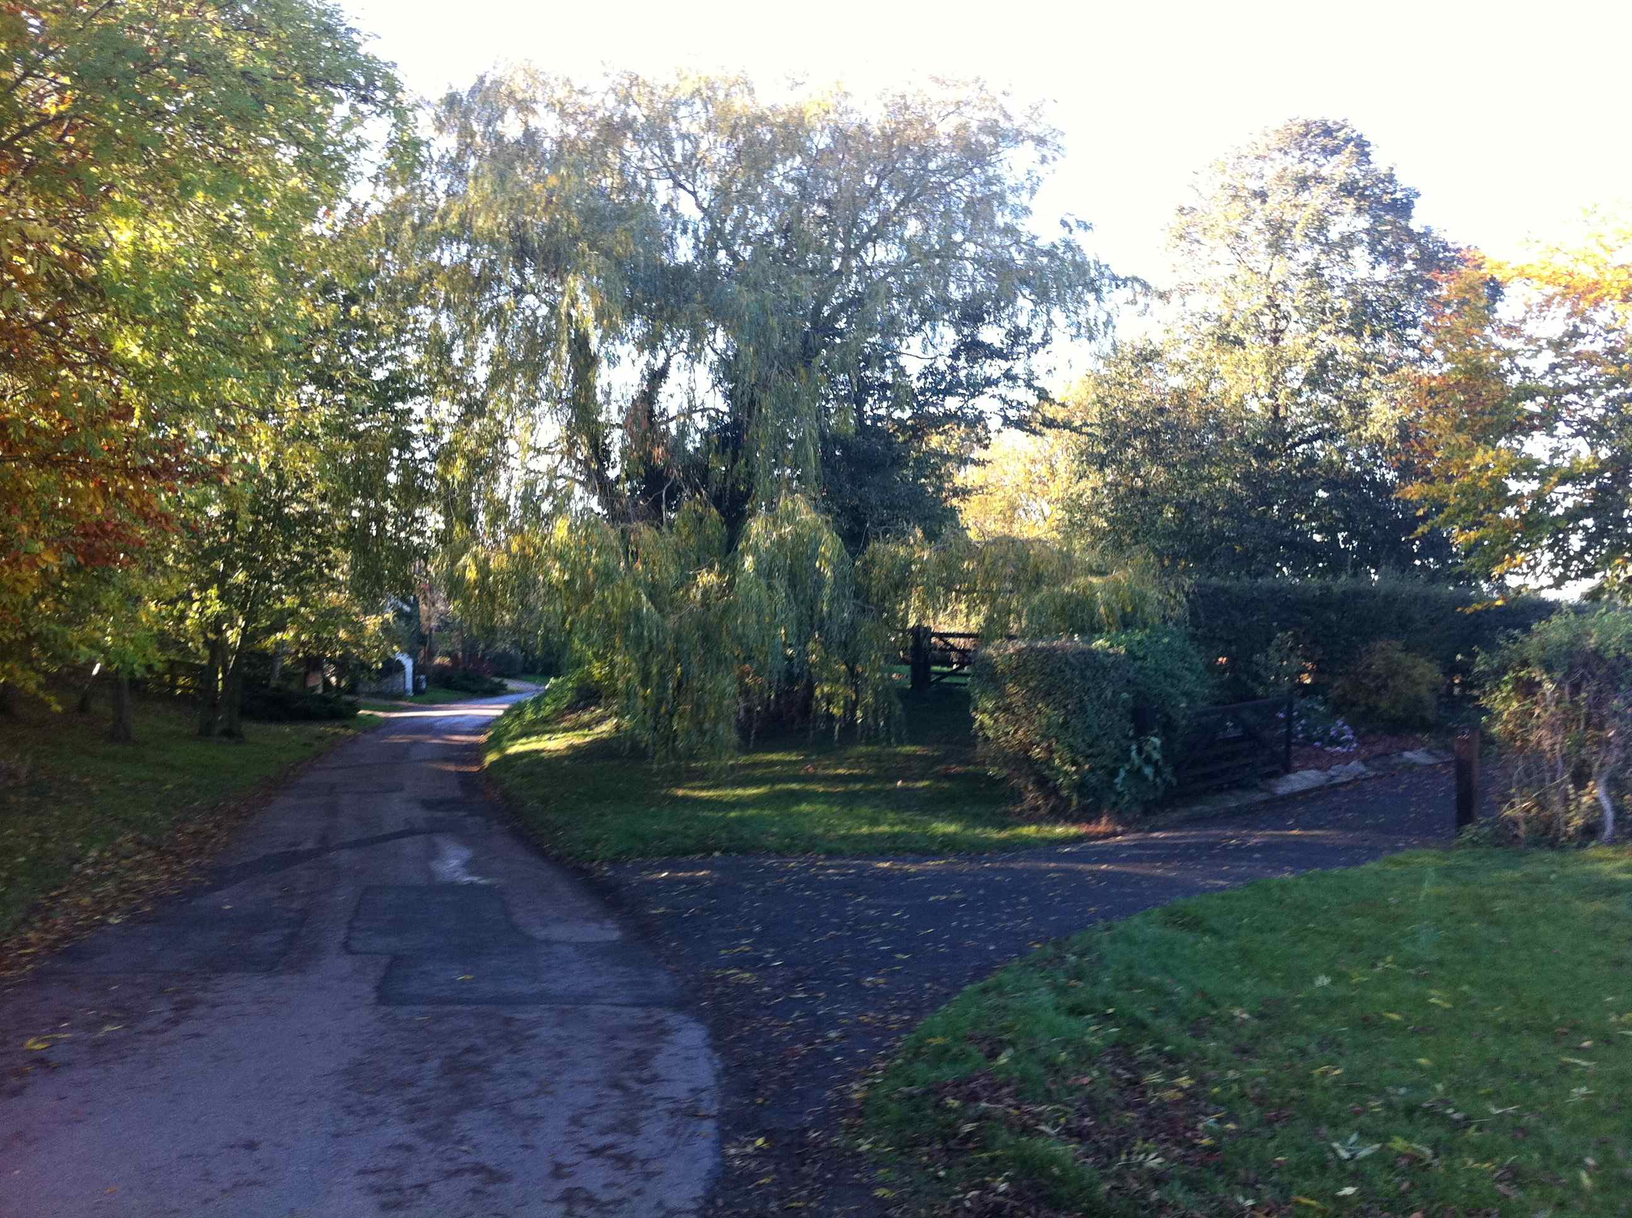
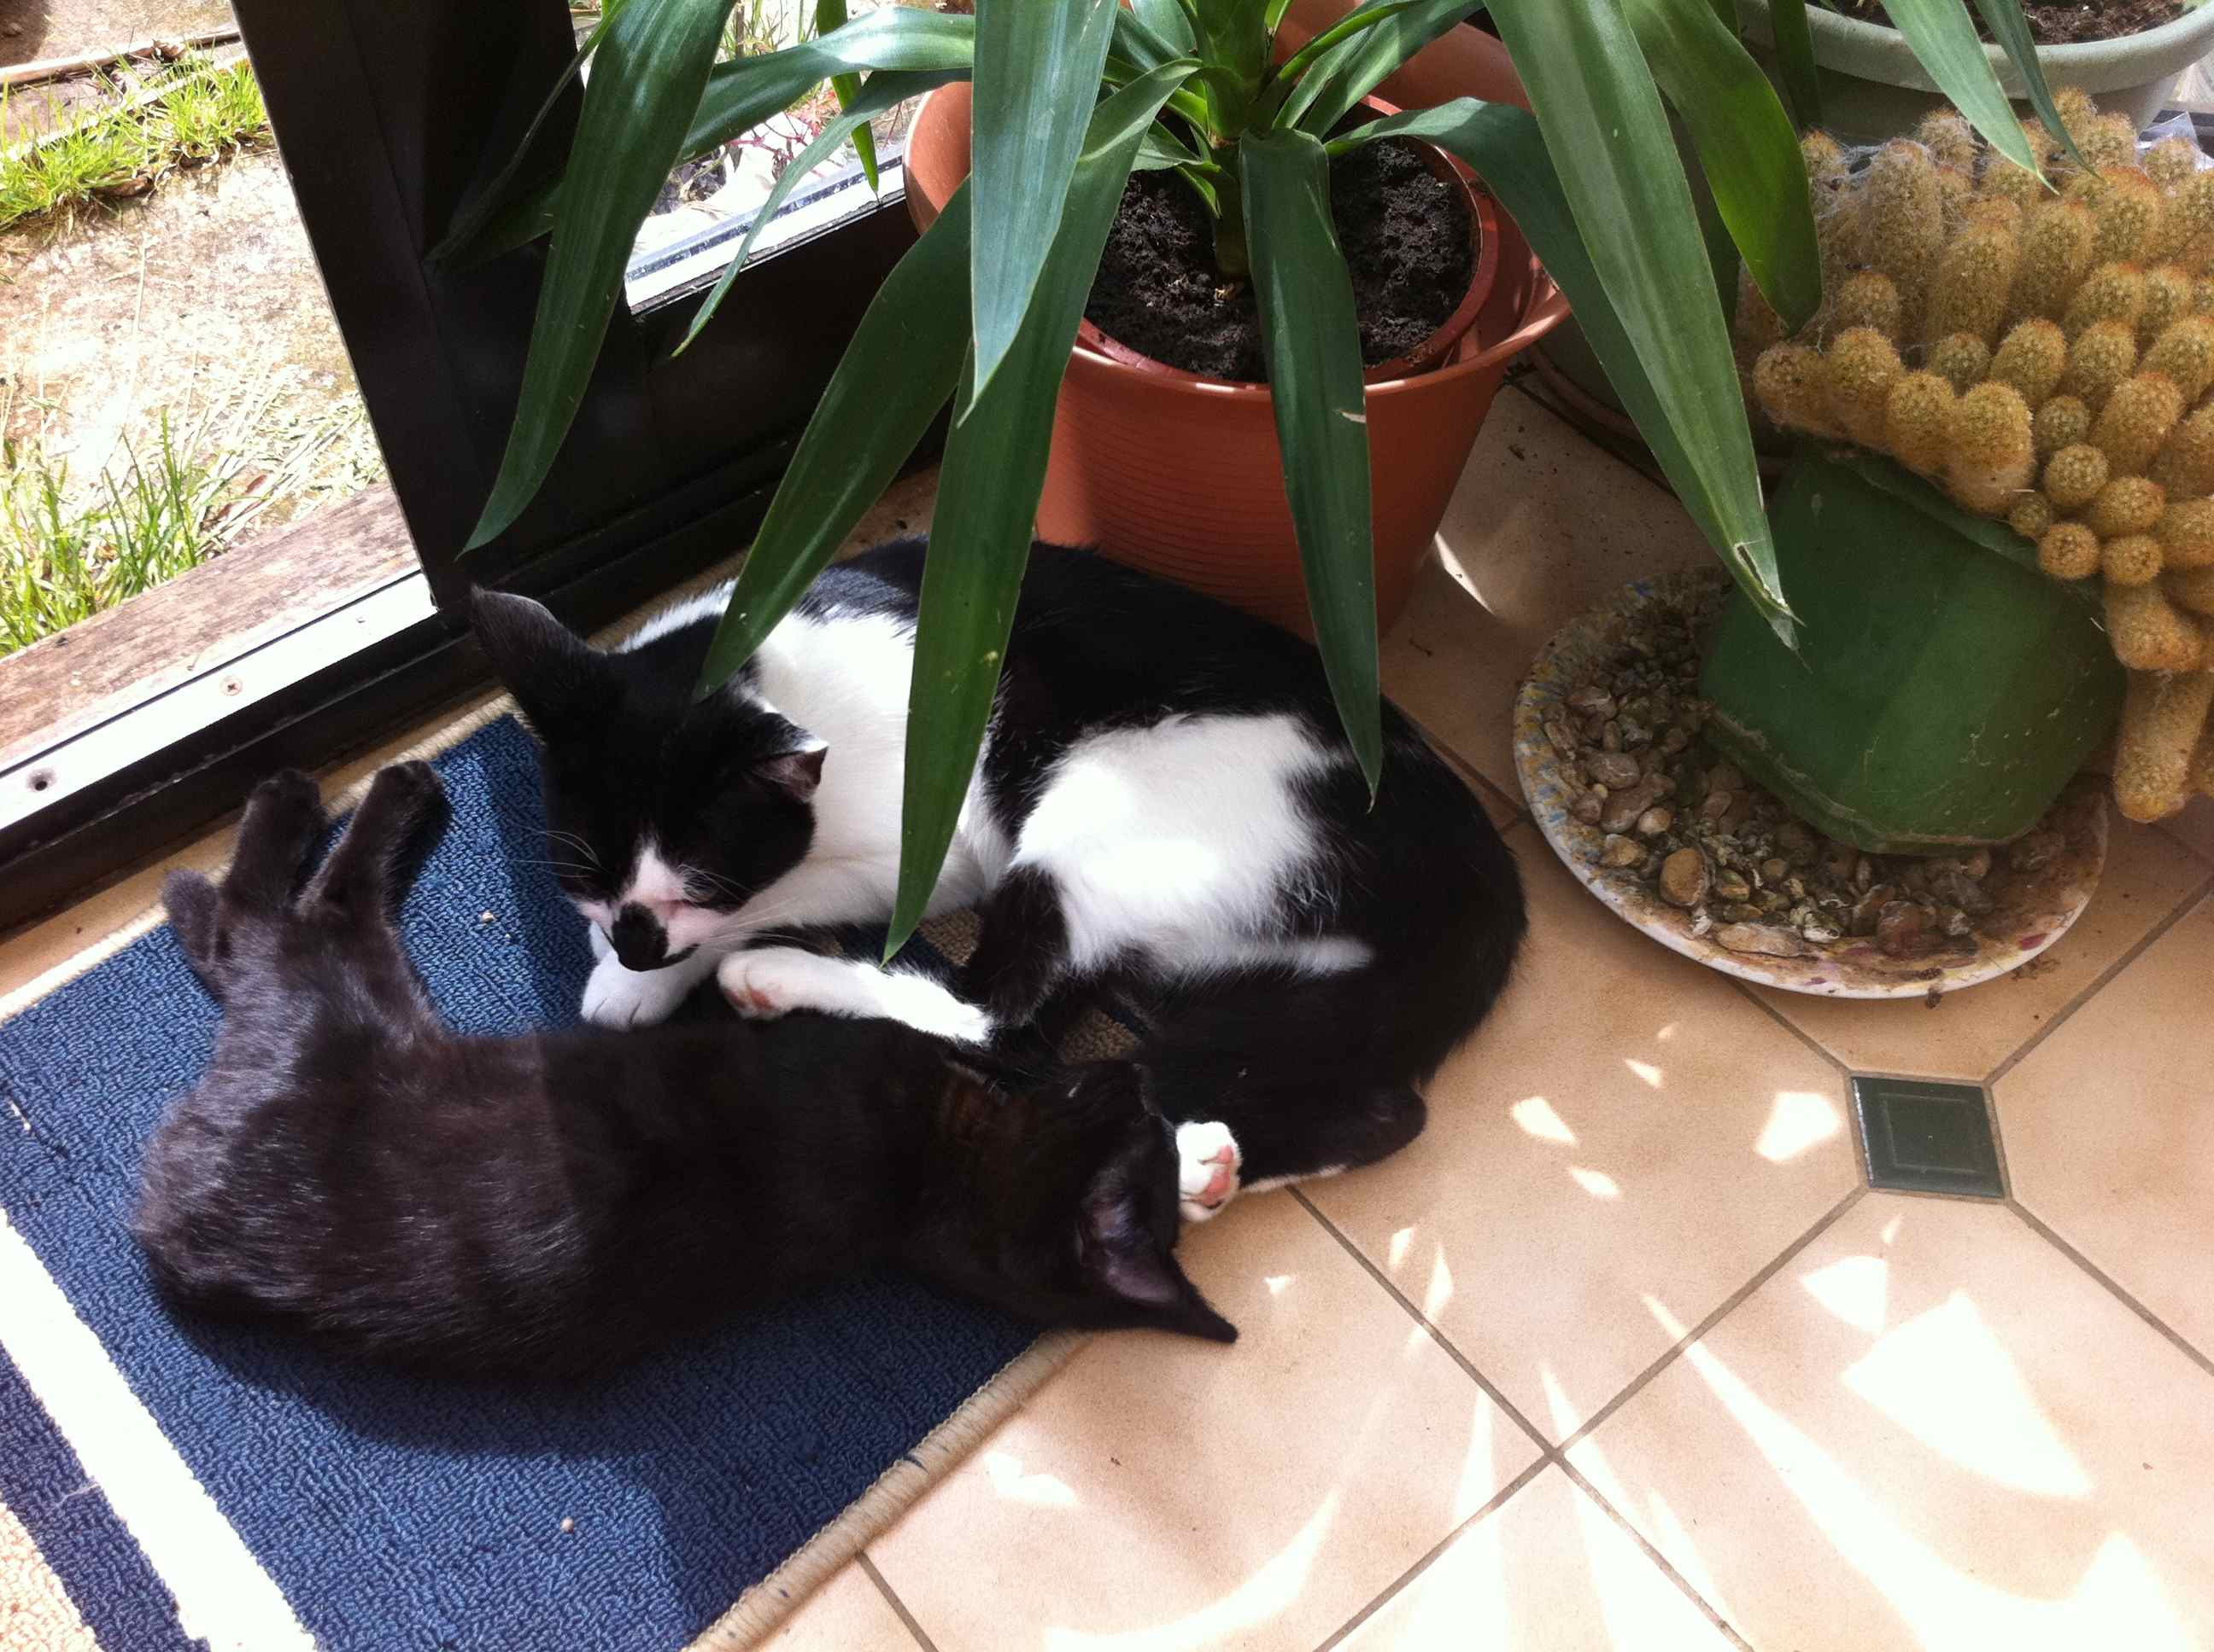
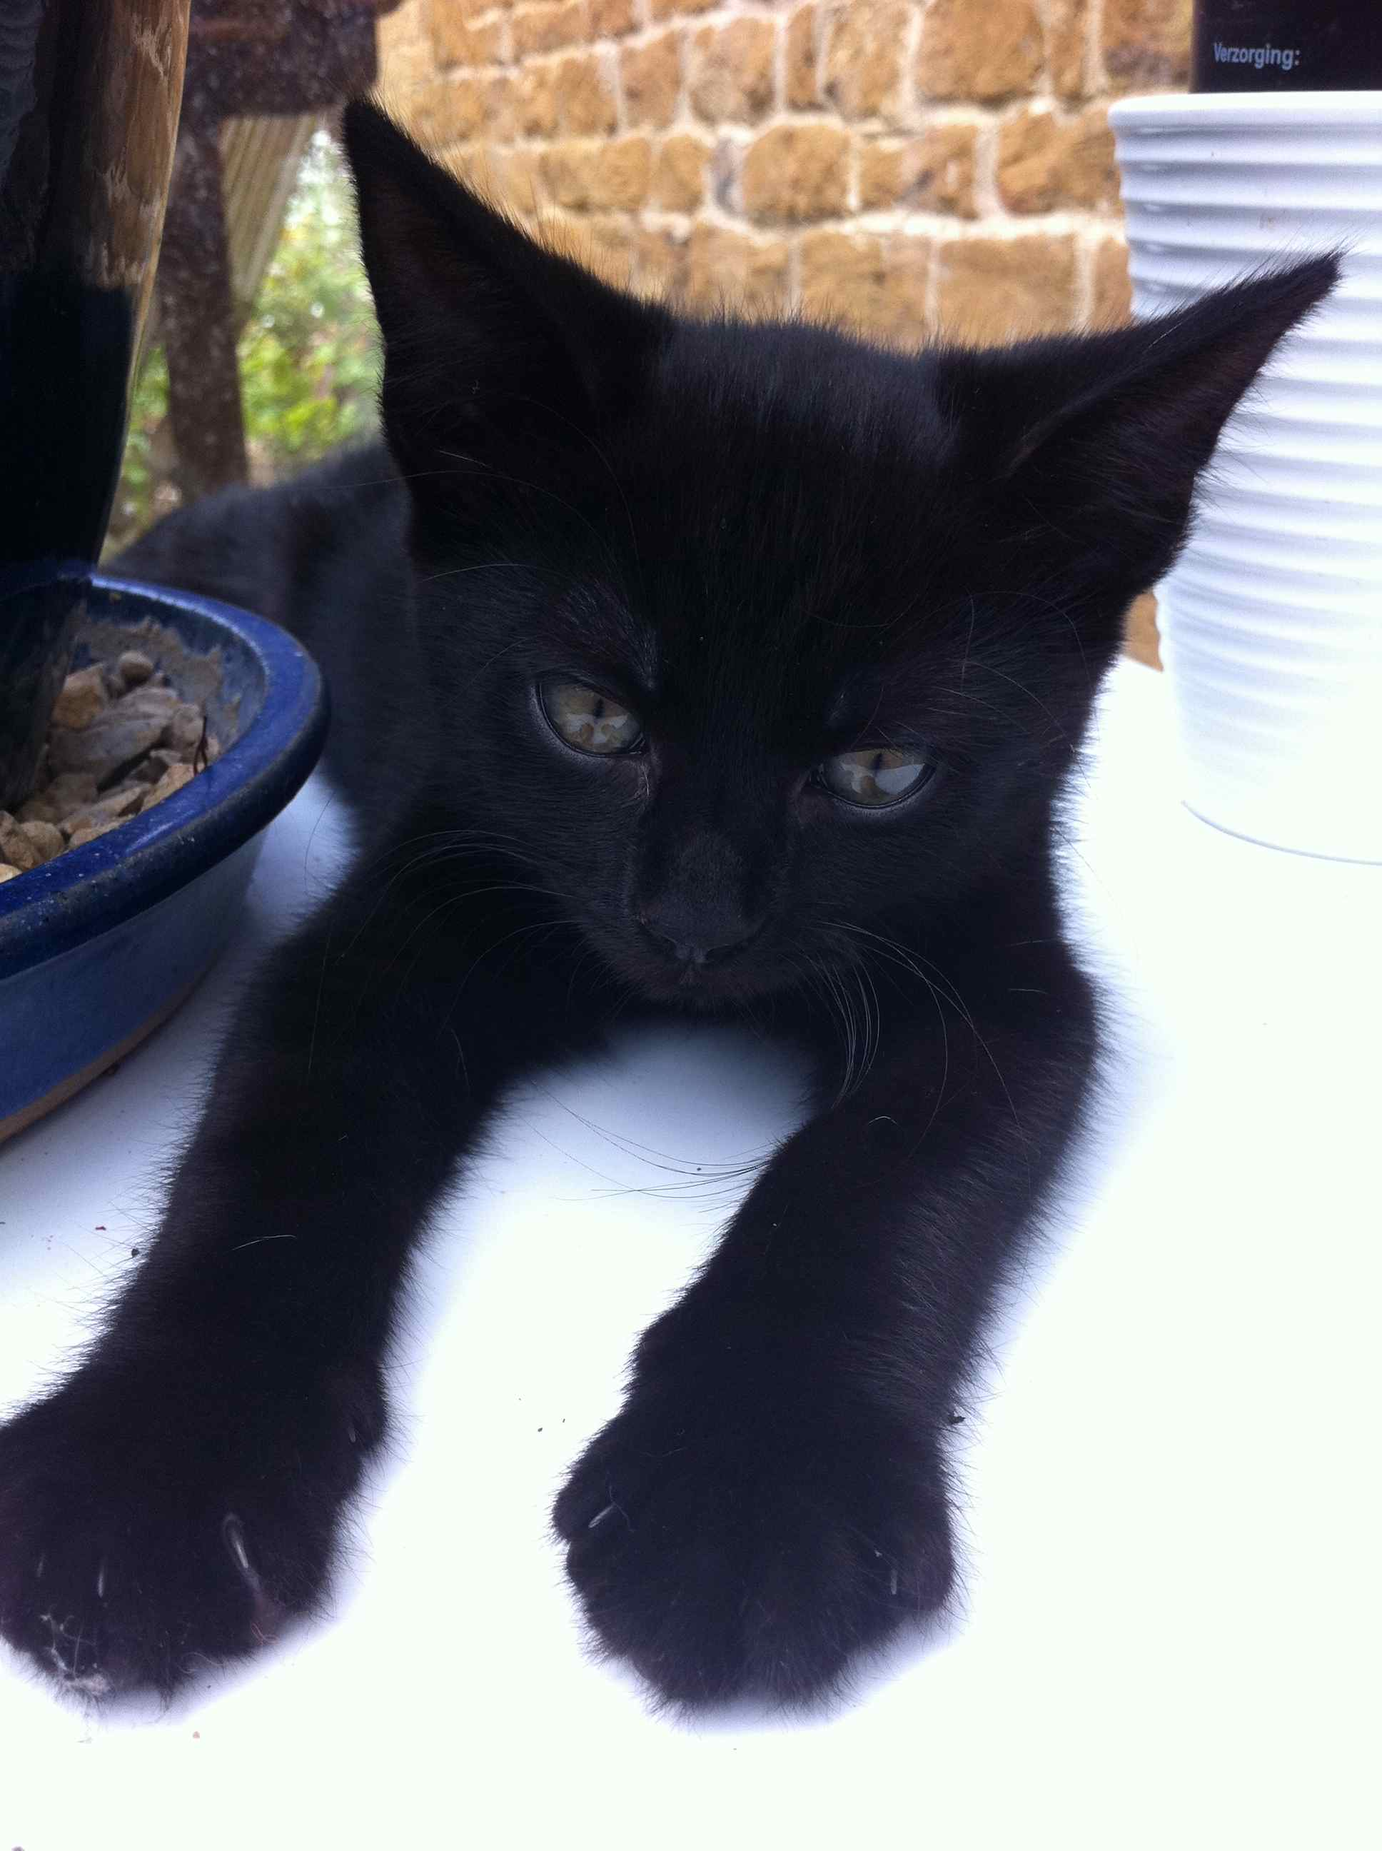
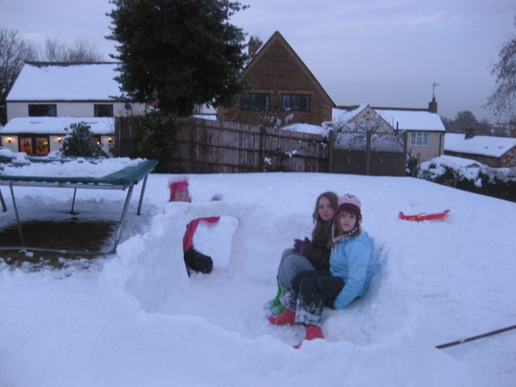
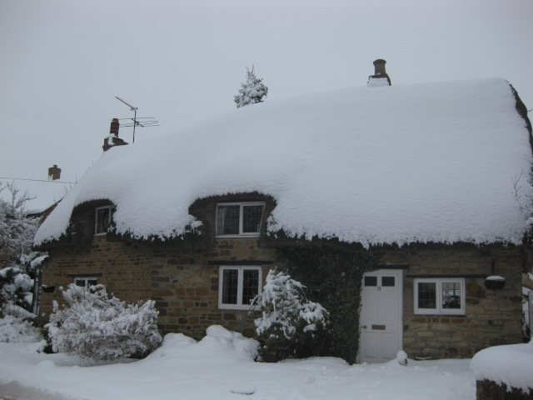

Slide 3

Outline
Technology trends
Pedagogical approaches
Learning design
Disaggregation of education
Changing practices and implications

Slide 4

E-Learning timeline
Learning Management Systems
Social and participatory media
Massive Open Online Courses
Open Educational Resources
E-books and smart devices
The Internet and the Web
Multimedia resources
Gaming technologies
Learning objects
Learning Design
Mobile devices
Virtual worlds
80s
93
94
95
98
99
00
01
04
05
07
08
http://scienceoftheinvisible.blogspot.co.uk/2012/08/a-ramble-through-history-of-online.html
http://halfanhour.blogspot.be/2012/02/e-learning-generations.html
Notes:
§

Slide 5
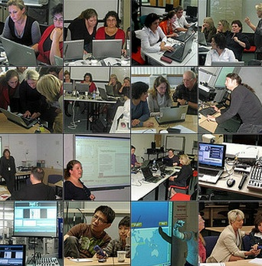
Technological trends
Mobiles and e-books
Personalised learning
Cloud computing
Ubiquitous learning
BYOD (Bring your own device)
Technology-Enhanced learning spaces
Learning analytics

Slide 6


The MATEL study
http://www.menon.org/matel/
Productivity and creativity
Networked collaboration
Content creation
Visualisation and simulation
Learning Management Systems
Learning environments
Games
Devices, interfaces and connectivity

Slide 7

Themes
Complex, disruptive, evolving
More open practices
Distributed, networked

Slide 8

Pedagogical approaches
Drill & practice
learning
Mobile
learning
Situated
learning
Immersive
learning

Slide 9
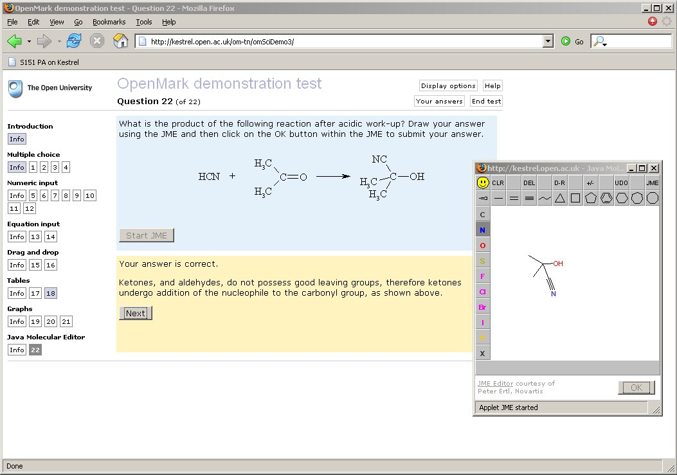
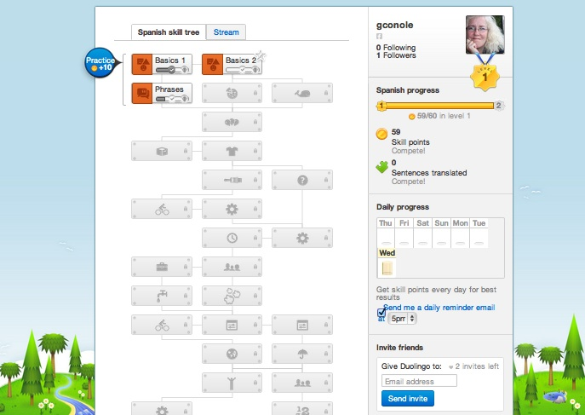
Drill and practice learning

Slide 10
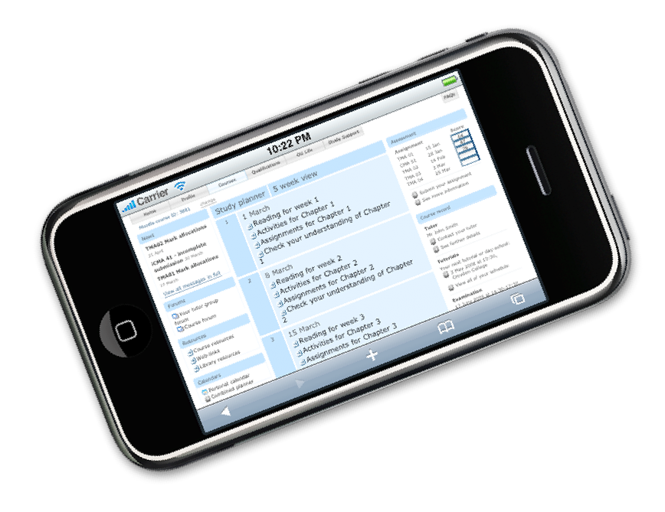

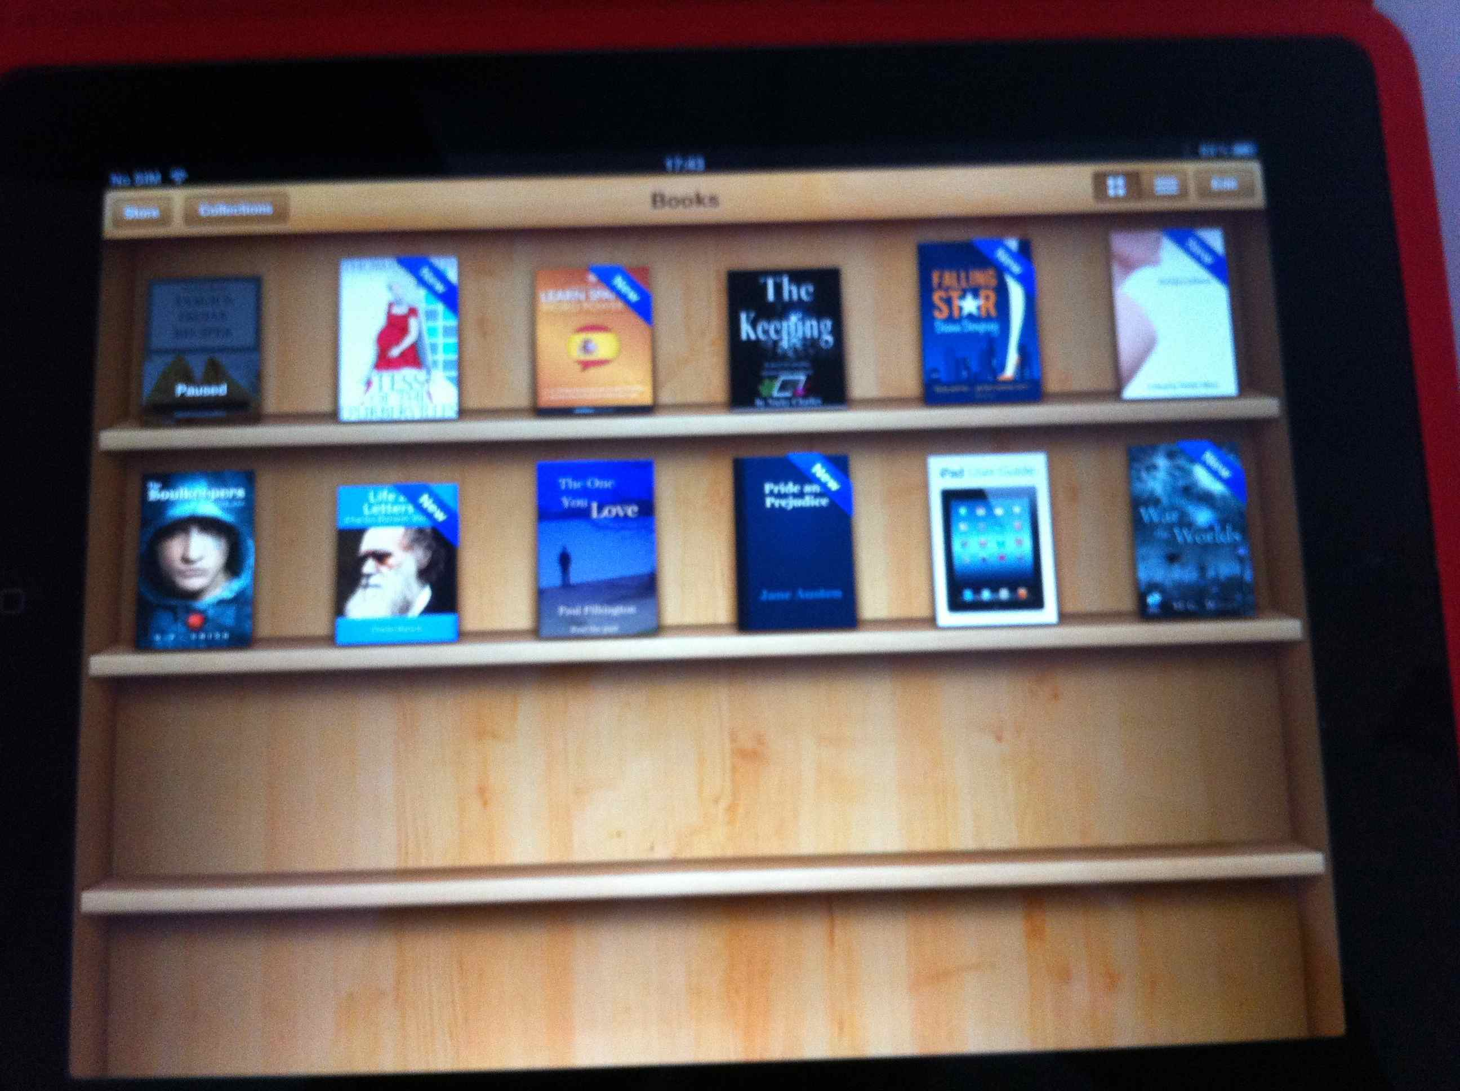
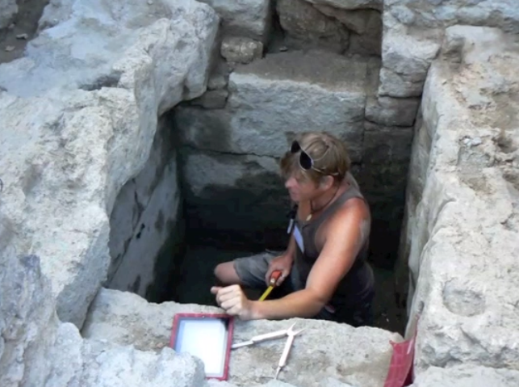
Mobile learning
Study calendars
E-books
Learning resources
Online modules
Annotation tools
Mind mapping tools
Communication mechanisms

Slide 11
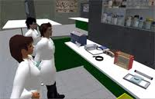
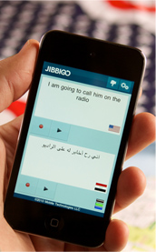
Situated learning
Archeological digs
Medical wards
Art exhibitions
Cyber-law
Virtual language exchange
Beyond formal schooling
http://www.jibbigo.com/

Slide 12
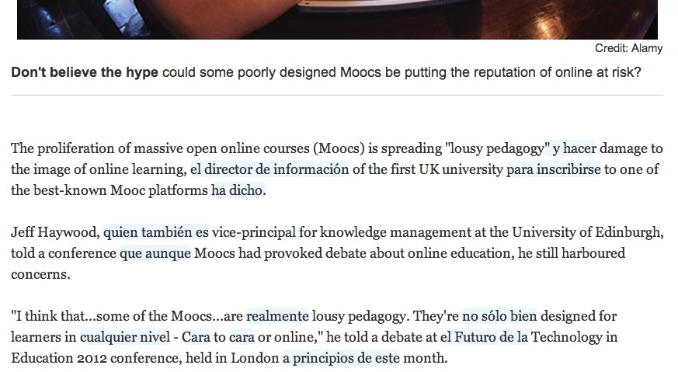
Immersive learning

Slide 13

Augmented Reality Games (ARGs)
Began with a code 91211
Twitter hash tag
Mysterious character Rufus
Series of clues – real and virtual
Video screen in Manchester spontaneously playing students’ videos
Helen Keegan
http://www.youtube.com/watch?v=qESNQMDupfY
Keynote, Eden Research Workshop, Leuven, 24th October 2012

Slide 14

Promise and reality
Social and participatory media offer new ways to communicate and collaborate
Not fully exploited
Wealth of free resources and tools
Replicating bad pedagogy
Lack of time and skills

Slide 15
Learning Design
Shift from belief-based, implicit approaches to design-based, explicit approaches
Learning Design
A design-based approach to creation and support of courses
Encourages reflective, scholarly practices
Promotes sharing and discussion

Slide 16
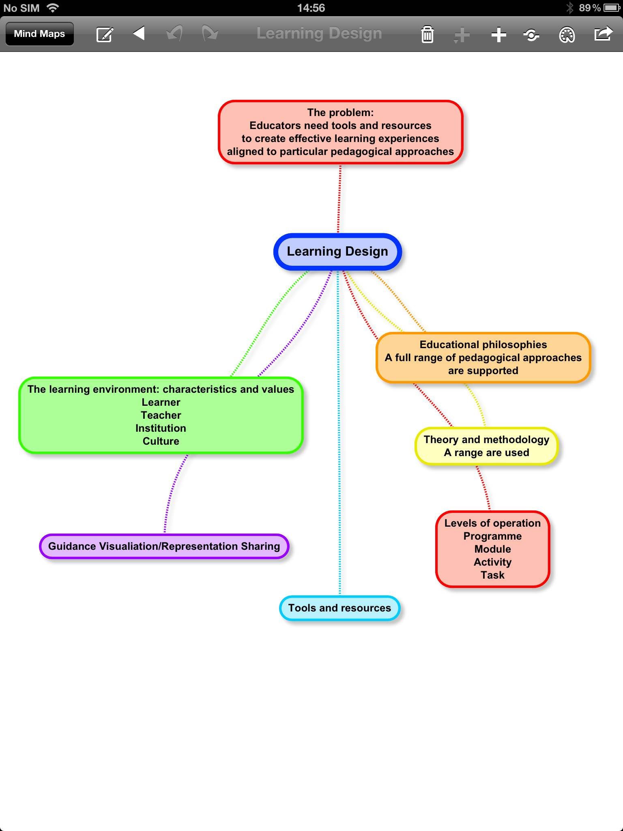
The Larnaca Declaration,
Sept 2012

Slide 17
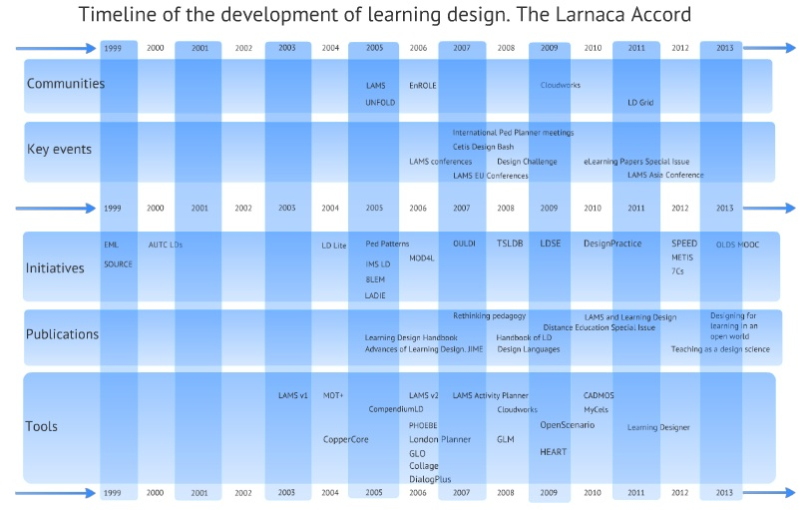

Slide 18
Conceptualise
What do we want to design, who for and why?
Capture
Resource audit
Create Storyboard, activities, content, artefacts, pathways
Communicate
Synchronously and asynchronously
Collaborate
Improve the design with others
Consider
Reflect, pilot, enhance
The 7Cs Framework
Consolidate
Evaluate and embed your design

Slide 19
Socio-cultural perspectives
Design Mediating Artefacts
Concepts
Tools
Dialogues
Activities
Mediating
Artefacts (MA)
Creates
Learning activity
or Resource
Teacher
Has an
inherent
Design
Research questions
What Mediating Artefacts do teachers use?
What Mediating Artefacts can we create to guide the design process?
Other teachers and learners
can use or repurpose
Vygotsky, Activity Theory

Slide 20
Analysis: Activity Theory
Mediating
Artefacts (MA)
Creates
Learning activity
or Resource
Teacher
Division of
labour
Rules
Community
Design and learning occur within a context

Slide 21
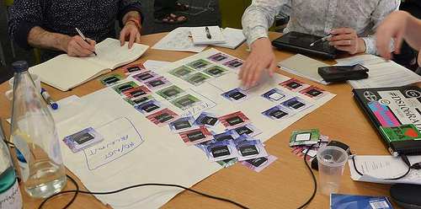
Course features
Pedagogical approaches
Principles
Guidance and support
Content and activities
Reflection and demonstration
Communication and collaboration

Slide 22

Theory based
Practice based
Cultural
Principles
Aesthetics
Professional
Political
Sustainable
International
Serendipitous
Community based

Slide 23
Inquiry based
Problem based
Case based
Pedagogical
approaches
Dialogic
Collaborative
Situative
Constructivist
Vicarious
Didactic
Authentic

Slide 24
Learning pathway
Mentoring
Peer support
Guidance &
Support
Scaffolded
Step by step
Study skills
Library support
Tutor directed
Help desk
Remedial support

Slide 25
Brainstorming
Concept mapping
Annotation
Content &
Activities
Assimilative
Modeling
Jigsaw
Pyramid
Aggregating
resources
Learner generated
content
Information
handling

Slide 26
Diagnostic
E-Assessment
E-Portfolio
Reflection &
Demonstration
Formative
Feed forward
Summative
Reflective
Peer feedback
Vicarious
Presentation

Slide 27
Structured debate
Flash debate
Group project
Communication &
Collaboration
Group aggregation
Peer critique
Group
presentation
Group project
Flash debate
For/Against debate
Q & Q

Slide 28

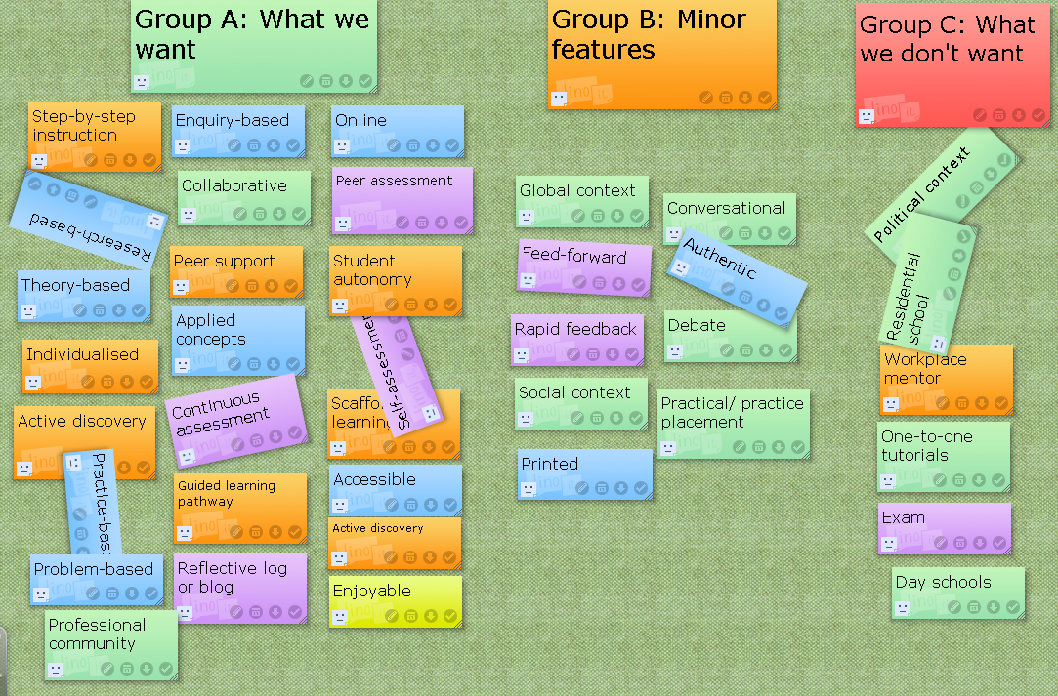
Activity: Course Features
Purpose: To consider the features you want to include in your module/course, which will determine not only the look and feel of the course, but also the nature of the learners’ experience.
Linoit canvas
E-tivity Rubric: http://tinyurl.com/SPEED-e4

Slide 29
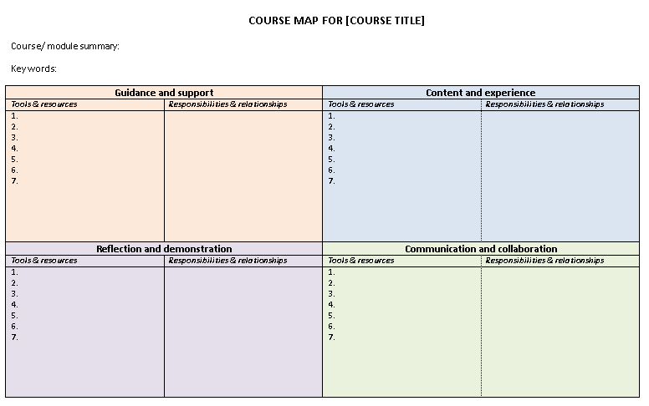
Activity: Course Map
Purpose: To start mapping out your module/course, including your plans for guidance and support, content and the learner experience, reflection and demonstration, and communication and collaboration.
E-tivity Rubric: http://tinyurl.com/SPEED-e5

Slide 31
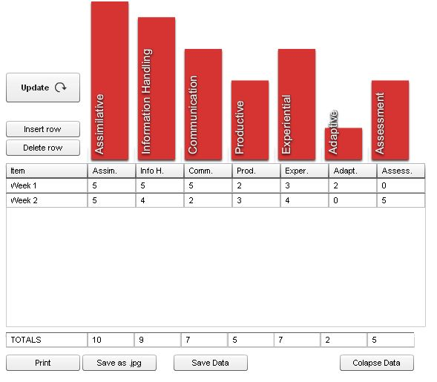
Activity profile
Types of learner activities
  Assimilative
  Information Handling
  Communication
  Production
  Experiential
  Adaptive
  Assessment

Slide 32
Activity: Activity Profile
Purpose: To consider the balance of activity types that will be included in your module/course.
Activity Profile Flash Widget
E-tivity Rubric: http://tinyurl.com/SPEED-e6

Slide 33


Co-evolution of tools and practice
Characteristics of tools
Characteristics of people
Reflection
Preferences
Dialogue
Interests
Evolving
practices
Aggregation
Skills
Interactivity
Context

Slide 34
Tools
Tasks
Forum, wiki, blog, etc.
Read, search, critique, etc.
Affordances
Reflection
Collaboration
Dialogue
Interaction
Inquiry
Learning Activity

Slide 35


Technology affordances
Affordances,
promotes…
Constraints,
think about…
Collaboration
A blog for reflective practice
Time consuming
(development)
Reflection
Difficult to use
Interaction
Affordances (Gibson)
All "action possibilities" latent in an environment…
but always in relation to the actor and therefore dependent on their capabilities.
For instance, a tall tree offers the affordances of food for a Giraffe but not a sheep.
Costly to produce
Dialogue
Time consuming (support)
Creativity
Assessment issues
Organisation
Lack of interactivity
Inquiry
Difficult to navigate
Authenticity
New literacy skills

Slide 36
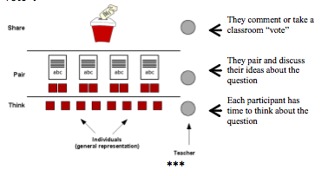
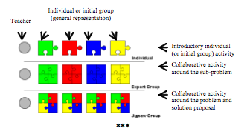
Pedagogical Patterns
Derived from Alexander’s work
“Solutions to problems”
  Introduction
  Context
  Problem headline
  Solution
  Picture
  Similar patters

Slide 37
Activity: Pedagogical Patterns
Look at the Pedagogical Patterns handouts
Choose one or more pattern and use it to create a collaborative learning activity
You can combine or adapt patterns if you want

Slide 38
Activity: Resource Audit
Using the JIGSAW pattern approach to look at the following repositories
  Http://learningdesigns.uow.edu.au
  Http://enrole.uow.edu.au
  Http://cloudworks.ac,uk
  Http://www.globe-info.org/
Complete the Carpe Diem Resource Audit sheet, indicating which OER you will include and what resources you need to create

Slide 39






Learning Outcomes
Start
End
Assessment

Slide 40
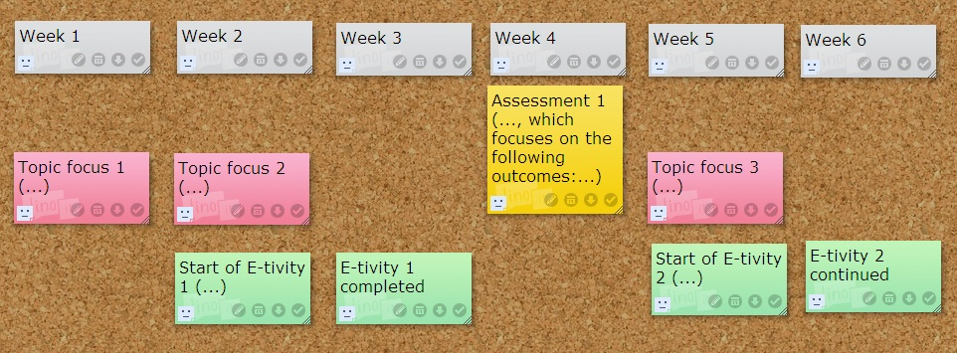
Activity: Storyboard
Purpose: To develop a storyboard for your module/course in which the learning outcomes are aligned with the assessment events, topics (contents) and e-tivities.
Linoit Canvas
E-tivity Rubric: http://tinyurl.com/SPEED-e8

Slide 41
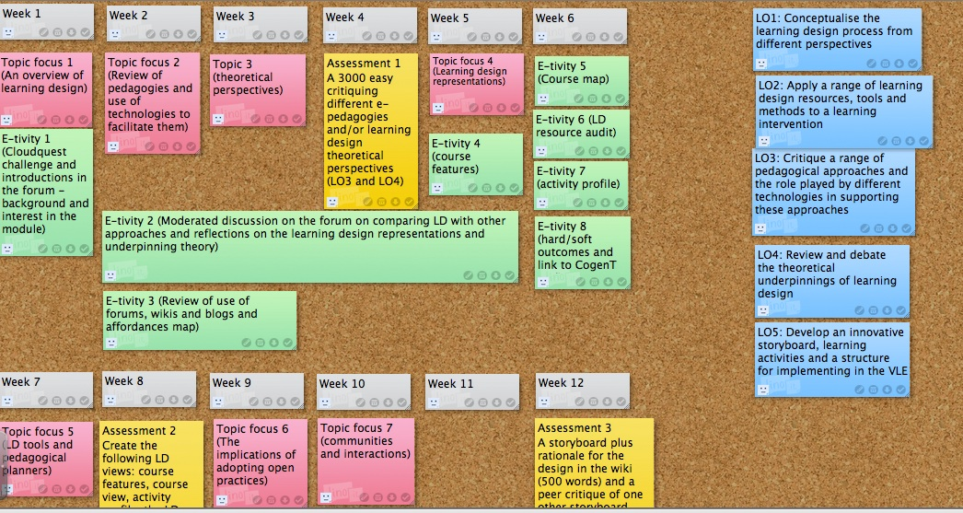
Storyboard
http://linoit.com

Slide 42
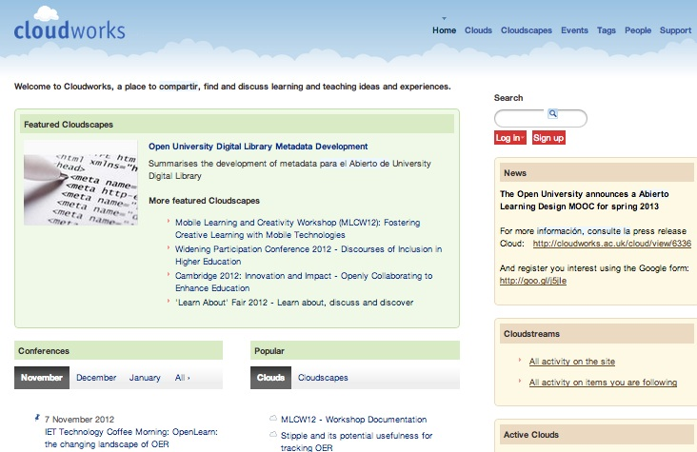

Slide 43

Disaggregation of education
Resources
Learning
pathways
Support
Accreditation
http://www.flickr.com/photos/emclibrary/2459359483/

Slide 44


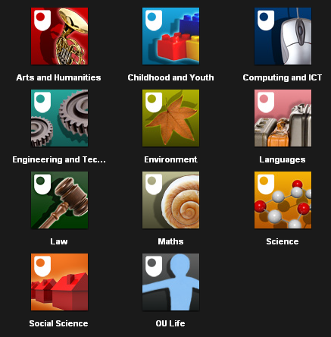
Resources
Over ten years of the Open Educational Resource (OER) movement
Hundreds of OER repositories worldwide
Presence on iTunesU
Podcasts - iTunes U

Slide 45
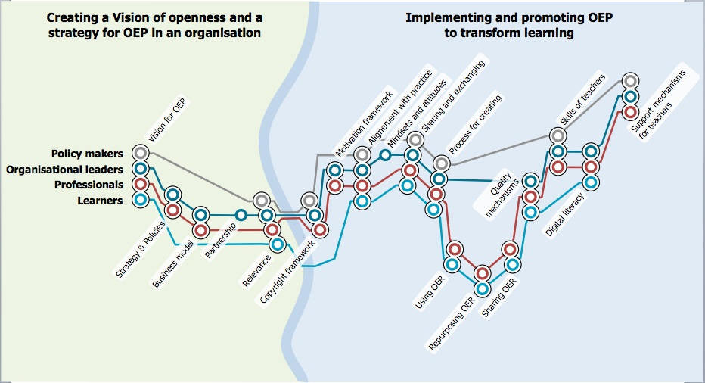
The OPAL metromap
Evaluation shows lack of uptake by teachers and learners
Shift from development to community building and articulation of OER practice
http://www.oer-quality.org/

Slide 46

POERUP outputs
An inventory of more than 100 OER initiatives http://poerup.referata.com/wiki/Countries_with_OER_initiatives
11 country reports and 13 mini-reports http://poerup.referata.com/wiki/Countries
7 in-depth case studies
3 EU-wide policy papers

Slide 47
Differences in education, internet, e-learning
Diversity of educational contexts
Diversity of internet provision
Diversity of use of e-learning
  Distance Learning is a feature of educational system, Canada and Australia
  State of e-learning below EU average, Hungary
Country | Internet (in 2011) | Broadband (in 2011)
Australia | 87% | 83%
UK | 73% | 71%
Italy | 62% | 52%
Hungary | 66% | 61%

Slide 48
Emergent themes
Shift from development to OER practices
Shift from basic OER awareness to OER maturity and embedding
Broader notion of open practices – open learning, teaching and research
Use of social and participatory media to foster OER communities

Slide 49
POERUP outputs
An inventory of more than 100 OER initiatives http://poerup.referata.com/wiki/Countries_with_OER_initiatives
11 country reports and 13 mini-reports http://poerup.referata.com/wiki/Countries
7 in-depth case studies
3 EU-wide policy papers

Slide 50
Statement 1: OER will have a major impact on students' learning in the next five years.
I agree
I disagree
Undecided

Slide 51
Statement 2: OER are better quality than commercially published textbooks.
I agree
I disagree
Undecided

Slide 52
Statement 3: I will use more OER in my teaching/learning in the future.
I agree
I disagree
Undecided

Slide 53
Challenges
Opportunities
Quality
Currency
Contextualization
Time to find
Engagement – building interactivity
Reluctance to share
Accessibility
Poverty
Accreditation
Wider access
Continuous improvement
Reduction of overheads
Leads to open practices
Creativity
Can identify learning approaches and change to meet these
Stimulation for lecturers lol – shared resources

Slide 54
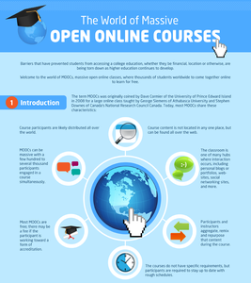
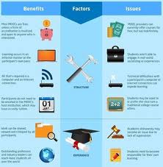
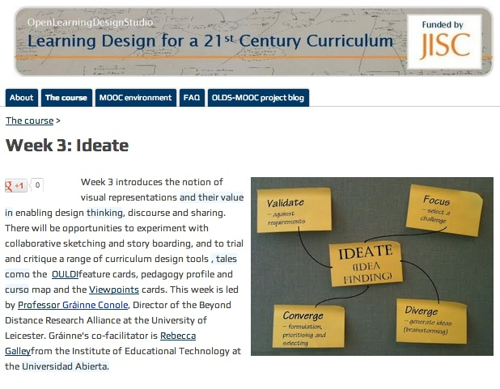
Massive
Open
Online
Courses
http://www.olds.ac.uk/
http://www.technologyreview.com/news/506326/the-technology-of-massive-open-online-courses/

Slide 55
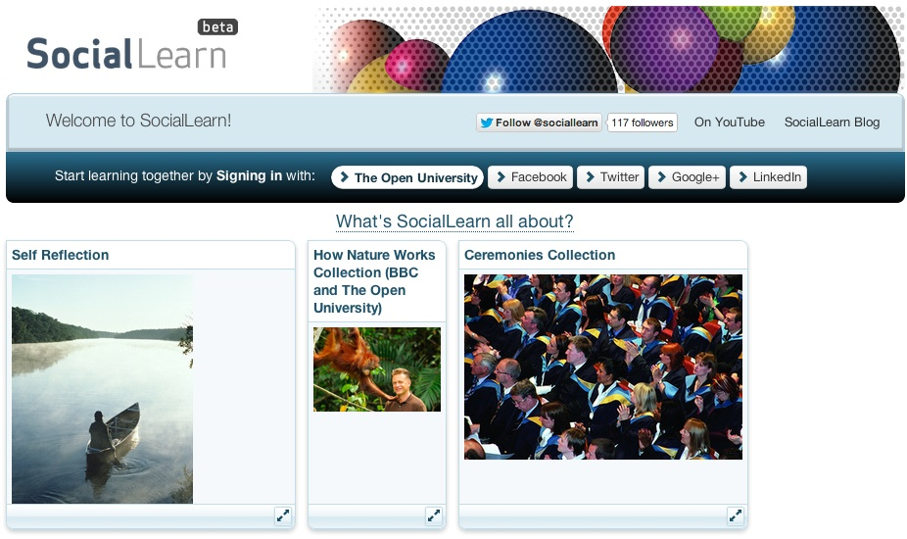
Learning pathways
Guided pathways through materials
Can promote different pedagogical approaches

Slide 56
Support
Computer assisted
Peer support
Tutor support
Community support
Mentoring
http://www.flickr.com/photos/24289877@N02/5851058394/

Slide 57


Accreditation
Peer to Peer University
OER University
www.p2pu.org/en/
wikieducator.org/OER_university/

Slide 58

Changing practices
Nature of learning, teaching and research is changing
It’s about
  Harnessing new media
  Adopting open practices
New business models are emerging

Slide 59
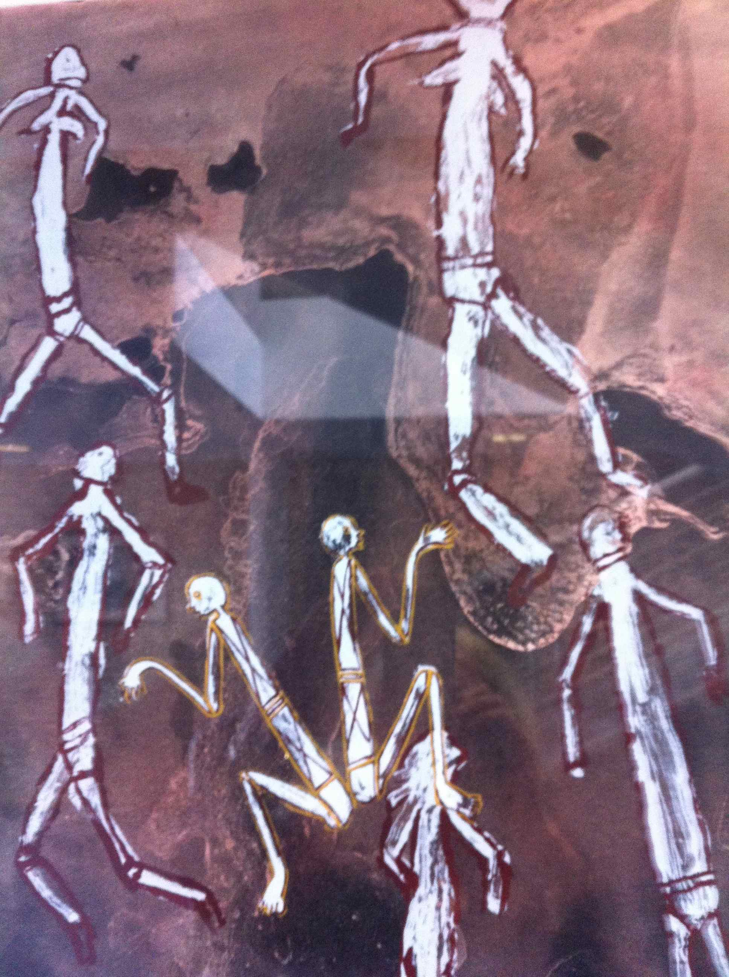
The future of learning
Changing nature of education
New forms of communication and collaboration
Rich multimedia representation
Harnessing the global network

Slide 60
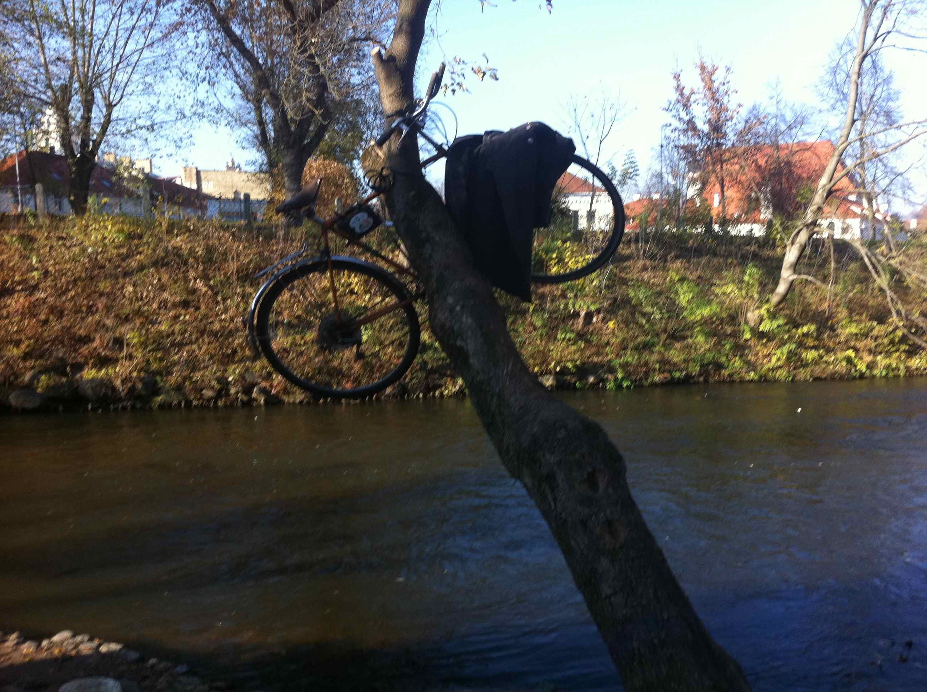
Implications
Blurring boundaries
New business models
More open practices
Changing roles
Importance of new digital literacy skills
Disruptive and complex

Slide 61


http://www.slideshare.net/GrainneConole
http://www2.le.ac.uk/departments/beyond-distance-research-alliance
grainne.conole@le.ac.uk
http://e4innovation.com

Slide 62
Useful sites and resources
OULDI website http://www.open.ac.uk/blogs/OULDI/
Carpe Diem website http://www.le.ac.uk/carpediem
7Cs OER page http://www2.le.ac.uk/projects/oer/oers/beyond-distance-research-alliance/7cs-workshop-resources
Cloudworks http://cloudworks.ac.uk/

