Slide 1
Digital Teaching and Learning Roadshow
Library Developments in Stream
Notes:
Today we will highlight some of the work librarians have been doing in support of teaching and learning in Stream.
Information literacy development is a core focus for the Library. The ability to identify when information is needed, know where and how to search, and to evaluate results found is a key skill both while at university and in the workplace – a graduate attribute for lifelong learning. Librarians support the development of information literacy in a number of ways – self-help information on the website, one-to-one interactions, and most importantly through embedding information literacy teaching into course content.
Librarians are now working in the blended learning environment by creating and supplying content for Stream.

Slide 2
Librarians can…
Provide activities and material to develop information literacy skills
Provide links to resources, including Discover
Notes:
In Stream, librarians can:
Provide activities and material to develop information literacy skills
And
Provide links to resources, including Discover, our new “Google-like” search engine. Discover was launched at the beginning of Semester 2 last year, and has been extremely well received by both students and staff. Discover searches many of the Library's article databases, ebooks, the catalogue, Massey Research Online and other resources, instead of searching each resource individually.
Many librarians have editing access to create material directly in the course, or can supply content for uploading by course design staff.
Additional info in case anyone asks about Discover:
Why did we buy Discover?
The Library had feedback from students over several years that they were often unsure where to go to get information for their assignments and struggled, in particular, to find journal articles. There are so many databases to search, it can be hard to know where to start, and students often ended up using only Google.
At the same time some new products have come onto the market. We spent several months assessing four similar products, choosing Discover ahead of its competitors - in large part due to the way we felt it met the needs of our clients here at Massey.
We have placed Discover on the Library home page so it is easy to find. The single search box makes it simple to use and results are brought together in one list. We think it is particularly useful for new students and anyone wanting an overview of what is available on a topic. The specialist databases are still available for more comprehensive searching. We have received positive feedback from both students and staff.

Slide 3
Information Literacy Skills
Point of need:
Activities
“Show Me How” demonstrations
Quizzes to assess learning
Stream Books
Tipsheets to reinforce or replace a face-to-face tutorial
Notes:
We believe (and our case study evidence shows) that the most effective time for students to develop information literacy skills is when they are required to find relevant information for an assignment or assessment.
Librarians are contributing content in a variety of ways:
Activities to develop and practise searching skills
Links to “Show me How” demonstrations on a number of topics using Captivate and Presenter – for example how to use specific databases, search strategies
Quizzes to assess learning
Stream Books with exercises and explanation
Tip-sheets to reinforce or replace a face-to-face tutorial
We prefer where possible to have this content in the central column, in the appropriate week for the course requirements. Placement of content has a major impact on its uptake and effectiveness.

Slide 4
Links to resources
Default and tailored Library blocks
Stream Books
Presenter tutorials
Tip-sheets
Notes:
While there is a default Library block in every course, librarians have also created customised blocks for programmes and papers with links to resources and accompanying demonstrations. These include textbooks, past exam papers, and broad subject guides which list reference works, article databases and websites.
Anecdotal evidence suggests student make good use of blocks when lecturers refer to them at key stages during the course.
The following slides show some examples of Library content supplied in the last couple of years.

Slide 5
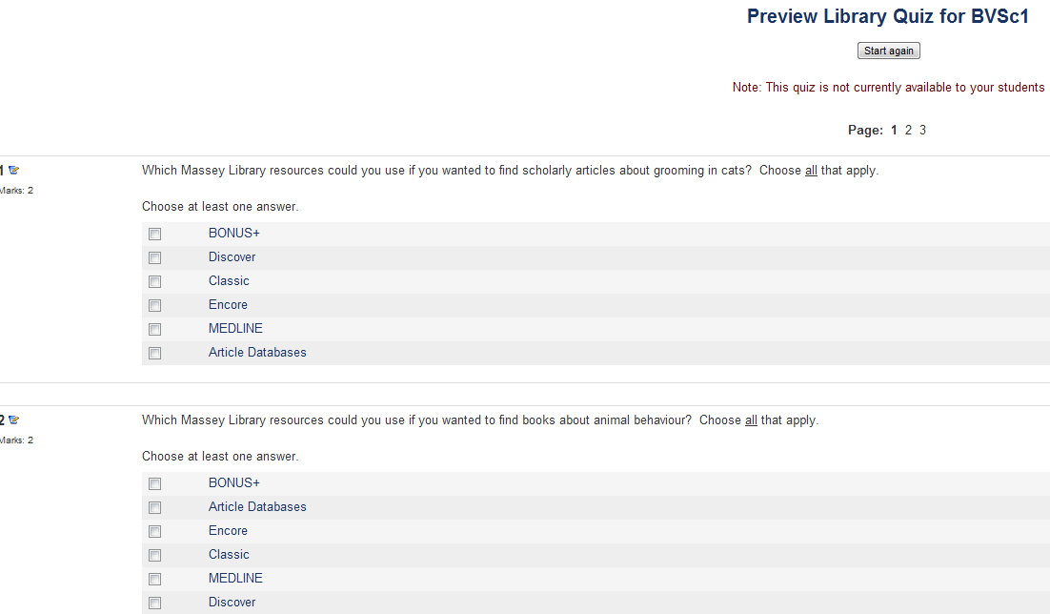
Quiz for 1st Year Vet Students
Notes:
This Library quiz was pitched at 1st-year vet students. If they were able to demonstrate prior knowledge they were exempted from attending a compulsory session in the Library. The quiz was open for one week and was optional. Students who scored 15 or more out of 20 did not have to attend the tutorial. 80 out of 103 student attempted the quiz and 41 passed. Those who did come to the tutorial were engaged and learned key skills!

Slide 6
Notes:
Here is an example of a tipsheet anchored to a tailored block in a first year psychology course. If this content is delivered face-to-face then the tipsheet (which follows the class outline) serves to reinforce the learning.

Slide 7
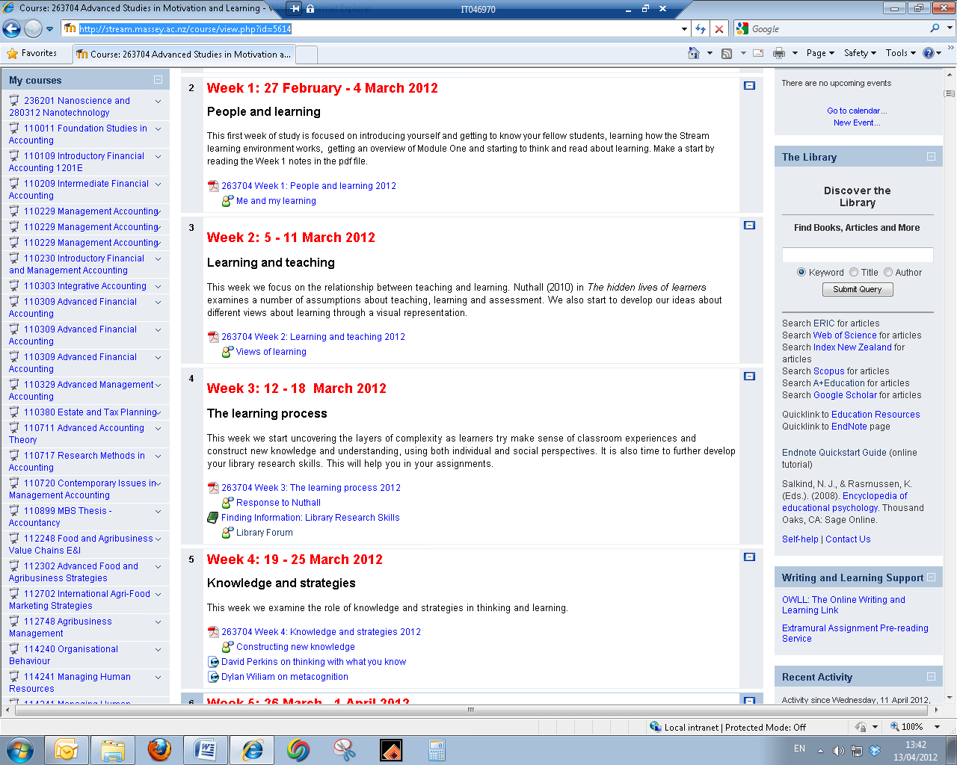
Notes:
In this example librarians worked with the paper coordinator to include a library module at the point where the students need these skills. Click mouse to insert circle.
The module takes the students through the skills they will require for this paper using relevant ‘show me how’ demonstrations , hands on practice based on the student’s assignment and the student’s reflection on their experiences of the practical application of the skills learnt, which they post to a forum.
Click mouse to insert module
The slide shows an example using the book format. The book is divided into chapters covering such skills as designing a search strategy, using appropriate databases, using EndNote, getting to the fulltext of a journal article.

Slide 8
Want to know more?
Contact your Liaison Librarian
Our details are on the Library website
Notes:
If you would like to know more, we would be happy to talk to you about what we can provide to support your teaching and the students’ learning.
Any questions?

