Slide 1
PISA 2012
Students and Money
Financial literacy skills
9 July 2014
Launch
Notes:
I need to remind you that the material remains under embargo until Wednesday 9 July 2014, 10AM Paris Time.

Slide 2
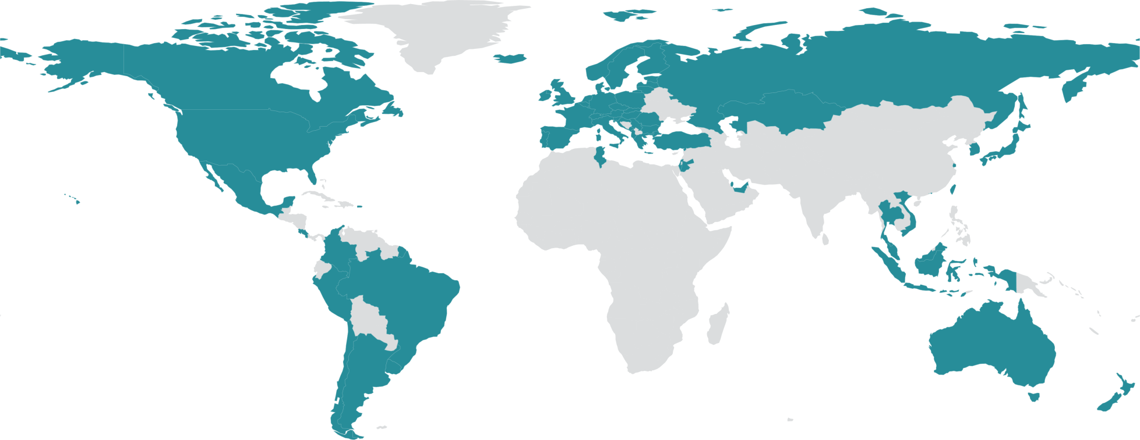
PISA in brief
29 000 of these students in 18 economies took the PISA test on financial literacy
Over half a million students…
representing 28 million 15-year-olds in 65 countries/economies
… took an internationally agreed 2-hour test…
Goes beyond testing whether students can reproduce what they were taught…
… to assess students’ capacity to extrapolate from what they know and creatively apply their knowledge in novel situations
Mathematics, reading, science, problem solving (financial literacy)
… and responded to questions on…
their personal background, their schools and their engagement with learning and school
Parents, principals and system leaders provided data on…
school policies, practices, resources and institutional factors that help explain performance differences .
…“knowledge and understanding of financial concepts and risks, and the skills, motivation and confidence to apply such knowledge and understanding in order to make effective decisions across a range of financial contexts … to enable participation in economic life”.
Notes:
“Financial literacy in PISA is primarily conceived of as personal financial literacy, distinguished from economic literacy, which includes both broader concepts, such as the theories of demand and supply, market structures and so on. Financial literacy is concerned with the way individuals understand, manage and plan their own and their households’ financial affairs, and with their awareness and understanding of the overall financial and economic landscape they live in. It is also recognised that good understanding, management and planning on the part of individuals has some collective impact on the wider society in contributing to national and even global stability, productivity and development.”

Slide 3
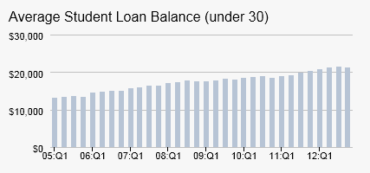
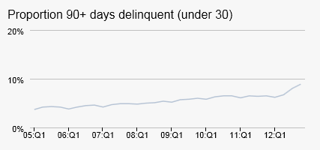
Big decisions at a young age: e.g. continuing education vs working
Shrinking welfare systems; increased personal responsibility
Shifting demographics- increased longevity
Changing labour-markets and reduced job security
Access to financial products at young ages
Increasingly complex financial markets
Why is financial literacy relevant for 15-year-old students?
More students are enrolling into
higher education.
In the US young adults owed more
in 2012 than before the financial crisis
Why is financial literacy relevant for 15-year-old students?
And they were
more likely to be
falling into arrears
(% of all loans- some of which are not yet in repayment phase)

Slide 4
% of students with a bank account
%

Slide 5
% with a prepaid debit card
%

Slide 6
And many teenagers are managing their mobile phone costs
In 2010 75% of 12-17 year olds in the US owned a cell phone
18% of phone users had a prepaid or pay-as-you-go plan
10% had their own contract
Large differences by socio-economic factors
Among teens in households with incomes <USD30 000 only 31% were on a household contract
21% of teens who did not otherwise go online accessed the internet from their mobile
69% had a phone that was part of a household contract
http://www.pewinternet.org/2010/04/20/teens-and-mobile-phones/
Notes:
And many have a phone contract or pay as you go to manage

Slide 7
Reliance on student loans
More students are enrolling into
higher education.
In the US young adults owed more
in 2012 than before the financial crisis
And they were
more likely to be
falling into arrears
(% of all loans- some of which are not yet in repayment phase)
Source: http://www.newyorkfed.org/studentloandebt/

Slide 8
PISA financial literacy assessment framework
8
Content
Money and transactions
Planning and managing finances
Processes
Identifying financial information
Analyse information in a financial context
Contexts
Risk and reward
Financial landscape
Evaluate financial issues
Apply financial knowledge and understanding
Education and work
Home and family
Individual
Societal

Slide 9
PISA financial literacy assessment framework
9
Content
Money and transactions
Planning and managing finances
Risk and reward
Financial landscape
Coins and notes
Different ways of making payments
Understanding bank statements
Saving and spending
Credit and debt
Financial decision making
Investment and saving
Diversification
Using credit
Volatility of the market
Exchange rates
Consumer rights and responsibilities
Understanding of the wider financial, economic and social system

Slide 10
PISA financial literacy assessment framework
10
Contracts, advertisements,
charts, tables, forms and instructions.
e.g. identify the features of a purchase invoice, or recognise the balance on a bank statement
Processes
Identifying financial information
Analyse information in a financial context
Evaluate financial issues
Apply financial knowledge and understanding
e.g. Compare the terms offered by
different mobile phone contracts
Draw on knowledge, logic and
plausible reasoning to make sense of,
and form a view about, a finance-
related problem
e.g. Work out whether purchasing
power will decline or increase over time when prices are changing at a given
rate.

Slide 11
PISA financial literacy assessment framework
11
Contexts
Education and work
Home and family
Individual
Societal
e.g. Tasks around payslips, planning to save for tertiary study, participating in workplace savings schemes
e.g. Buying household items or family groceries, keeping records of family
spending
e.g. Choosing products and services
such as clothing, toiletries or haircuts, or buying consumer goods such as
electronic or sports equipment
e.g Being informed about consumer
rights and responsibilities, and
understanding the purpose of taxes

Slide 12
Examples of what this might mean for 15 year olds
Balance their priority and plan what to spend money on
…if they go to the cinema, will they still have enough money for the bus fare home? Or would it be better to buy pizza and invite friends home?
Remember that some of the purchases have ongoing costs
…a games console will need new games, a motorbike will need fuel and tyres and services and so on.
Being alert to possible fraud
…Some emails that look like they came from their bank might not be legitimate, they should know what to do if they are not sure
Knowing what risk is and what insurance is meant for
…If their phone gets stolen, they should ask their parents if it is covered by their household insurance
Make an informed decision about credit
…they should know that if they buy a computer on credit they will have to pay interest on the loan as well as paying the advertised price for the computer
…and they will realise that the less they repay of that loan each month, the more they will pay in interest
Notes:
In practice a 15-year-olds’ might…
- Estimate the amount of change they should get when they pay for something in cash, and remember to check
- Make decisions about what to spend their money on, taking into account the things that they might really need to pay for. For example, if they go to the cinema, will they still have enough money for the bus fare home? If not, maybe they should buy pizza and invite friends round to theirs to watch a DVD instead?
- Remember that some of the things that they buy will have ongoing costs. A games console will need new games, a motorbike will need fuel and tyres and services and so on.
- Some emails that look like they came from their bank might not be legitimate , but they will know what to do if they are not sure.
- If their phone gets stolen, they will ask their parents if it is covered by their household insurance
- Make an informed decision about credit: (those with higher levels of proficiency) …will know that if they use credit to buy a computer, they will have to pay interest on the loan as well as paying the advertised price for the computer. ..and they will realise that the less they repay of that loan each month, the more they will pay in interest
- Understand risk diversification …they will be able to explain why the saying ‘don’t put all your eggs in one basket’ might apply to investment.
Realise that buying something on credit is likely to make an item cost more in the long run. They will understand why the saying ‘don’t put all your eggs in one basket’ might apply to investment.

Slide 13
Sample Question: INVOICE
Sara receives this invoice in the mail
Question 1: Why was this invoice sent to Sarah?
A. Because Sarah needs to pay the money to Breezy Clothing.
B. Because Breezy Clothing needs to pay the money to Sarah.
C. Because Sarah has paid the money to Breezy Clothing.
D. Because Breezy Clothing has paid the money to Sarah.

Slide 14
Sample Question: INVOICE
Sara receives this invoice in the mail
Question 2: How much has Breezy Clothing charged for delivering the clothes?
Delivery charge in zeds:
…….............................……………………………………………...
10 zeds

Slide 15
Sample Question: INVOICE
Sara receives this invoice in the mail
131 zeds
Question 3:
Sara notices that Breezy Clothing made a mistake in the invoice. Sara ordered and received two T-shirts, not three. The postage fee is a fixed charged. What will be the total of the new invoice?

