Slide 1

The importance of living wage in South Africa
By
Dr. Molefe J. Maleka

Slide 2
AGENDA
MOU Massey and TUT
History living wages within LRS in SA
Living wage scoping
Research design & data collection
Preliminary results
My story
Discussion

Slide 3
MOU (Massey and TUT)
Signed MOU is between 2015 to 2018

Slide 4
History of LW in SA
Master and Servant Laws No.1 1841 and No. 15 of 1856 - craft unionism and high living wages (Jones, 1982: 26).
The Mines and Works Act No. 12 of 1911 - job reservation for white workers (Finnemore, 2009: 26).
The Black Regulations Act No. 15 of 1911- casualization of black workers (Bendix, 2010: 57- 60).
Industrial Conciliation Act No. 11 of 1924 - exclusion of black workers from collective bargaining (i.e. benefits, skills development) (Bendix, 2010: 57- 60).

Slide 5
History of LW in SA
1922 Rand rebellion – replacement of white expensive labour by cheap black workers (Bendix, 2010: 60).
1948 apartheid system
Wage gap increased from 10.6 percent to 15.1 percent between 1948 and 1970 (Seekings & Nattrass, 2005: 137).
Industrial Conciliation Act No. 28 of 1956 – dual LR system, leading to black and white unionism (Seekings & Nattrass, 2005: 138).

Slide 6
History of LW in SA
In 1994, ANC became the ruling party and subsequently passed these legislation:
  Constitution of 1996 – Section 23 labour relations and section 9 equality.
  Employment Equity Act (EEA) No. of 55 of 1998 – equality in workplace and wages.
  Basic Conditions Of Employment Act No. 75 of 1997 – sectoral determination for low-income workers (i.e. domestic and agricultural workers).

Slide 7
Labour economics trends in the last decade:
- CEOs increment 54% & GF highest in the OECD
countries (0.7) (Massie, Collier & Crotty, 2014: xxiii).
- Collectively bargaining based on CPI.
- Outsourced employees in some sectors (i.e. retail, security
etc.) had 0% wage increases and not unionised.
- Unemployment averaging 25% and employees migrating to
big cities.

Slide 8
Quality of life research in SA
HSRC 2014 survey: It also showed that low income earners said they will be satisfied if they can have access to housing, education and afford to buy food and accommodation. It showed that high income workers life satisfaction is high.

Slide 9
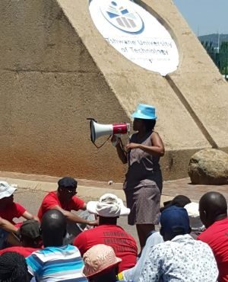
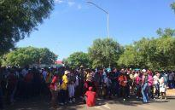
Trends in LW
Students and low income workers embarked on protests against outsourcing/ casualisation. Living wage demanded (R10 000).
- TUT and UP offers (R5000 + plus benefits) > above the minimum
wages according to sectoral determination: security guard
R2,533 A-grade (NZD 250/per month).

Slide 10

Scoping of the LW: NZ & SA
Prof Carr visited SA in June 2015 and two projects were scoped:
- Impact of LW and human capabilities (four market sites were identified for data collection: Tshwane (n=200), Cape Town(n=200), Christ Church (n=200) and Auckland (n=200).
Why measure LW in NZ & SA?
Different GC/inequality levels,
we can learn from each other’s
experiences.

Slide 11
Research design & data collection
Systematic sampling technique (i.e. every 3rd respondent).
Piloting in October 2015 on 10 respondents:
Respondents did not answer Q30: gross household income.
One RA, Jafta Khoza, collected data and it difficult to sample 3rd person.

Slide 12
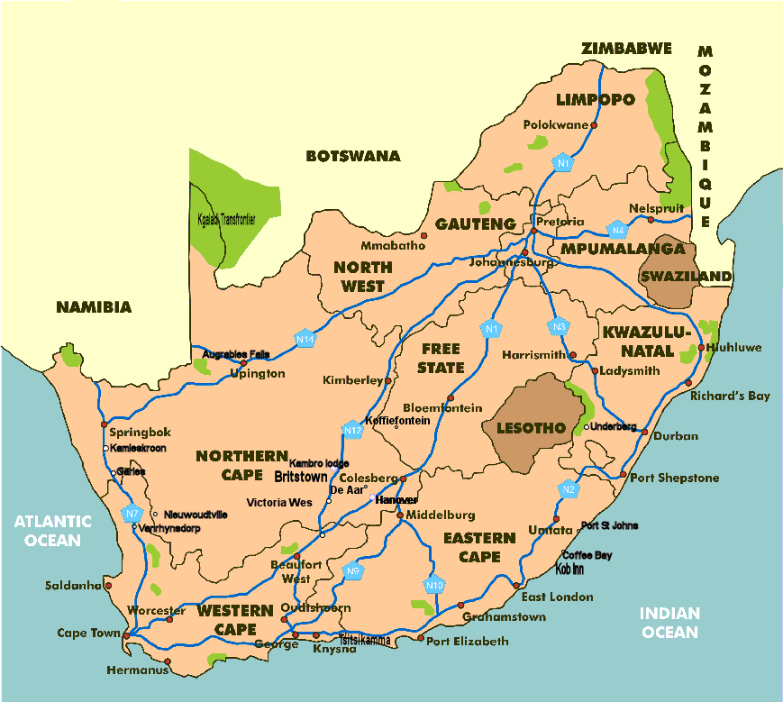



Research design & data collection
Questionnaire (n=44 questions) and measures: JS, LS, Dignity & Fairness
G
Empowerment ranged 1-10, Job Satisfaction 1-3. Life Satisfaction 1-3, Unstressed 1-3,
Fair rate 1-3, Living arrangement 1-6.

Slide 13
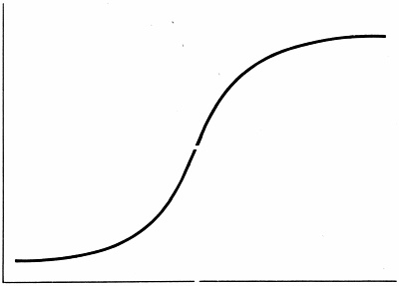
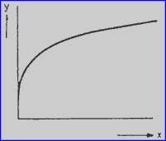

Wages questions and Wages Theories
Q30: If you don’t mind asking, how much did your household have last month?
Q31: If you don’t mind us asking how much was your own take-home pay last month?
Q32: If you don’t mind us asking, what if you (approximate) rate of pay (for your primary job)?
JS and pay = linear
Poverty trap = sigmoidal
Law of diminishing returns = logarithmic
Inverse of sigmoidal (Carr et al, 2016: 2)

Slide 14
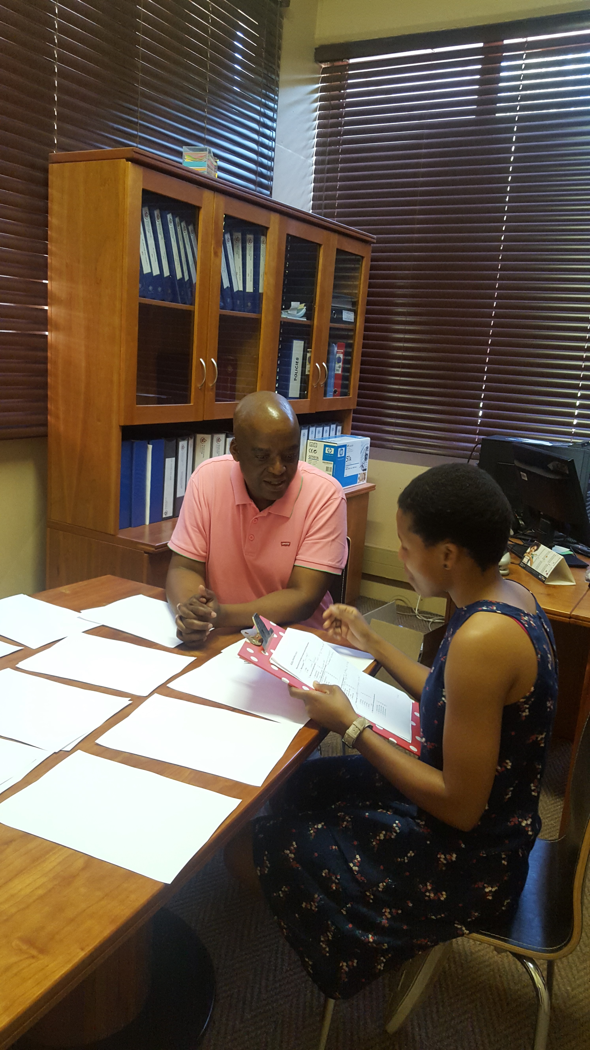
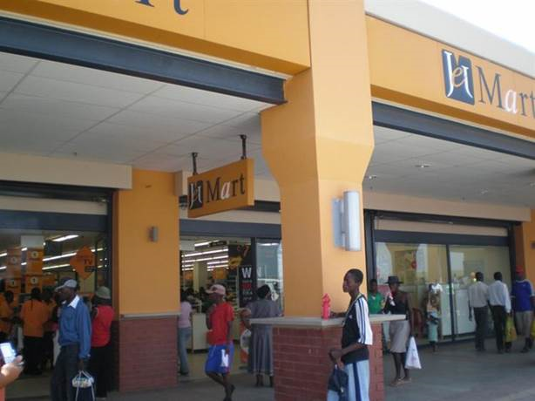
Procedure & data collection
Second RA , Mary Ntsweng, training and research site.

Slide 15
Data analysis
Data reduction (EFA).
Curve estimation (“To enable sigmoidal curve fitting, which requires positive number, a constant +4 was added to factors scores saved from Principal Components Analysis” (Carr et al, 2016: 18).
Co-variance (Manocova): Part-time/full-time/unemployment status 1-3, dependents, incomes statistically controlled and not significant in the study.
Chi-square = significant association between income bracket and basic needs.
Thematic content analysis (based on EFA factors).

Slide 16
Summary of exploratory factor analysis results for the Living Wage questionnaire (n=205)
 | Principal Components
 | Fairness | Dignity | Quality of life | Upward comparison
Fair rate to your qualifications | 0.815
Fair rate for the job | 0.810
Fair rate to your effort | 0.741
Pay satisfaction | 0.726
Job satisfaction | 0.574
Fair rate for similar jobs elsewhere | 0.522
Overall pay satisfaction | 0.417
Dignity |  | 0.854
General empowerment |  | 0.691
Pride |  | 0.634
Life satisfaction |  |  | 0.883
Physical wellbeing |  |  | 0.837
Middle manager |  |  | 0.642
CEO |  |  |  | 0.934
Supervisor |  |  |  | 0.869
Fair payment |  |  |  | 0.815
Eigenvalues | 6.48 | 1.60 | 1.57 | 1.23
% of variances | 40.50 | 10.00 | 9.81 | 7.70
Coefficient alphas | 0.86 | 0.61 | 0.72 | 0.63
Note: Loadings above are in line 0.4 criteria by Field (2013: 706) .

Slide 17
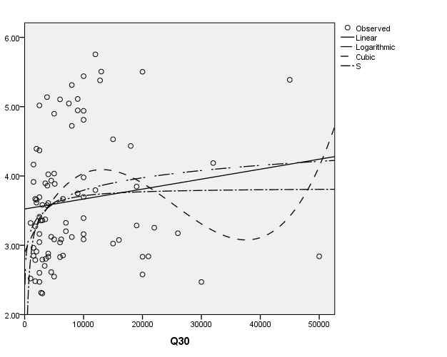
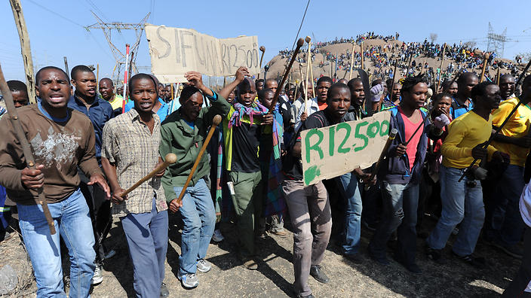
Preliminary results (HI v Fairness)
 | Model summary
Equation | R Square | F |  | Df | Sig
Linear | 0.020 | 1.833 |  | 1,88 | 0.179
Logarithmic | 0.066 | 6.259 |  | 1,88 | 0.014
Cubic | 0.118 | 3.838 |  | 3,86 | 0.012
S | 0.073 | 6.902 |  | 1,88 | 0.010
The cubic function was: y = 2.99 + .0.00x - 1.06x² + 1.40x³
From the figure below, it can be seen that the
above curve peaks almost at R11 000.
Fairness
The IV is: “If you don’t mind us asking, how much did your household have last month?” (Rate of pay ZAR per month).
Note: The above pattern was the same with variable 31 (net take home pay, r-squared cubic = 22%). Other curve estimation between wages and dignity, quality of life and upward comparison will be analysed at a later.

Slide 18
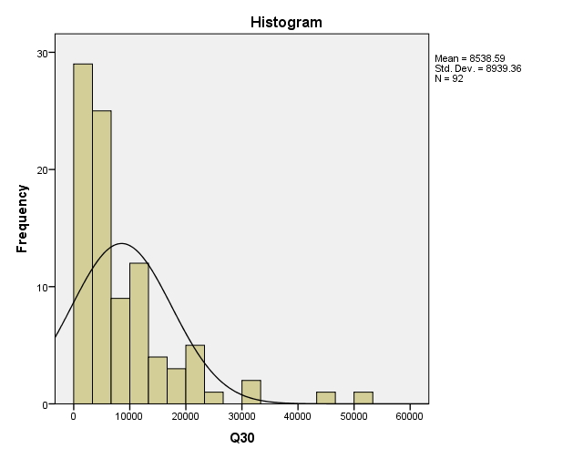
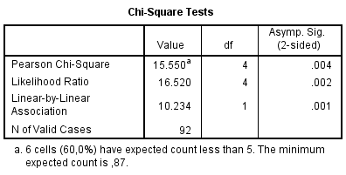
Preliminary results
HouseholdBracket10Ks
 |  | HouseholdBracket10Ks |  |  |  |  | Total
 |  | R1000 to R9999 | R10000 to R19999 | R20000 to R29999 | R30000 to R39999 | R40000 to R50000
Basic needs | Yes | 19 | 14 | 4 | 1 | 2 | 40
 | No | 44 | 5 | 2 | 1 | 0 | 52
Total |  | 63 | 19 | 6 | 2 | 2 | 92
Majority (44%) in the low income said the wages don’t enable to basic needs.
Note: (R1000 p/m = NZD 100 p/m).

Slide 19
Verbatim quotes
Fairness
Wage and qualification
I would say the amount itself that I get every month is not that bad, but comparing it with the qualifications I have its nothing. (Employee earning R8000. 00).
Dignity
Pride
I am so proud of my job, because I am able to do what I want with my wage. (Employee earning R18 000).

Slide 20
Quality of life
Psychological and physiological wellbeing
Compared to what I used to earn, now I am stress-free. (Employee earning R35 000).
Life satisfaction
I am able to provide for my family. I can also arrange for holiday whenever I get time off work. (Employee earning R11 000).
Upward comparison
Comparison with management
I receive a small salary every month whereby I can even fail to provide for my family. People holding higher positions are earning higher salaries than ours. (Employee earning R2500).

Slide 21
What’s my story
Quantitative data showed that household income significantly correlates with fairness.
Evidence and quantitative data showed LW peak/pivot higher than minimum wages.
Data suggest that there is a wage level that will enable people to afford education, accommodation and afford basic needs.
Qualitative data revealed that LW is related to quality of life (i.e. psychological wellness, less stress ) and dignity (i.e. pride of the job).

Slide 22
Future research
Have focus groups or individuals interviews to solicit narratives around the predicted peak fair living wages (Darrin Hodgetts).
Possible longitudinal study
Living wages and human resources outcomes (i.e. JS, talent management, engagements, organisational commitment & quality of life). Included household net in the instrument.
Global living organisational wage (GLOW) project.
Supervision of M & D students.

Slide 23
Ke a leboga/ Kia Ora/Thank you
Any Questions and Suggestions for future research?

