Slide 1
Geoleadership: global business leadership
November 2015
MASSEY UNIVERSITY – Albany, New Zealand
Dr. Eileen (E.S.) Wibbeke
U.S. Fulbright Specialist

Slide 2
ABOUT DR. WIBBEKE
Dr. E.S. (Eileen Sheridan) Wibbeke holds a BA in International Relations, an MBA in International Management, and Doctorate in Management (Organizational Leadership).
Cross-cultural consultant to individuals and organizations for over two decades; one decade spent in Silicon Valley (i.e. Borland, Novell, Siebel Systems).
Brick and mortar and online course instruction at UC Santa Cruz, University of Liverpool and other international institutions for 14 years. Students logging in for lectures from more than 156 countries currently.
Fluent in English and Spanish; studied German, Italian and Japanese. Dual citizenship with U.S. and Republic of Ireland. Studied abroad in Costa Rica, Nicaragua, and Spain.

Slide 3
A moment for warren bennis
Contribution by WARREN BENNIS
We were honored to have had Warren contribute the Foreword for the second edition of Global Business Leadership (2014).
Warren received the Lifetime Achievement Award from ILA in 2008.
Warren stated that “Authors Wibbeke and McArthur stretch us beyond our borders and into a reality where mastery of business, culture, and leadership is no longer a "nice to have”, it is a “must have!”

Slide 4
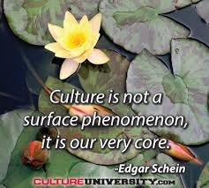
Contribution by EDGAR SCHEIN
We were pleased to have Professor Edgar Schein, formerly of MIT, contribute to the second edition of Global Business Leadership (GBL).
Contributed information from his book, Organizational Culture and Leadership 4e to Chapter 9 of Global Business Leadership 2e “The Principle of Capability”.

Slide 5
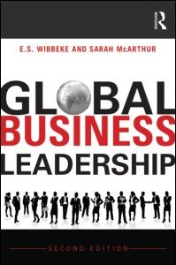
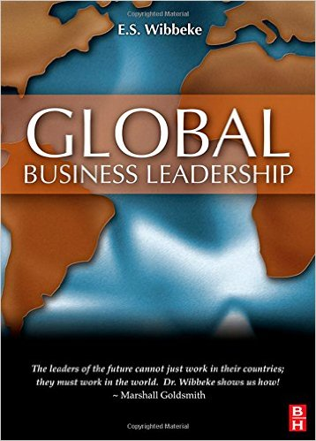
GLOBAL BUSINESS LEADERSHIP
Wibbeke, E. (2008). Global Business Leadership (1st ed.) . Oxford, UK: Routledge.
Wibbeke, E., & McArthur, S. (2014). Global Business Leadership (2nd ed.). Oxford, UK: Routledge.

Slide 6
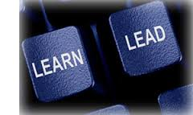
A moment for warren bennis
Two Book editions
In the first edition, we concentrated on explaining the Geoleadership Model and utilized case studies.
In the second edition, we concentrated on interviews with thought leaders and what they thought of the Geoleadership Model
Where in the world is your GEOLEADER?

Slide 7
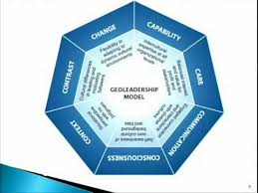
GEOLEADERSHIP MODEL - first edition
Geoleadership Model: The Seven Competencies Required of a Geoleader
Capability
Care
Change
Communication
Consciousness
Context
Contrasts
Each competency is key in being an effective leader across cultures in this era of rapid globalization. Leadership and culture are inextricably linked. Both are about relationships, resources, and respect.

Slide 8
Global business LEADERSHIP - capability
Intercultural capability at all organizational levels
Capability Defined: Intercultural competence requires leaders that are able to their own and others’ capability and build it where there is deficit.
?

Slide 9
Global business leadership – care
Enhanced interests and value for profit and stakeholders
Care defined: Sensitivity , concern and appreciation for other cultures are primary requirements for the new intercultural leaders – we call this the principle of Care. Leaders can improve both and intercultural relations by adopting sustainable view of business strategy.

Slide 10
Geoleadership - CHANGE
Self-awareness of own culture background and basis
Change is not a natural human condition.
Change defined: In order for a leader to be a brilliant visionary and an adroit communicator, the leader must be able to scan be disruptive of current forces in order to imagine a compelling future

Slide 11
GEOLEADERSHIP MODEL – communication
Engaged operations and interactions with diverse cultures
Communication defined: The essential message here is that you must connect from other to understand them. To understand people who are difference from us, we must engage in meaningful communication. For the intercultural leader this means developing a general understanding of how communication works.

Slide 12
Geoleadership - Consciousness
Situational perspective with no judgment
Consciousness Defined: We live in a changing global culture in which there are two driving and ostensibly forces, one is globalization, and the other is the counter-globalization fueled by political and religious factions. No one is sure what globalization will lead to; however, most authorities and theorists believe that globalization will continue.
Is there any industry in any country of the world that has not been touched by globalization?

Slide 13
Geoleadership - Context
Cultural differences in leading and motivating followers
Context Defined: Global leaders must develop the ability to perceive, discern, and adapt to the situations within which they work, and to suspend judgement. Leaders need to understand each culturally learned behavior in the context of where that behavior originates and appears.
Remember that the context of a situation gives way to situational leadership almost in all ways.

Slide 14
INTERVIEWEES for second edition
INTERVIEWEE | TITLE | INTERVIEWEE | TITLE
John Ryan | CEO, CCL | George Mitchell | Attorney, Envoy
Fons Trompenaars | Intercultural Consultant | Jean-Christophe Bas | UN Strategist
Sally Helgesen | Author | Michael Dukakis | Gov. Massachusetts
Geert Hofstede | Professor Emeritus | Garry Ridge | CEO. WD40
Irwin Jacobs | Founder, Qualcomm | Harry Triandis | Psychology Prof.
Alan Richter | Consultant, QED | Linda Sharkey | Consultant
George Simons | Intercultural Consultant | Ulzii Vangansuren | Mgmt Prof-Mongolia
Todd Fortner | Auto Executive in China | Marye Anne Fox | Fmr Chancellor UCSD
Jim Kouzes | Leadership Author | Jane Roberts | 34 Million Friends-UN
Marshall Goldsmith | Executive Coach | Osama Bedier | VP Global Pymts,Google
Maya Hu-Chan | Leadership Consultant | Peter Farrell | CEO, ResMed
Alain Barbier | Interpol Rep. to European Union | Tom Carson | CEO,Rovi Corp
Mark Dankberg | CEO, ViaSat

Slide 15
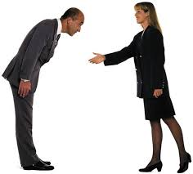
GLOBAL BUSINESS LEADERSHIP – second edition
First finding:
Cultures vary widely in how they view business including how to lead and how to follow.
Even with the minimal understanding of cultural differences that can be learned through distant study, the going can be tough and frustrating.

Slide 16
GLOBAL BUSINESS LEADERSHIP
Second finding:
Combination of globalization, complex societal changes, demographic changes, and the lack of skilled business leaders being graduated from business schools has created a global talent crisis.

Slide 17
GLOBAL BUSINESS LEADERSHIP
Third Finding:
There is no right or wrong culture, just different cultures.
Differing types of economies also exist, including knowledge economy and creativity economy. Intellectual capital resides in the brainpower of employees. Culture shapes the image of the ideal of a particular nation or organization.
https://www.youtube.com/watch?v=qHwMg-kYLEk

Slide 18
Geoleadership challenges
INTERVIEW: John Ryan, CEO, Center for Creative Leadership
Question: What are the most important decisions you make as a leader of an organization of which you have been a part?
Answer: Leaders need to make the right decisions in three key areas. No. 1 is setting direction, which means developing a realistic and competitive strategy. No. 2 is creating alignment. This is not about merely organizing people, which is instead the role of management. It’s more about establishing effective communication up, down and across the organization to foster empowerment. No. 3 is prioritizing talent decisions. It is crucial to hire well, ensure everyone is in the right position and give individuals and teams the resources to execute strategy. This might sound trite, but so few leaders give talent the focus it deserves.

Slide 19
CULTURE AND LEADERSHIP
Individualism versus Collectivism
Uncertainty Avoidance
Long-Term versus
Short-Term Orientation
Masculinity versus Feminity
Power Distance
INTERVIEW: Geert Hofstede, Professor Emeritus
Question: What is the biggest challenge facing global business leaders today in corporations?
Answer: The biggest challenge is becoming a victim of greed.

Slide 20
communication
INTERVIEW: Jim Kouzes, co-author of The Leadership Challenge
Question: What is the biggest challenge facing global business leaders today?
Answer: The biggest challenge global business leaders face today is trust. Virtual trust is very difficult to establish. For people to feel fully confident in their leaders, they have to have some interpersonal interaction with them. While social media has enabled leaders to communicate more quickly and more deeply with people than ever before, we are much more likely to trust our leaders if we see them face-to-face.

Slide 21
capability
INTERVIEW: Ulziibayaar Vangansuren – Professor at National Academy of Governance (Mongolia)
Question: What effect do you think national culture has on business leadership decision-making? (This can also include how your own native national culture affects your decision-making)
Some cultural aspects that have an effect on decision making are nepotism, corruption, and cultural biases (stereotypes, prejudices, religious beliefs, etc.) pertinent to that culture. In Mongolia, for example, most business leaders consult with Buddhist monks prior to setting launch dates for important business activities, such as grand openings of buildings/branches. They are guided by their religious belief that there are good days for certain activities and rituals. Also in Mongolia, nepotism is seen in the relations of extended family members, classmates/school ties, political affiliations, and people from the same province or people sharing the same birthplaces. These relationships sometimes affect the leaders’ decisions.

Slide 22
CULTURAL COMPETENCE
THE BOTTOM LINE
Humans are quite similar as beings in some ways; however, as cultures we vary widely in our worldview. Everything we do is influenced by cultural norms. This includes how we both conduct and lead
businesses globally.

Slide 23
ADDITIONAL CHAPTERS
Gender and Leadership
Technology and Leadership
Geoleadership in the Community
Interesting video:
https://www.youtube.com/watch?v=57KW6RO8Rcs

Slide 24
Cultural competence - geoleadership
VIDEO:
https://www.youtube.com/watch?feature=player_detailpage&v=Uj56IPJOqWE
Q& A
CONTACT:
Dr. Eileen Wibbeke
docwibbeke@gmail.com

Slide 25
Go here to get a copy of the PDF of the Geoleadership Model:
http://geoleadership.com/model.asp
You can also email me if you would like a copy of these slides
You can contact me at:
Dr. E.S. Wibbeke
3104 Via Amata
San Diego, CA 92111 USA
docwibbeke@gmail.com

