Slide 1
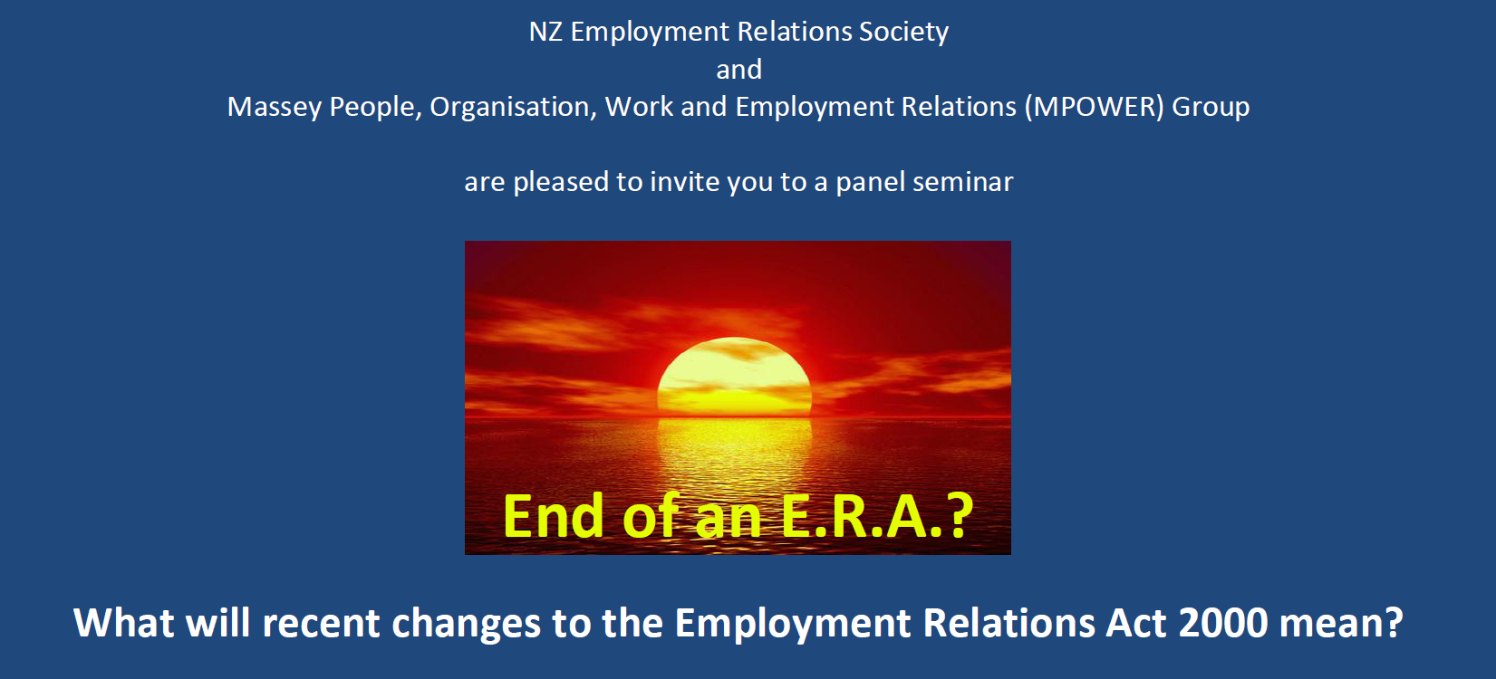


Slide 2


What will recent changes to the ERA 2000 mean?
End of an ERA?

Slide 3
What will recent changes to the ERA 2000 mean?
Employment Relations Amendment Act 2014
What has changed?
Flexible work hours
Prior to March 6th, employees with caring responsibilities were allowed to request flexible work arrangements every 12 months and employers were required to respond within three months. The new law extends the right to any employee. There is also now no limit on requests and employers have a month within which to respond.
Rests and meal breaks
In 2008, minimum paid rest breaks and unpaid meal breaks were established in law. The new law removes the requirement to provide such breaks if restrictions are deemed reasonable and necessary having regard to the nature of the work, although employers are required to provide a reasonable compensatory measure, such as the equivalent time off at the end of the working day.
Part 6A
From December 2004, under Section 6A, ‘vulnerable employees’, namely those providing cleaning, food catering, caretaking or laundry services in specified sectors (i.e., school, hospitals or residential care sectors, airports, public service), had special protections in the event of a restructuring. Under the new law, any company with less than 20 employees is exempt from these requirements under Section 6A.
End of an ERA?

Slide 4

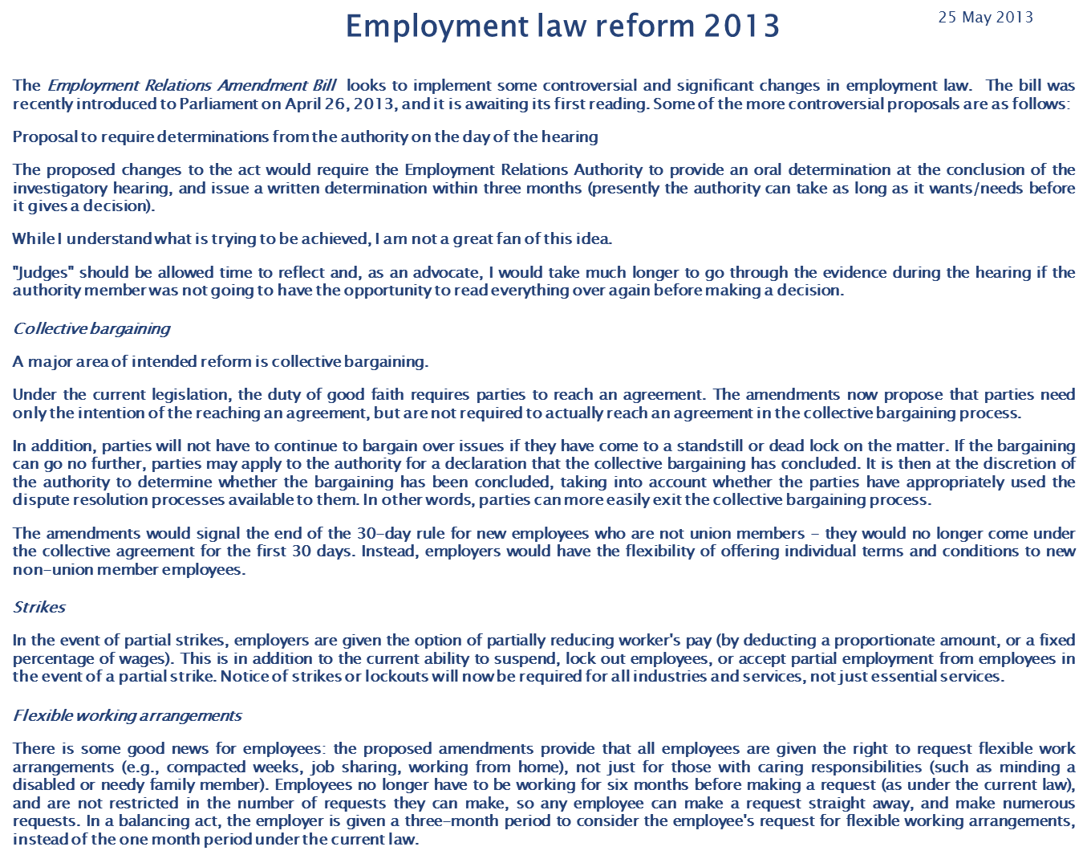
What will recent changes to the ERA 2000 mean?
Employment Relations Amendment Act 2014
A major area of intended reform is collective bargaining.
End of an ERA?

Slide 5
What will recent changes to the ERA 2000 mean?
Employment Relations Amendment Act 2014
What has changed in collective bargaining?
Good faith
Removes the requirement to conclude a collective agreement, and protects against stalemate by allowing a declaration to be sought from the Employment Relations Authority as to whether bargaining has concluded. If it is so declared, neither party can start bargaining again for at least 60 days after the declaration, unless they both agree.
Multi-employer collective agreements
Previously, if a workforce voted to be covered under a multi-employer collective agreement (MECA), the employer was required to join the negotiations. The new law will allow employers to opt out of a MECA. Opponents argue it will undermine the sort of bargaining that has set industry standards.
Continuation of collective agreements
Previously, a collective agreement continued in force for up to 12 months after it expires, only if the union initiated bargaining before the collective agreement expired and bargaining is still taking place. Under the changes a collective agreement also continues if an employer has initiated the bargaining.
End of an ERA?

Slide 6
What will recent changes to the ERA 2000 mean?
Employment Relations Amendment Act 2014
What has changed in collective bargaining?
Initiating bargaining
The law previously gave unions a window of opportunity to make sure they could take the lead in determining the parties to the bargaining and the approach. The change means the 60-day period (or 120 days before the date on which the last applicable collective agreement expires where either party desires to consolidate bargaining of more than one collective agreement) will apply to both unions and employers and it will see a return to competition over who initiates bargaining first, to gain the advantage of the "head-start".
Thirty day protection
The amended legislation removes the requirement that employers offer new employees at least the same terms and conditions for 30 days of employees doing the same work as those covered by a union, even if the new employee does not belong to a union.
Strikes and lockouts
The law change ends open-ended strikes or lock-outs. All employees and unions, not just those certain essential industries (as was the case), will have to give written notice of industrial action. Notice must include a start and finish date. Likewise for lock-outs by employers. The new law also gives employers the power to deduct 10 per cent of an employee's pay for partial strike action or reducing an employee’s pay by a proportionate amount (using a four-step formula).
End of an ERA?

Slide 7
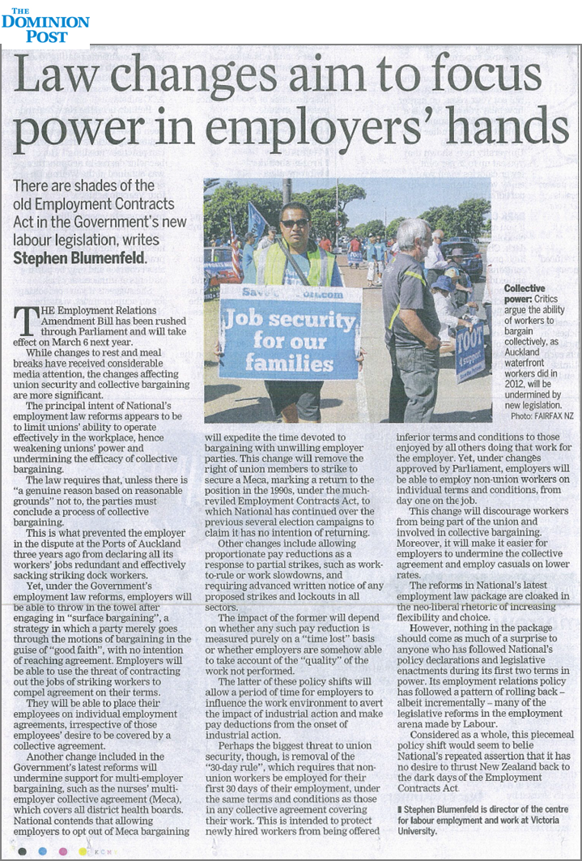

What will recent changes to the ERA 2000 mean?
Tuesday Nov 11, 2014
End of an ERA?

