Slide 1
MPOWER-The Warehouse Group Ltd Collaboration Launch
A Seminar on ORGANISATIONAL LEADERSHIP AND DIVERSITY
Tuesday May 5th, 2015
The Warehouse North Shore
Auckland
The Business of Inclusion: Through a “Living” Wage?
Prof. Stuart C. Carr
End Poverty & Inequality Cluster (EPIC)
Industrial & Organisational Psychology Programme
Massey University, Auckland
Acknowledgements:
Vice-Chancellor’s Discretionary Research Fund, Massey University
Programming Analyst Mr. Harvey Jones, School of Psychology

Slide 2
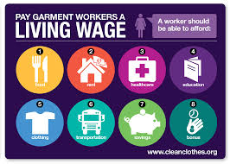
Some Global and Local CONTEXT
UN Sustainable Development Goals (SDGs)
SDG 8 – Decent Work Agenda (ILO), e.g., Inclusion
Living Wage debate, ‘hot’ topic!
E.g., in USA, UK, NZ, Colombia, Cambodia, Papua New Guinea
Often framed around wellbeing and welfare
But also, increasingly, as having Business Case
A Living, LEADING Exemplar: your CAREER RETAILER WAGE - Ka pai!

Slide 3
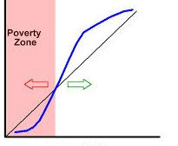
Income Today
Where might WE add some value? First, SOME APPLIED THEORY:
- Poverty Traps, Capability theory, Diminishing Marginal Returns
Income Tomorrow
And
CAPABILITY?
ñ
LIVING WAGE THRESHOLD?
Source: Carr, S. C., Parker, J., Arrowsmith, J., & Watters, P (2015). The Living Wage: Theoretical integration and an applied research agenda.ILO’s International Labour Review, in press.

Slide 4
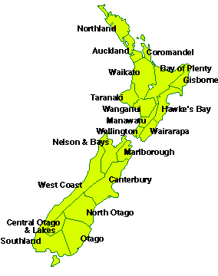
What more could applied ‘research’ possibly bring? E.g., Ongoing activity: WageingWell (Phase 1, Time 1, soon Time 2!)
Consultative process (with unions, firms, stakeholders)
Online mobile-assisted survey experience
Very preliminary – still in process; 1st glimpses emerging from Wave1…
Sample biases – modally: twin-occupants 0 kids, 1 F/T fixed income, ¾ women, age 51-65 yrs., professional, large public org. employer
Incomes: Household mode = $100-119K; individually – mean $65K, hourly $26.44
However: N = 1,185, well-distributed geographically across wider New Zealand:-
Measures: Empowerment, Job Satisfaction, Occ. Pride & Work Justice
Plus: Life Satisfaction, Wellbeing (physical and mental), & Community Participation
Work-life Balance

Slide 5
Where could we go with a collaboration?
E.g., with a large major organization
With global supply chains
(http://www.fairwageguide.org/)
Systematically, over time, assess the “living dynamics” of a living wage initiative
Continuing to center around shared prosperity
Inclusion
Decent Work, i.e.,
Human & Organisational Capability… ???

