Slide 1
Prototype
Genuine Progress Indicator for New Zealand: 1970-2006
Presentation to Sustainable Otautahi Christstchurch
University of Canterbury
12 March 2012
Professor Murray Patterson
School of People, Environment and Planning
Massey University

Slide 2
NZ GPI Research Team
Research Leader: Prof Murray Patterson
Research Team (Socio-Economic Components):
  Dr Garry McDonald,
  Jenna Zhang
  Derrlyea Hardy
  Nicky Smith
Research Team (Environmental Components):
  Vicky Forgie, Robbie Andrew
  Dr Nancy Golubiewski,
  Bruce Taylor, Nick Potter, Hillary Phipps
External Audit Panel:
  Prof Eric Neumayer (London School of Economics)
  Prof Martin O’Connor (University of Versailles)
  Dr Philip Lawn (Flinders University)

Slide 3
Roadmap
Why a Genuine Progress Indicator?
History of the Genuine Progress Indicator
  (World-wide, NZ)
Results: New Zealand GPI

Slide 4
Rationale
Primary Motivation = to develop a better measure of societal progress than the GDP
GDP was never intended to be a measure of the nation’s welfare
“the welfare of a nation can scarcely be inferred from a GDP” (Kuznet 1934)
GDP measures ‘the amount of production of goods and services in the economy’

Slide 5
Where the GDP Gets it Wrong!
Boundary Problem (doesn’t include external costs and benefits)
  household work (benefit)
  ecosystem services (benefit)
  soil erosion (cost)
GDP Incorrectly includes some “costs” as benefits
  car accident
  pollution event
Equity Problem
  $ income poor person > $ income rich person
Failure to take account changes capital stock
  particularly natural capital (eg, depletion of Maui gas field)

Slide 6
Genuine Progress Indicator: Quick Overview
Developed from Daly and Cobb (1990)
Measures societal progress across economic, social and environmental spheres
Based on welfare theory from neoclassical (conventional) economics
It is one of many measures of “societal progress”
  But, the most widely used, most widely accepted.
  Refer to Patterson (2002) for coverage of other indicators.
5. Standard international template, allows comparison between nations – we altered this in the NZ GPI

Slide 7
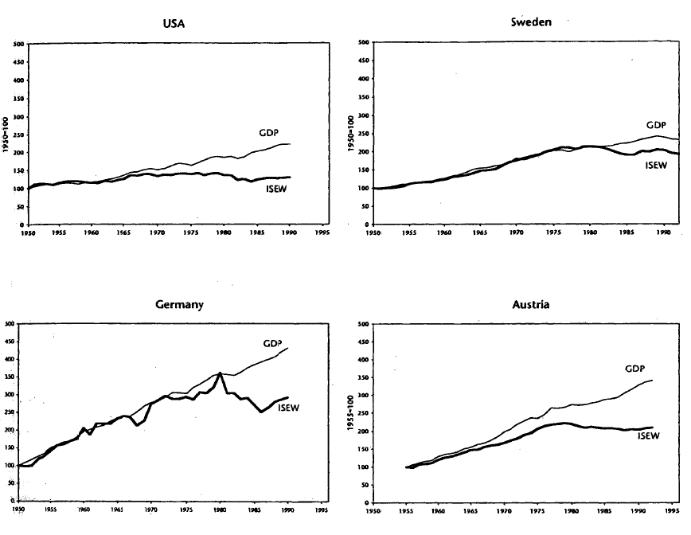

Slide 8
Paradigm Shift in Last 5 Years
Two years after the Stiglitz-Sen-Fitoussi report: What well-being and sustainability measures?" Conference organised by France and the OECD to take stock of initiatives and reflections at national and international levels.
> Download conference programme - 12 October 2011 (pdf, 580 kb)
> Watch video - 12 October 2011
European Parliament resolution underlines that the Rio+20 Summit should deliver an alternative model to measure growth and welfare 'beyond GDP'.
> Read resolution, European Parliament - 29 September 2011
European Commission proposes provisional set of resource efficiency indicators and launches a two-year stakeholder process to further improve them.
> Read section 6 of policy paper on resource efficiency in English, French and German
> Read annex 6 on indicators and targets (pdf, 4.6 mb)
20 September 2011
Eurofound's third European Quality of Life Survey: Field work to start in September 2011
> Read more about the field work, Eurofound - 9 September 2011
Huge response in national debate will help statisticians create the UK's first set of national well-being indicators. The report "Measuring what matters" summarises the key findings and outlines the next steps in the measurement of national well-being.
> Download report (pdf, 1.3 mb) - 27 July 2011
> Download supplementary papers from the Office for National Statistics website - July 2011
> Read news article, BBC - 25 July 2011
OECD Chief Statistician presents Better life and other initiatives to measure well-being and progress at UK National Well-being Event
> Download OECD presentation (pdf, 970 kb) - 25 July 2011
OECD reaffirmed its strong commitment to support more inclusive measures of growth at the conference: "New Directions in Welfare 2011" held in Paris, France on 6 July 2011
> Read Secretary-General Angel Guirria's opening remarks
> See conference programme and presentations
Final report of the research project "Well-being 2030 - A new vision for 'Social Europe' aims to bring the insights of the research on well-being definition and measurement into the policy debate over the long-term future of Social Europe:
> Download report
19 July 2011
European Policy Centre
UK podcast explains existing measures of economic well-being
> View podcast, Office for National Statistics - 19 July 2011
Finnish expert group proposes that a new set of indicators should be developed to improve the assessment of wellbeing.
> Read press release - 5 July 2011 (in English, Finnish and Swedish)
> Read news article from YLE (Finnish or Swedish) - 5 July 2011.
> Download report (in Finnish, pdf, 1.1 mb)
Commissioner Janez Potočnik welcomes adoption of Beyond GDP Report and new Regulation on Environmental Economic Accounts. These outcomes demonstrate broad consensus that human development and wellbeing is about more than what we can measure through monetary values, he points out in a statement issued after the vote.
> Regulation on Environmental Economic Accounts - 7 June 2011 (in all EU languages)
> Read Commissioner Potočnik's statement - 8 June 2011
Beyond GDP resolution adopted by European Parliament. The final vote in the plenary session showed broad support to the resolution which has been discussed in six EP Committees. The Commission is now to come up with concrete ideas for new indicators, says Rapporteur Anna Rosbach.
> Resolution on GDP and beyond: measuring progress in a changing world - 8 June 2011
> Read interview with rapporteur Anna Rosbach - June 2011
> See opinions and documents from debate in EP Committees
Regulation on Environmental Economic Accounts adopted by the European Parliament. In the debate in plenary preceding the vote, several speakers underlined the importance of measuring aspects of progress relating to the environment. This is the first out of five actions proposed in EU Roadmap 2009 to be implemented.
> View press briefing by Jo Leinen, Rapporteur and Chair of EP Environmental Committee - 7 June 2011
> Read EP press release, - 7 June 2011
> View debate in the European Parliament, - 6 June 2011
> See transcript of debate in the European Parliament - 6 June 2011
> Regulation on Environmental Economic Accounts - 7 June 2011 (in all EU languages)
German chancellor Angela Merkel supports the efforts to develop a new, alternative measure of prosperity. She emphasises the need to integrate the value of natural capital in economic accounting.
> Read Chancellor Angela Merkel's speech (in German), Federal Chancellor's website - 24 May 2011
Your Better Life Index - new, interactive measure of well-being
OECD launches new online tool which lets people measure and compare their lives in a way that goes beyond traditional GDP numbers.
> Go to Your Better Life Index.
> Read press release. - 24 May 2011
> Watch video
The Belgian web-docu "le bonheur brut", which deals with alternative indicators of economic growth, received this year's Dexia award in the category Business and Financial Press.
- News article - 28 April 2011, Le Soir (in French)
- Official press release - 28 April 2011, Dexia (in French and Dutch)
- Go to web-docu "Le bonheur brut" (in French)
UN responds to concerns and critiques about the Human Development Index and makes changes to the choice of variables and the functional form. Report explains the rationale behind new HDI.
> Download "The Human Development Index 2010: New Controversies, Old Critiques" (pdf, 740 kb)
April 2011
UNDP
> Read more on the UNDP website
Growing international interest among leading politicians in new British happiness index
> Read article (in German)
18 April 2011
Der Standard
New public attitude survey shows slight increase in the average rating of 'life satisfaction' in England.
> Read more about the survey, Department for Environment, Food and Rural Affairs - 13 April 2011
The report "Consumption Dilemma - Leverage Points for Accelerating Sustainable Growth" questions rising GDP as an appropriate measure of success.
> Download report (pdf, 1.4 mb), World Economic Forum - April 2011
The Eurostat conference on "Statistics for policy making: Europe 2020" took place on 10 & 11 March 2011 in Brussels. President Barroso, Commissioner for Environment Potocnik, OECD Chief Economist Padoan, Belgian Minister of Finance Reynders and others confirm that measuring progress needs to go beyond GDP.
> View video of opening speeches
> Download:
Conference leaflet with programme, presentations and speeches (pdf, 8.8 mb)
> Opening speech of President Barroso
> Speech of Commissioner Potočnik
> Speech of OECD Chief Economist Padoan
> Conclusions by Commissioner Rehn
India/China comparison must go beyond GDP, says Amartya Sen, Nobel price winner in economics
> Read article, The Hindu - 14 February 2011
Global poll shows continued strong public support for going beyond GDP
> Read article, GlobeScan - 21 January 2011
German parliamentary committee starts the work to develop new indicator of prosperity
> Read article (in German), Handelsblatt - 21 January 2011
New update of the Sustainable Society Index, SSI-2010, is now available
December 2010
Sustainable Society Foundation
"What's life like in Italy?" (in Italian)
- updated index of the quality of regional development in Italy.
16 December 2010
Sbilanciamoci Campaign
Italian debate on the importance of going beyond GDP when measuring wealth
(in Italian with an English transcript)
12 December 2010
TV programme report on Rai Tre
Chancellor Merkel and President Sarkozy received the joint report on measuring progress from the economic advisory councils of Germany and France
10 December 2010
Related news article in Handelsblatt (in German)
The German Prosperity Quartet combines four measuring instruments to record the prosperity of societies
7 December 2010
Denkwerk Zukunft
The German Bundestag has established a Study Commission on growth, well-being and quality of life in terms of sustainable development and societal progress
> Read mandate (pdf, 39 kb) - 23 November 2010 1 December 2010 bundestag.de
Read news article - 1 December 2010 (in German)
Can biodiversity become a parameter for measuring the wealth of nations?
29 November 2010
seedmagazine.com
Cameron turns to statistics to measure happiness
15 November 2010
The Guardian
David Cameron aims to make happiness the new GDP
14 November 2010
The Guardian
Parliamentary Committee in Germany to develop new indicator of prosperity (in German)
12 November 2010
Sueddeutsche.de
Germany debates over new committee to discuss GDP questions (in German)
22 October 2010
Welt Online
EU Committee of the Regions supports Commission's beyond GDP agenda and requests use of complementary indicators to GDP for regional development policies
5 October 2010
Opinion of the EU Committee of the Regions
New insights into the economy, quality of life and sustainable development (in French)
4 October 2010
INSEE
INSEE (Institut National de la Statistique et des études économiques) reporting on work done, one year after the Stiglitz Commission report. (in French)
4 October 2010
The European Week of Regions and Cities includes several beyond GDP workshops. The final programme is now available.
Brussels, 4 - 7 October 2010
4 and 5 October, Flanders and the EU Committee of the Regions organise an Open Days 2010 workshop on indicators and policies for sustainable development.
17 September 2010
The EU Committee of the Regions has published a summary of contributions to new indicators for measuring the progress of societies, and calls for contributions to the Opinion it will be preparing.
15 September 2010
European Commissioner Olli Rehn's concluding remarks at the conference "Economic Growth for Better Quality of Life in Europe".
14 September 2010
Austrian Foreign Minister calls for different measurement of economic growth (in German)
18 August 2010
Die Presse
Eurofound publishes survey on trends in Europeans' quality of life 2003-2009
12 August 2010
UK publishes its annual statistical review of the country’s progress:Measuring progress: Sustainable development indicators 2010
30 July 2010
Department for Environment, Food and Rural Affairs
Social Indicators extensively discussed at World Congress of Sociology
11-17 July 2010
Online tool allows users to calculate and compare their life situation with the Dutch Life Situation Index
8 July 2010
Netherlands Institute for Social Research
Coordination of Agenda 21 in Italy results in a survey on environmental accounting which examines the experience of over 100 local authorities
(in Italian)
Clear Environmental and Reporting Project
May 2010
The Rise and Fall of the G.D.P.
The New York Times
15 May 2010
Eurostat launches dedicated webpage on its work on complementary indicators to GDP
10 May 2010
The European Economic and Social Committee welcomes the Commission's communication Beyond GDP - Measuring progress in a changing World and the initiatives it outlines.
29 April 2010
European Commission delivers first item of the Beyond GDP roadmap: the proposal for an EU Regulation (in all 23 EU languages) on integrated environmental economic accounting.
9 April 2010
Study by the National Bank of Slovakia discusses the weaknesses of GDP and suggests alternative approaches to measure quality of life
April 2010
National Bank of Slovakia
Full report (in Slovak)
Non-technical summary (in English)
Wuppertal Institute publishes report "Alternatives to GDP for Measuring Progress"
April 2010
Eurofound publishes its Second European Quality of Life Survey
25 March 2010
Janez Potocnik, European Commissioner for Environment, calls for the right indicators to induce the right changes.
23 March 2010
GDP understated the depth of the latest recession and may be overstating the pace of recovery, a Federal Reserve economist said
18 March 2010
European Commission adopts Europe 2020 strategy, saying:
The European Commission will monitor annually the situation on the basis of a set of indicators showing overall progress towards the objective of smart, green and inclusive economy delivering high levels of employment, productivity and social cohesion.
3 March 2010
Wales Assembly Government proposes to gauge overall life satisfaction
Western Mail
1 March 2010
EU Committee of the Regions consults on GDP and beyond
Deadline 16 April
March 2010
Progressive thinking - It is time to abandon GDP as the overriding measure of social development and economic health.
17 February 2010
Nature 463, 849-850
German Chancellor Angela Merkel wants EU to reflect on outcomes of the Stiglitz-Commission (in German)
6 February 2010
die tageszeitung
Video podcast from Angela Merkel (in German)
French President Nicolas Sarkozy and German Chancellor Angela Merkel agree to propose new growth indicators for the EU.
News article on the French-German summit
Conférence de presse conjointe Sarkozy & Merkel
Gemeinsame Pressekonferenz Merkel & Sarkozy
Entscheidungen im Bereich Wirtschaft, Finanzen, Beschäftigung
Décisions en matière de economie, finances et emploi
4 February 2010
Is GDP an Obsolete Measure of Progress?
Time Magazine
30 January 2010
Measuring Welfare in Germany - A suggestion for a new welfare index.
January 2010
Research Centre for Environmental Policy / Protestant institute for interdisciplinary research
Climate Change, GDP and measurements of prosperity
18 December 2009
Side event of the EESC at the Climate Conference in Copenhagen
In the matter of happiness money doesn't play a role.
15 December 2009
Financial Times Deutschland (in German)
Summary (in German)
German Chancellor Merkel expressed interest in the work of Stiglitz Commission (in German)
23 November 2009
President of France's statistical office presents roadmap on implementation of the Stiglitz-Commission recommendations - summary (in French)
17 November 2009
Council of the EU welcomes Commission Communication "GDP and beyond"
10 November 2009 on EU Statistics and
21 October 2009 on Eco-efficient economy
OECD releases conclusions of the 3rd OECD World Forum, including the OECD Roadmap on measuring and fostering well-being and progress
29 October 2009
European Commission President Barroso said that GDP could no longer be the sole major measure of progress
Full speech
Audio-visual press material
27 October 2009
The Prime Minister's Office and Statistics Finland have built a new, free online service called Findicator containing around 100 indicators describing social phenomena
14 October 2009
European Parliament resolution on the Pittsburgh G20 Summit calls for new indicators for sustainable development that go beyond GDP measuring well-being and environmental impact
8 October 2009
Media coverage on the Commission Communication "GDP and Beyond" and other recent international initiatives
October 2009
Newly released: BellagioSTAMP principles for sustainability assessment
3rd OECD World Forum “Charting Progress, Building Visions, Improving Life”
27-30 October 2009, Busan, Korea
India says aims for green GDP alternative by 2015
13 October 2009
Reuters India
Sustainability analysis of Italian regions (in Italian)
A study by the University of Pisa ranks Italian regions according to performance in terms of sustainable development.
September 2009
University of Pisa
G20 encourages work on measuring progress more comprehensively
Leaders Statement: Pittsburgh summit
25 September 2009
Final report of the Stiglitz Commission on the measurement of economic performance and social progress
14 September 2009
EU Commission presents Communication “GDP and beyond” to stakeholders
8 September 2009
Well-being must increase, not gross national product (in Swedish)
23 August 2009
Dagens Nyheter
EU Commission adopts Communication “GDP and beyond”, the EU roadmap to go beyond GDP
20 August 2009
G.D.P. R.I.P.
9 August 2009
New York Times
The struggle against GDP (in German)
15 July 2009
Financial Times Germany
Stiglitz Commission releases draft summary for public comment
June 2009
We need to rethink the notion of progress (in French)
8 June 2009
Le Monde
Growing better (in German)
23 April 2009
Die Zeit
The deficits of statistics (in German)
26 March 2009
Die Zeit
Beyond GDP Conference Proceedings
The full proceedings of the Beyond GDP Conference are online and available for download.
4 March 2009
Professor Stiglitz outlines the work of the French Commission on the Measurement of Economic Performance and Social Progress
February 2009
A More Humane Way to Measure Progress
How can you tell if your life is getting better? One answer is to ask a statistician. The problem, however, is that you might not like, understand or remotely identify with the answer you receive.
31 January 2009
Financial Times
De-fetishising GDP
Supplement, do not supplant, gross domestic product
29 January 2009
Financial Times
A measure remodelled
Growth indicators - With more economists denouncing GDP as 'a mirage' that ignores the social worth of an activity, the search is on for other yardsticks - but each will have its snags.
27 January 2009
Financial Times
new economics foundation releases report on National Accounts of Well-being
24 January 2009
Research Report "Measurement of Welfare in Germany - A proposal for a new welfare index" published. (Summary - Forschungsbericht in German, 2 MB)
December 2008
Beyond GDP Newsletter # 1 published
December 2008
European Economic and Social Committee adopts opinion on Beyond GDP
22 October 2008
Need to look beyond GDP
3 October 2008
The Times of India
Le bonheur est dans la "richesse véritable", pas dans la croissance
6 septembre 2008
Les Affaires
Economists look to expand GDP to count 'quality of life'
1 September 2008
International Herald Tribune
Issues Paper of the Commission on the Measurement of Economic Performance and Social Progress released by Stiglitz Commission
25 July 2008
Commission on the Measurement of Economic Performance and Social Progress
Walter Radermacher, President of the German Statistical Office and designated Director General of Eurostat speaks on the topic of "Beyond GDP - providing the basis for a future-orientated sustainable economic policy"
16 July 2008
Representation of the State of Hessen to the European Union
Terra Futura: dal Pil alla decrescita per sviluppo e benessere
24 maggio 2008
dirittiglobali.it
European Parliament resolution of 24 April 2008 on the Green Paper on market-based instruments for environment and related policy purposes
Welcomes the recent conference "Beyond GDP" organised by the Commission, the European Parliament, the OECD, the WWF and the Club of Rome, and the major conclusions drawn; stresses the importance of complementing GDP by other indicators so as to assess welfare and progress in society in a more balanced way, in particular with regard to the effects of economic growth on the atmosphere and ecosystems;
24 April 2008
European Parliament
Maybe money does buy happiness after all
16 April 2008
New York Times
Wachstum durch Zufriedenheit
Vom Glück, Franzose zu sein
Ist Glück messbar? Lässt sich die Zufriedenheit einer Nation statistisch erfassen? Mit dieser Frage beschäftigt sich derzeit der ökonom und Nobelpreisträger Joseph Stiglitz im Auftrag des französischen Staatschefs Sarkozy, der kritisiert, dass die heutigen Statistiken nur quantitativ statt qualitativ messen.
15 April 2008
Frankfurter Rundschau
L'altro Modello (video)
16 marzo 2008
Rai Tre
Richesses? Débat
13 mars 2008
La Vie
Se busca alternativa para medir el bienestar
3 February 2008
Gara
Sarkozy sucht das GlÜck
12. Januar 2008
NZZ Online
Amartya Sen: "Non si vive di solo Pil"
11 gennaio 2008
ILSOLE24ORE
French Use Happiness As Economic Measure
10 January 2008
USA Today
La croissance ne se résume pas au PIB: Sarkozy puise é gauche
9 janvier 2008
rue89
Beyond GDP Conference Summary now available
4 January 2008
Beyond GDP

Slide 9
NZ GPI Research Project
Funded by the Foundation of Research Science & Technology ($400,500) & Parliamentary Commissioner for the Environment ($110,000)
Started June 2006 Ends June 2009
  National GPI:
  Regional GPI: Auckland and Waikato
Standard international template, some (stock) componnets were dropped as they should be in a sustainability measure.
Data for every year from 1970 to 2006
20 individual indicators, and one headline index

Slide 10
NZ GPI Results

Slide 11
Component Indicators of GPI
Base Data only -----→
positive
positive
positive
negative
negative
negative
X
X
positive
negative
negative
negative
Excluded as a Stock
Excluded as a Stock
Negative (positive)
Negative
(positive)
Negative
(positive)
negative
Negative
(positive)
negative
Negative
(positive)
Negative
(positive)
negative
X
Excluded as a Stock
Notes:
Really important aspect of GPI = much sure you have positives and negatives correct.
Some components: positive, negative, both, excluded.
Key Criteria = impact on welfare

Slide 12
Cautious and conservative in our estimates

Slide 13
Socio-Economic Components

Slide 14
Growing Inequity
Flat to Declining Growth:1970-1980
Strong Growth: 1991-2006;

Slide 15
Includes: education, health, community services
Doesn’t include ‘defensive expenditures’ – $ needed to eliminate/
avoid the unwanted side-effects of economic growth
– e.g. health expenditure resulting from air pollution.

Slide 16
Services from publically owned infrastructure – eg, roads and water supply
Decline during economic reforms 1984-1990 – taken a long time to recover
Not that easy to measure. Calculated as depreciation of capital stock

Slide 17
Second largest contributor to GPI (next to personal consumption)

Slide 18
Calculated on the basis of ‘involuntary leisure hours’

Slide 19
Calculated on the basis of the extra hours that a worker wants to work

Slide 20
Work more than 50 hours a week
Extra hours at average wage rate.
No 1970-1985 data, so modelled.

Slide 22
1970 -1992: Year-after-year crime got worse
1992 : turning point

Slide 23
Treat with caution.
Data has a number of assumptions.
Currently being revised.

Slide 24
Environmental Components

Slide 25
Cost of Deforestation (net loss of ecosystem services + passive values) Approx.20%
Damage caused by Pests Approx.80%
Notes:
Proxy of cost of pest control. Native Forest → Scrub, assumed for net loss of ecosystem services.

Slide 26
Most undervalued
Ecosystem!
$50,000 per hectare
per year
Based on 3 known points (1972,1983,2002) for spatial coverage – the rest interpolated
Scarcity value of 2% pa applied in the valuation

Slide 27
65% Loss of production due to Erosion
5% Ecological impacts of Erosion
30% Net loss of land due to Urban Expansion

Slide 28
Only reliable data for PM₁₀ from 1996-2006
1970 – 1995 time series regression
Air quality is improving , but more people affected.

Slide 29
Mainly cost of landfills, but also includes the clean-up costs of contaminated sites

Slide 30
Used Proxy: cost of paying for NZ’s GHG emissions.
Based on net greenhouse gas emissions:
(1) Energy & Industry (+), (2) Agriculture (+), (3) Forestry Plantings/Harvest (-/+)
Notes:
1972-1979 forestry harvestings contributed to increased cost.
Used Proxy: cost of paying for NZ’s GHG emissions.
Instead of impact of climate change on the welfare of NZers

Slide 31
($2006 million)
Notes:
Mostly non-point pollution
Point Source Pollution has improved since the 1970s.

Slide 33
Only based on traffic noise
The near-linear trend, due to near-linear increase in vehicle-km.

Slide 34
Overall Result
– Has New Zealand Progressed
since 1970?

Slide 35
New Zealand GDP vs GPI
($2006 million)
Key Findings:
1970-1984: Both indicators are similar
Since 1984: Genuine Progress Indicator less than GDP
Since 1984: The gap is widening.
Notes:
Strictly speaking they should nor be on the same axis.

Slide 36
New Zealand GDP vs GPI
($2006 million)

Slide 37
Conclusions and Caveats
Data is inadequate in number of components (cost of overwork, cost of commuting, air quality, water quality, noise pollution)
Proxies for Welfare Needed to used for some components (climate change, water quality)
Nevertheless, the overall trends in the GPI presented today robust
Challenge to the Government ...... We need a GPI, and proper resources to construct it.
Notes:
Only when data and proxy issues are resolved, then can the ‘prototype’ be dropped.

Slide 38
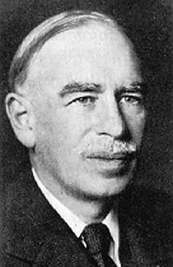
“It is better to be roughly right, than precisely wrong”.
John Maynard Keynes

Slide 39
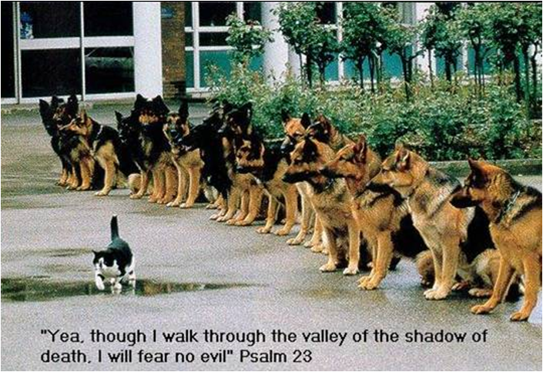

Slide 40
Thank you

