Slide 1


Slide 2

Counting the Elements…
Earth, Fire, Water, Air and Life
Graeme Wake
Professor of Industrial Mathematics
From 8th May, this lecture can be downloaded
from: http://www.mathsinindustry.co.nz

Slide 3
Other past professorial lectures on this kind of theme:
1.“Whether, whither, wither: Mathematics? ”
July 1988, Massey Manawatu
(Professor of Applied Mathematics)
2.“Hi-tech Angles”
August 1995, University of Auckland
(Professor of Industrial and Applied Mathematics)
3.“Industrial Mathematics Initiatives”
July 2003, Daejon, South Korea
(Visiting Foreign Professor in Applied Mathematics)

Slide 4



Slide 5


Outline:
Introduction:
The under-pinning role of mathematics
2. Examples:
FIRE – The story of spontaneous ignition.
WATER – Dealing with Pollution.
EARTH and AIR - Nitrogen and clover cycle.
LIFE – Cell Cycling in tumours and the “ghosts in our genes.”
3. Closing remarks:
and pointers to the future

Slide 6
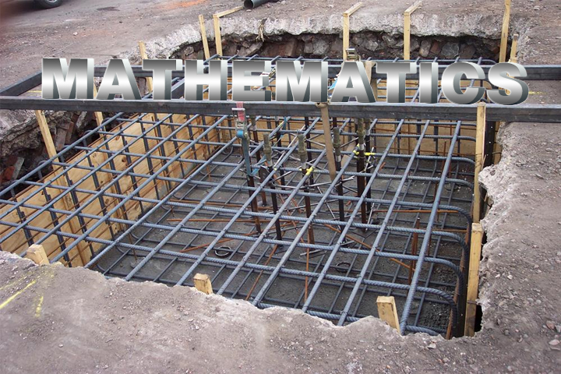
PART 1 - INTRODUCTION
The under-pinning role of
Mathematics
Question: Industrial Mathematics Initiatives
Is this an (inter) national need?

Slide 7


OECD Report: The challenge
The Academic Environment
“The academic discipline of mathematics has undergone intense intellectual growth, but its applications to industrial problems have not undergone a similar expansion.”
“The degree of penetration of mathematics in industry is in general unbalanced, with a disproportionate participation from large corporations and relatively little impact in small- and medium-sized enterprises.”
IM = Industrial Mathematics
Key Reference:
Organisation for Economic Co-operation and Development : Global Science Forum Report on Mathematics in Industry July 2008
http://www.oecd.org/dataoecd/47/1/41019441.pdf

Slide 8

IM activity has a positive spin-off, for it serves to establish better links between industry and academic mathematics.
Plus enhance the image of mathematics in the community.
We can provide improved university education of mathematicians through:
Expanded employment prospects for mathematics graduates.
Fresh research problems for mathematicians.
Innovative material for teaching courses.

Slide 9

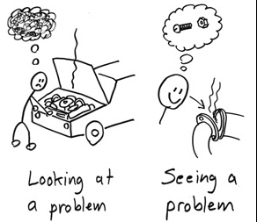
Industrial Mathematics is a distinctive activity:
It starts from a client’s problems, which, although not described by mathematics, are possibly solvable using quantitative techniques of analysis and / or computation.
Illustrative case-study examples will be described where spectacular results have been obtained in medical and engineering applications.

Slide 10



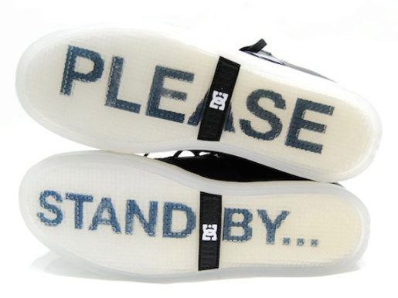
The lot of an Applied Mathematician
Applied Mathematics seems to be about finding answers to problems. These are not written down in some great book and in reality the hardest task for an applied mathematician is finding good questions.
THE TRIVIAL
There seem to be three types of problems in the real world:
THE IMPOSSIBLE
The boundaries between them are very blurred. They vary from person to person, and some of my strongest memories are of problems that suddenly jump one from category to another, and this is usually with the help of colleagues!
THE JUST SOLVABLE

Slide 11

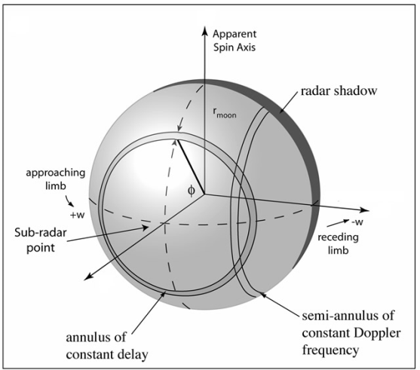
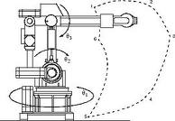
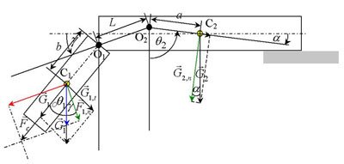
Mathematical models
Mathematical models use the language of mathematics to very effectively describe, understand and evaluate systems. Mathematical models are used not only in the natural sciences and engineering disciplines (such as physics, biology, earth science, meteorology, and engineering) but also in the social sciences (such as economics, psychology, sociology and political science); physicists, engineers, computer scientists, and economists use mathematical models most extensively.
The process of developing a mathematical model is termed 'mathematical modeling'.
The process involves a four-stage process:
Formulation - Solution - Interpretation - Underpinning Decision Support.

Slide 12


Modelling Paradigms
The 10 Commandments
Simple models do better!
Think before you compute.
A graph is worth 1000 equations.
The best computer you’ve got is between your ears!
Charge a low fee at first, then double it next time.
Being wrong is a step towards getting it right.
Build a (hypothetical) model before collecting data.
Do experiments where there is “gross parametric sensitivity”
Learn the context…the biology, etc.
Spend time on “decision support”

Slide 13
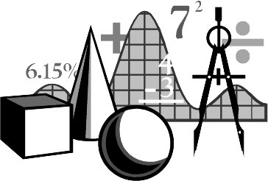
What skills are needed for Industrial Mathematics?
Breadth in the mathematical sciences + depth in some area of the
mathematical sciences.
Breadth in science, technology and commerce.
Ability to abstract essential mathematical/analytical characteristics from
a situation and formulate them in a fashion meaningful for the context.
Computational skills, including numerical methods, data analysis and
computational implementation, that lead to accurate solutions.
Flexible problem solving skills.
Communication skills.
Ability to work in a team with other scientists, engineers,
managers and business people.
Dedication to see solutions implemented in a way that
make a difference for the enterprise.
Willingness to follow through to ascertain what real impact the
modelling/analysis has had in the enterprise.

Slide 14

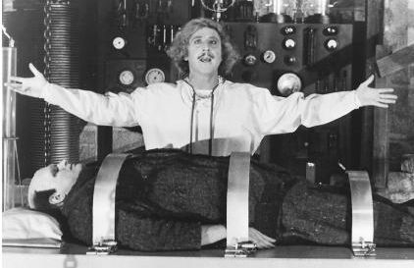
Why aren’t there more mathematical scientists in industry?
Recently the low interest in mathematics was the topic of a report in Britain entitled; “Low Interest in Mathematics set to Cripple British Industry”.
(See “Mathematics Today, IMA Bulletin, October 2003.”)
The same is true in other countries.
The necessary skills (formulation, modelling, implementation and decision support) are often not part of mathematical sciences training in universities.
Collaboration between academics and industrialists requires crossing cultural barriers with high investment costs
Often industry hires well-trained scientists/engineers with strong maths/stats background to take care of mathematical sciences issues. Why?
Industrial mathematics is often interdisciplinary and is not appreciated by the mathematical sciences community
We are not producing the right mix of graduates, especially at the postgraduate level.

Slide 15
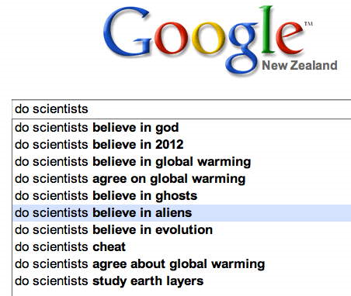
The Academic Perspective
Incentives for collaboration with industry:
Relevance of expertise to real world applications
Satisfaction arising from knowledge transfer
Source of interesting new problems?
Financial gain?
Disincentives:
“Dirty end” of science?
Career structure
Rating = function of : (research publications + teaching)‏

Slide 16

The Industry Perspective
Is mathematics actually relevant to industry?
What benefits can I expect?
What are the different mechanisms?
How much will it cost?
Why can’t I buy it today?
Only useful for long-term projects?
Will I actually understand the end result?
How can I protect our IPR?
What’s in it for academics?

Slide 17

Example Areas – G. Wake
Began * Still active
1963 (1) Thermal Ignition – Explosions Foodstuffs/Fuels *
1969 (2) Geothermal – Power
1986 (3) Water quality – weed in Lake Taupo and the Waikato
1987 (4) Cell-growth models – plants/muscle *
1990 (5) Pasture growth and utilisation
1991 (6) Population dynamics – Tb in possums
1992 (7)) Survival thresholds for Kiwis
1996 (8) Carcass composition*
1999 (10) Dairy milk quality
2000-11+ (11) Maths in Medicine*
        Muscles
        Plankton
        Tumours*
        Epigenetics – watch this space!!! *
        Foetal Growth*

Slide 18

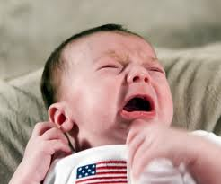
PART 2 EXAMPLES – THE ELEMENTS
life

Slide 19
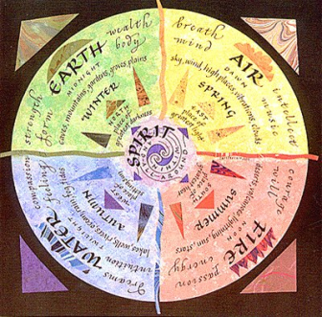
The Elements.
Fire A. Spontaneous Ignition
Earth
Water B. Pollution
Air
C. The nitrogen cycle
Life
D. Cell growth and division.
Gene expression

Slide 20
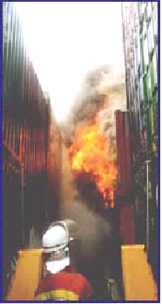
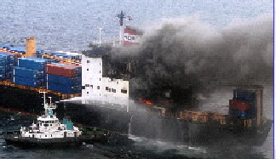
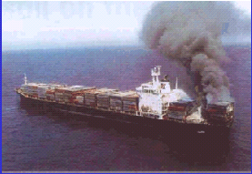
Spontaneous fires 2nd only to “arson” in the number of occurrences. Arises from “self-heating” and has been reported in a wide range of industries, in manufacturing processes, storage, or transportation

Slide 21
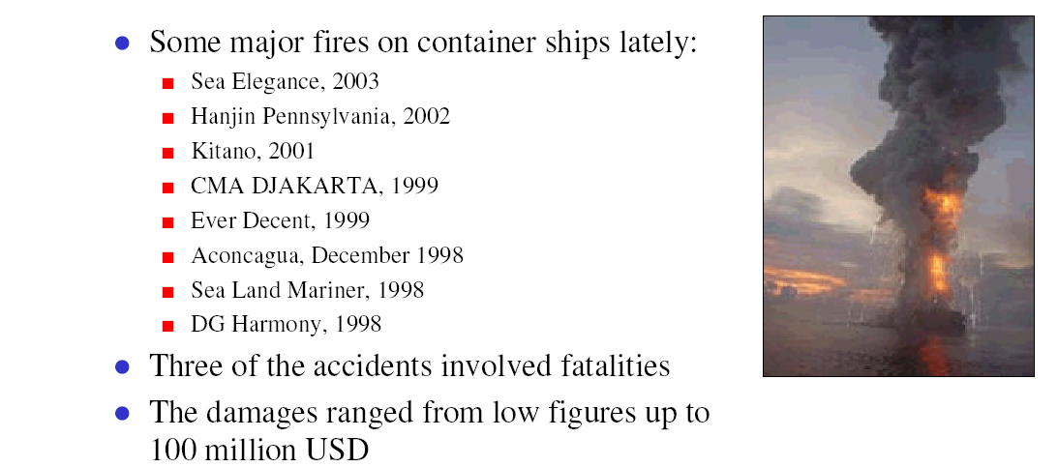
Calcium Hypochlorite
Sourced from: http://www.dnv.com/binaries/Internet%20Presentation%20Cargo%20Fires_tcm4-71851.PDF

Slide 22
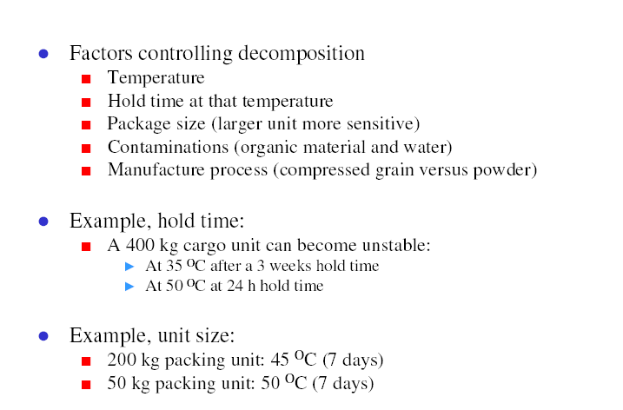
Calcium Hypochlorite
Sourced from: http://www.dnv.com/binaries/Internet%20Presentation%20Cargo%20Fires_tcm4-71851.PDF

Slide 23

Background
In many process manufacturing industries, materials are often produced at elevated temperatures and subsequently packed prior to cooling.
Some organic products (e.g. milk powder) could undergo further exothermic oxidation.
Resulting Temperature increases could degrade product or possibly lead to ignition.
Many fires have resulted from the assembly of hot materials even though the storage conditions were known to be sub-critical based on steady-state theory
(Bowes, 1984)“Storage” problem versus “Assembly” problem

Slide 24
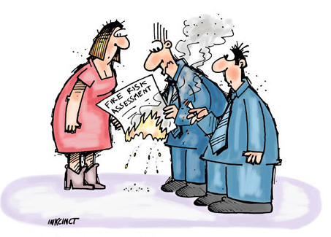


Needs
Accurate predictive capability is needed to distinguish between safe and potentially hazardous assembly and storage conditions.
Hazards Assessment / Definition of Safety Standards
Actuarial Risk Assessment / Industrial Fire Forensics

Slide 25
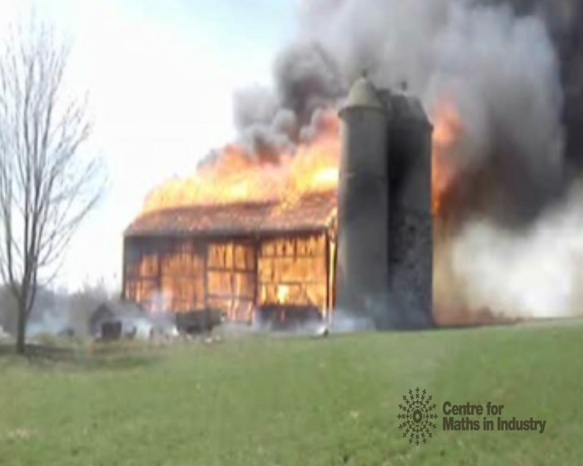
History
Previous mathematical studies of reaction-diffusion equation have deepened our knowledge and enabled predictive capabilities for thermal ignition.
  Identification of stable low-temperature & high-temperature steady-state branches
  Existence of an unstable intermediary branch
  Existence of critical ambient temperature(T_{a,cr} ) for “safe storage”
  Existence of critical initial temperature threshold (T_{o,cr} ) for “safe assembly”

Slide 26
Background Maths (grossly simplified)

Slide 27
“Cheque-book “balance act”
Rate of change of heat content:
credits
debits
0
u_{a}
u

Slide 28
“Cheque-book balance act”
We get the nonlinear heat production-transfer equation
with boundary conditions on (e.g. u= U: Dirichlet);
This formulation uses what is now called
“the Gray-Wake variables”.

Slide 29
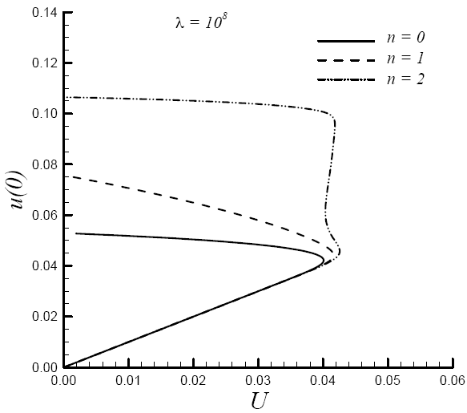
Storage problem:
8
Baseline Bifurcation Diagram: λ = 10⁸

Slide 30
Dynamic b.c.
Computational outputs:

Slide 31
Oscillatory b.c.
→ instability

Slide 32

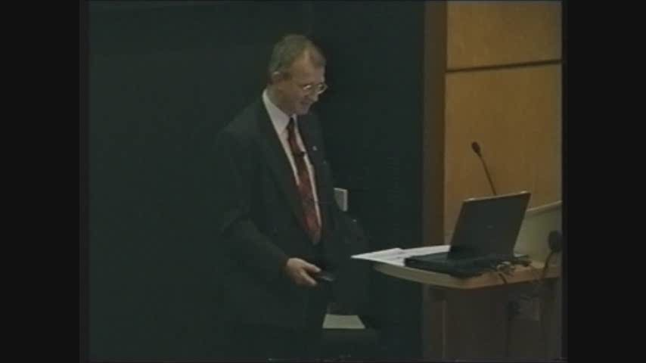
Flashover: Pike River? Professor Andy McIntosh, Leeds

Slide 33
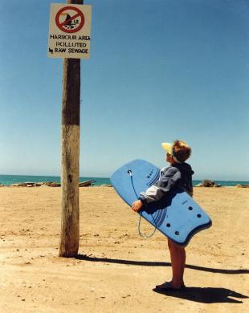
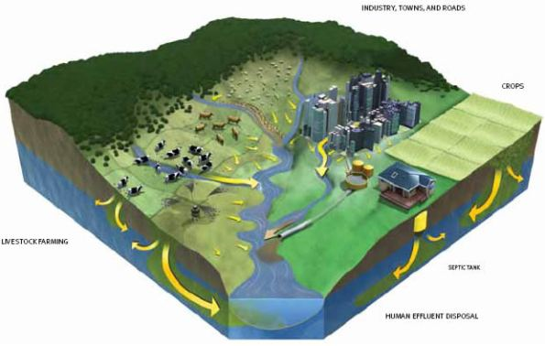
Water Pollution

Slide 34
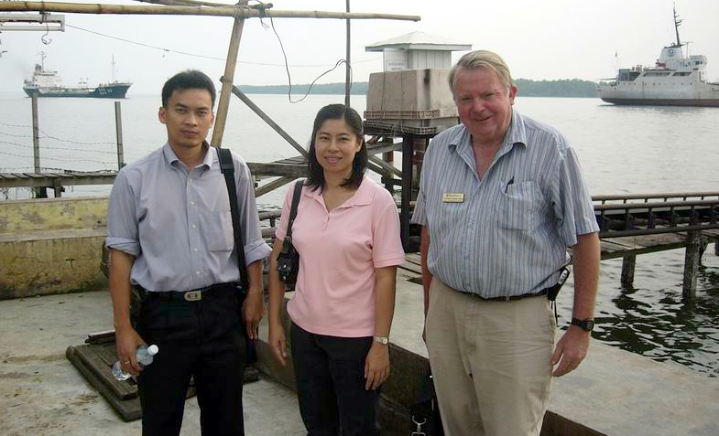
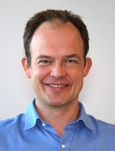
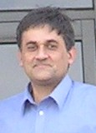




Modelling River Pollution & Removal by Aeration
Authors: Busayamas Pimpunchat, Winston Sweatman, Wannapong Triampo, Graeme Wake and Aroon Parshotam

Slide 35
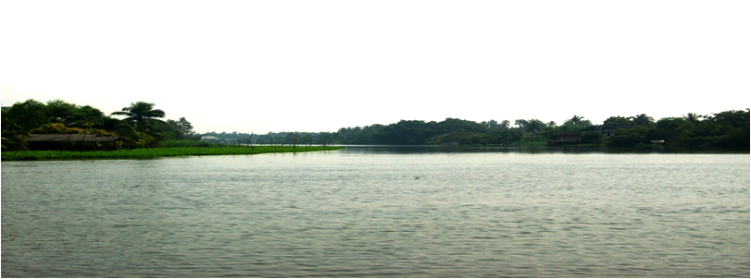
Outline
Motivation – Tha Chin River
The Model description
Special Cases of the model
Numerical procedure
Discussions and conclusions

Slide 36
Motivation
Economic activities were developed rapidly within the Tha Chin River Basin increasing amounts of contaminants discharge
Water pollution, through point and non-point sources, have become a major environmental concern in the basin
Hence, studies of mathematical models of water pollution for this basin are desirable, in order to make effective management of water quality
The Model…..

Slide 37
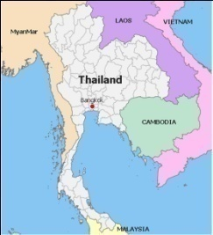
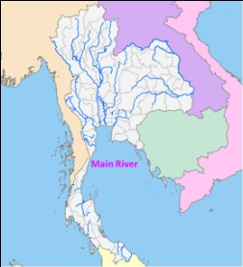
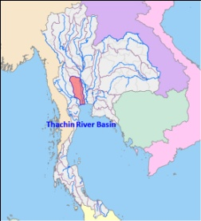
Tha Chin river
Thailand
River Basin
Tha Chin
Latitude from 6 N to 21 N
Longitude from 98 E to 106 E
Tha Chin is a major river in the Central Plain
Catchment area covering area of 13,000 km²
Population of around 2 million
Total length is 325 km

Slide 38
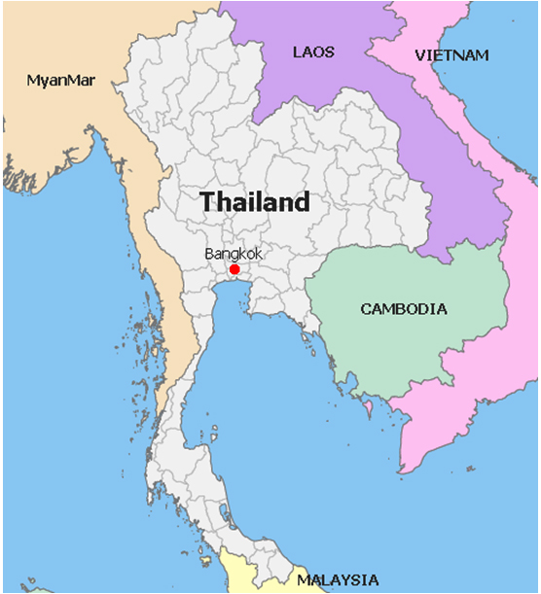
Thailand
River Basin
Tha Chin
Latitude from 6 N to 21 N
Longitude from 98 E to 106 E
Tha Chin is a major river in the Central Plain
Covering area of 13,000 km²
Population of around 2 million
Total length is 325 km

Slide 39
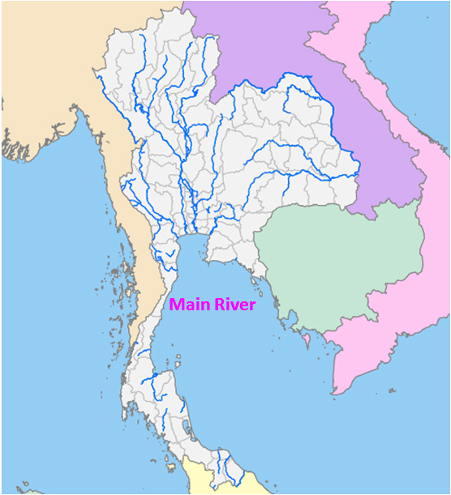
Main River
Tha Chin
Latitude from 6 N to 21 N
Longitude from 98 E to 106 E
Tha Chin is a major river in the Central Plain
Covering area of 13,000 km²
Population of around 2 million
Total length is 325 km

Slide 40
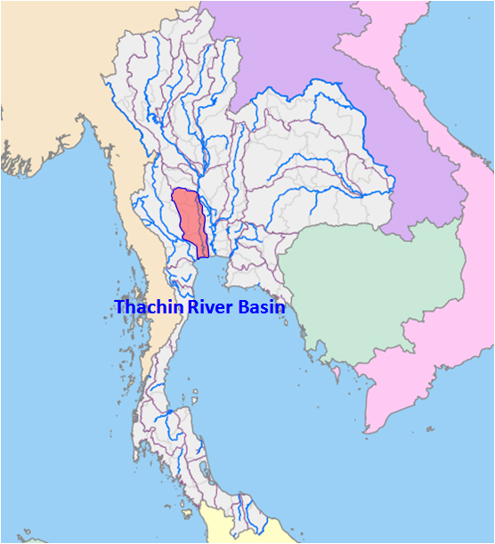
Tha Chin river
Latitude from 6 N to 21 N
Longitude from 98 E to 106 E
Tha Chin is a major river in the Central Plain
Covering area of 13,000 km²
Population of around 2 million
Total length is 325 km

Slide 41
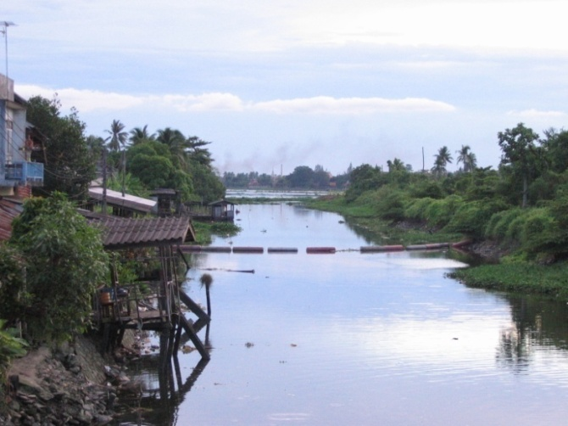
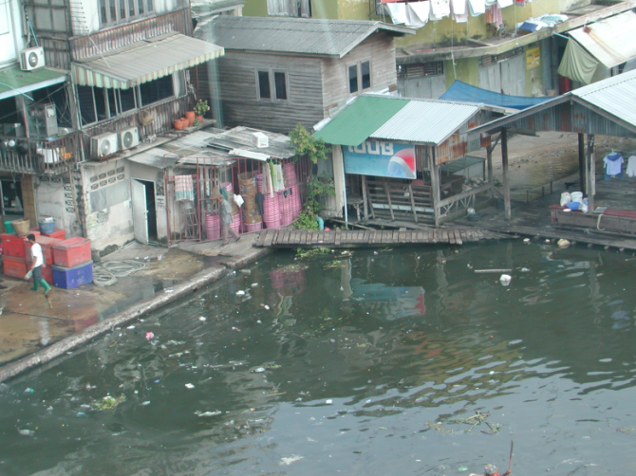
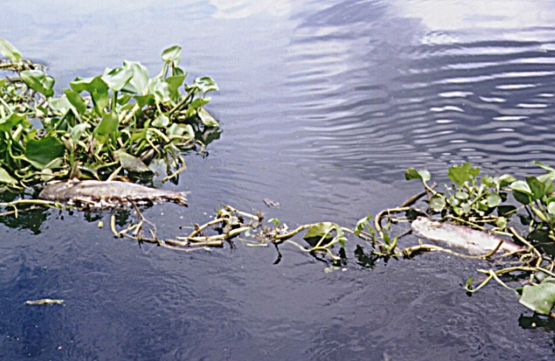
Tha Chin is one of the most polluted rivers in Thailand
(especially the lower section)
DO depletion in the river
Death of fish
Toxic Substances
Excessive nutrients
Bacteria contamination
Algae toxin
Solids contamination
In April 2000 DO: 0.0-05 mg/l
In March 2001 DO: 0.5-0.9 mg/l

Slide 42
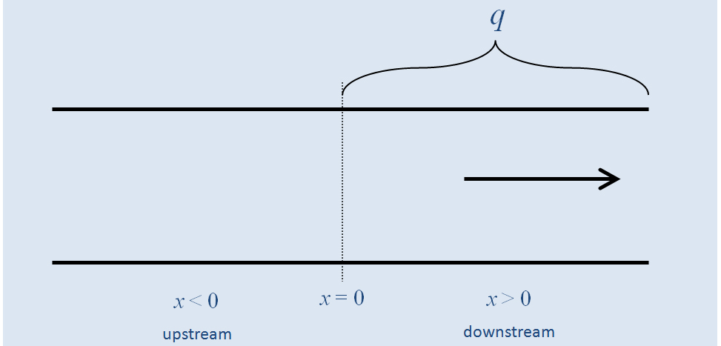
Mathematical model of water quality Edit. (clean/dirty)
Schematic picture of the river & q is the pollutant distributed source

Slide 43
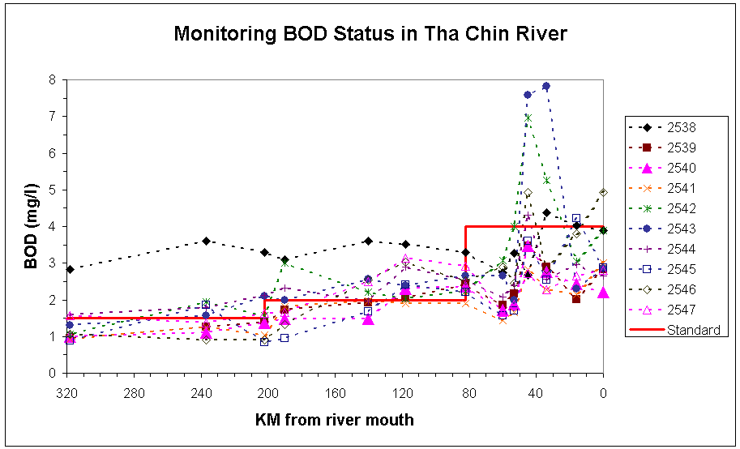
From: Tha Chin River development project: The king of Thailand’s initiative. RID

Slide 44
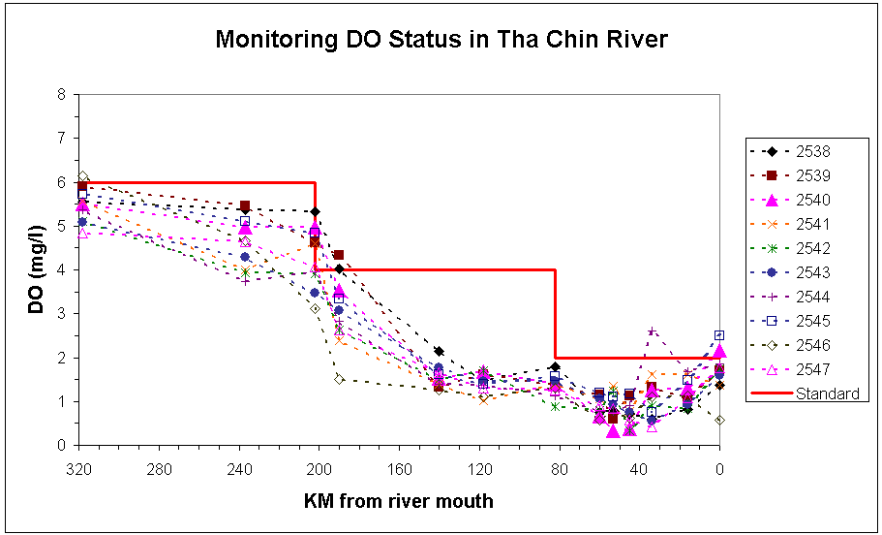
From: Tha Chin River development project: The king of Thailand’s initiative. RID

Slide 45
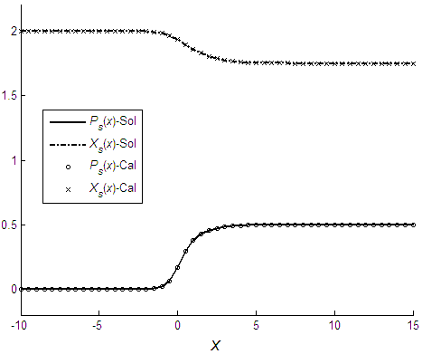
Numerical procedure reveals:
How transient solutions approach asymptotically to solution downstream
Numerical calculations agree with analytical solution under no pollution and saturated dissolved oxygen far upstream tending to a steady state far downstream for a long river DO depletion in the river.

Slide 46
Concluding remarks
Such a model and its solutions provides decision support on restrictions to imposed on farming and urban practices.
The oxygen level fortunately remains above the critical value of 30% of the saturated oxygen concentration and reaches zero far beyond the length of 325 km of Tha Chin River.
The model appeared capable of illustrating the effect of aeration process to increase DO to the water.
This constraint is not reached due to the finite length over which pollution is actually discharged and the oxygen concentration which remains above the critical threshold value provided q is low enough.

Slide 47
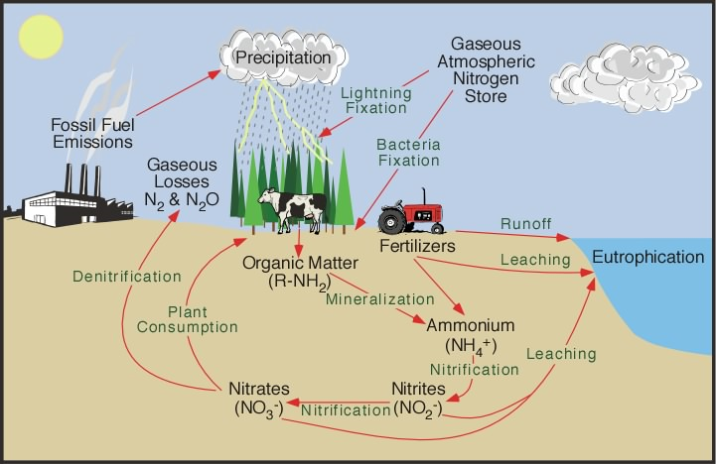
C. MODEL FOR THE NITROGEN CYCLE IN PASTURE
47

Slide 48

Introduction
Intensively grazed temperate pastures are commonly grass dominant and rate of herbage production is chronically limited by availability of soil mineral nitrogen (N).
For this reason, soil mineral N supply from mineralisation of soil organic matter is often supplemented by regular applications of fertiliser N.
Clovers in these pastures are valued for this N-fixing ability and also for their superior feed quality for grazing animals
However in some countries, including New Zealand, the major inputs to the soil-pasture-animal N cycle are from fixation of atmospheric N₂ by the clover-Rhizobium symbiosis.
48

Slide 49
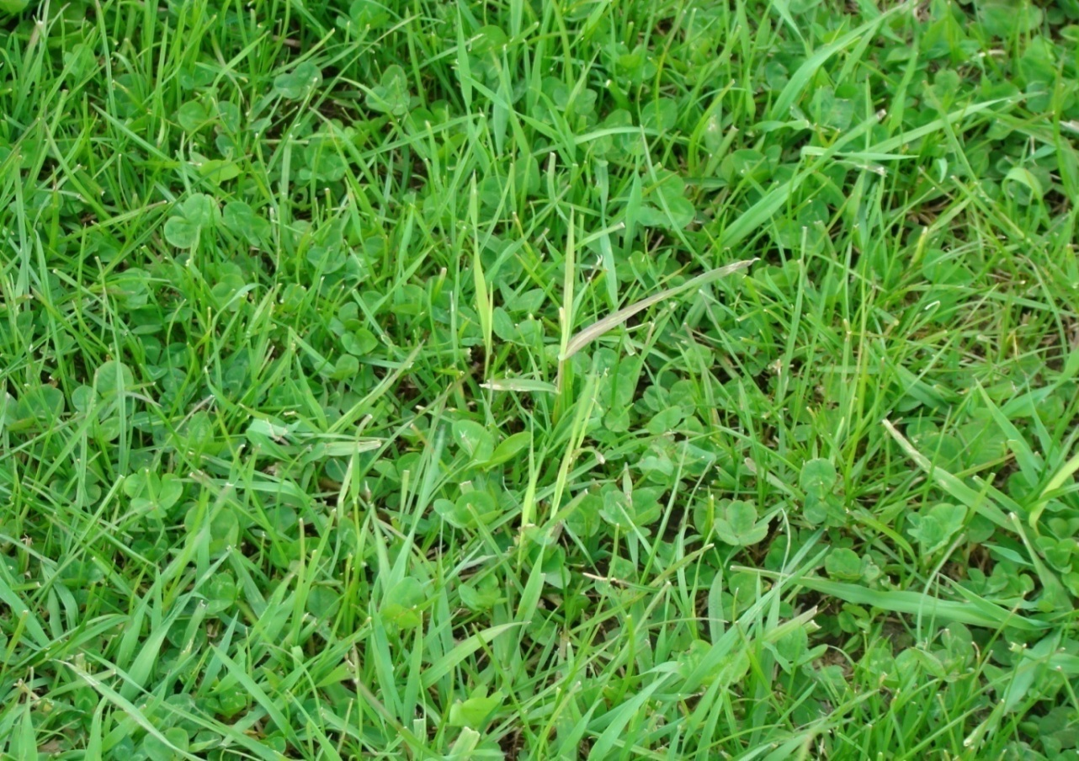
Rye grass and Clover pasture mix

Slide 50
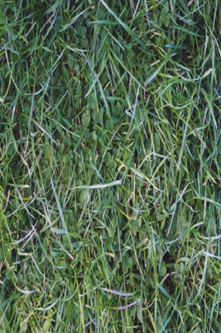
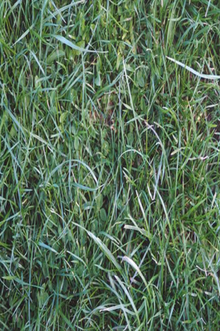
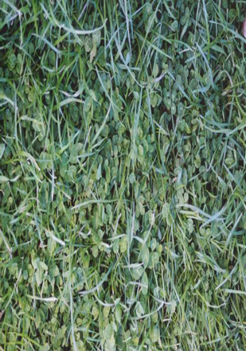

Clover Percentages
10%
20%
40%

Slide 51
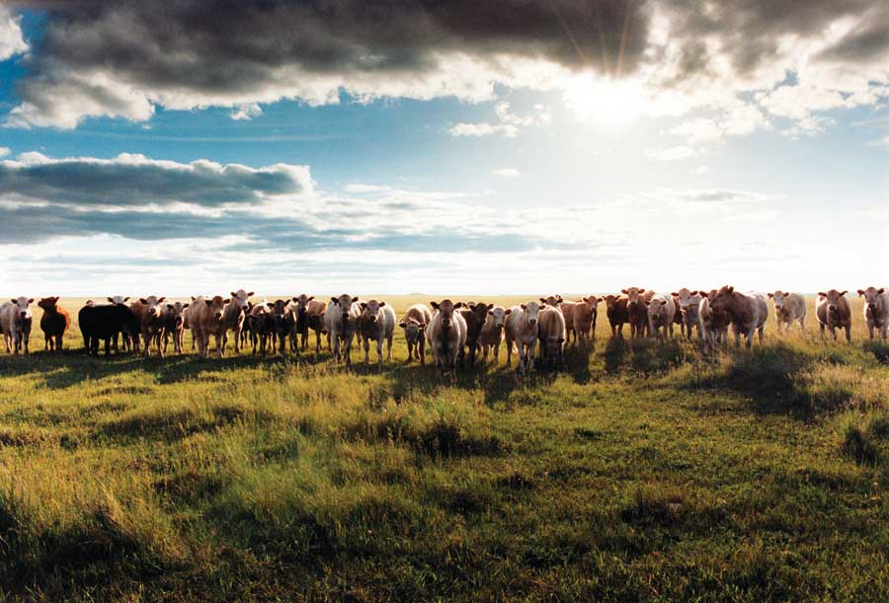

Slide 52
Enhancement of grass growth
Rye-grass
Clover
Soil Nitrogen

Slide 53
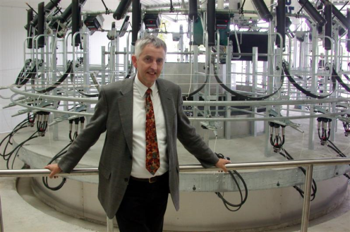
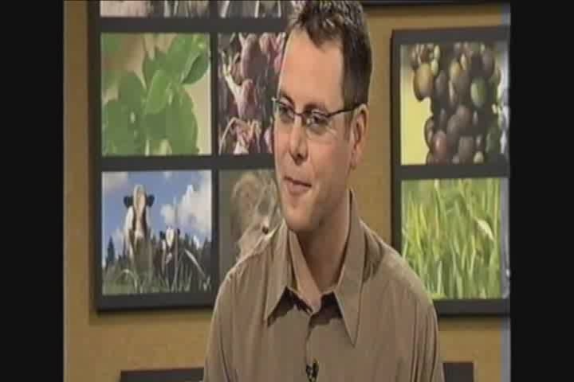

Television interview
Dr Andy West – May 2008 (Ex-CEO of AgResearch)
NZ’s biggest Crown Research Institute
53

Slide 54


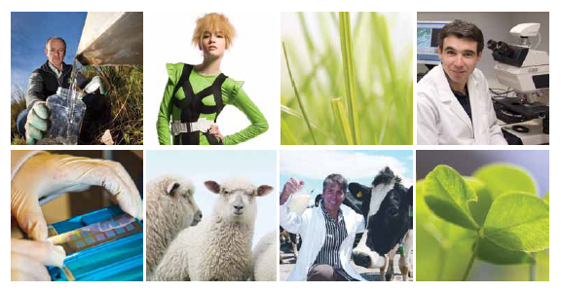
“New Zealand's largest Crown Research Institute
A combination of renowned research centres such as Ruakura, Grasslands, Lincoln and Invermay.
But most importantly, individual scientists and teams whose work is at the heart of pastoral industries, food processing and innovative products that benefit all New Zealanders.
Mathematics has had a strong focus in this work, with a major underpinning role.”

Slide 55
DDDEs Some novel mathematics
Distributed-delay-differential equations
(These arise when the past affects the present)
Example 1: y’(t) = y(t-T), y([-T,0]) given: A Point delay
What is the solution?? Homework!
(Often the past effects might be distributed)
My first of many examples of nonlocal calculus…where cause and effect are separated by time or space…
55

Slide 56

Model development
Clover content in pastures is commonly considered less than optimum, and is subject to large fluctuations in time.
The proportion of clover in pasture and rate of N fixation has large environmental impact for farmers and the wider community.
56

Slide 57


Soil N availability has a powerful effect on clover/grass proportions, clovers being more competitive where N availability is low while grasses dominate where N availability is high in part because uptake of N from the soil is more efficient than a combination of uptake and fixation.
However there are also intrinsic reasons for this variability, relating to the interactions between coexisting clovers and grass.
The observed variability over time in clover content is often attributed to environmental factors e.g., plant mortality due to adverse climate or pests and diseases.
57

Slide 58

Formulation
The state variables are:
Standing masses at time t of clover C(t), and ryegrass R(t)
These will be measured in units of kg DM (dry matter) per hectare
We do not attempt to describe the nitrogen cycling explicitly since this would require introducing a variable for soil nitrogen, which is extremely difficult to measure.
We introduce a gross simplification of the complex processes which occur over various timescales when clover “fixes” nitrogen in an attempt to capture the essence of the fixation mechanism.
These processes include growth of clover tissue from the fixed nitrogen, senescence of this tissue and subsequent mineralisation which makes the nitrogen available in a form that can be used for ryegrass growth.
Instead of describing these processes explicitly, we relate the enhancement effect on ryegrass growth to the total amount of clover mass turnover occurring in a past period of time.
58

Slide 60
Conclusions
Feature of the model is an N fixation mechanism that attempts to describe the beneficial effect of clover on ryegrass without explicitly introducing an N variable.
Local analysis of the model together with some simulations using the delay times T₁ and T₂ as the control parameters
This leads to a wide variety of outcomes.
These range from monocultures of clover and ryegrass, to coexistence equilibria, to periodic solutions where the period can be as large as 10 years.
In these periodic solutions it is possible to have long time intervals where both clover and ryegrass standing mass are alternately low and high but the oscillations are sustained indefinitely.

Slide 61
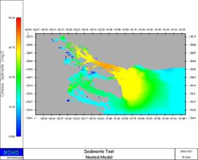

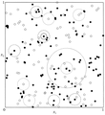
This is in contrast to the simulations reported by Thornley et al. (1995) where large-scale fluctuations existed but eventually settled into a coexistence equilibrium.
Similarly, the spatial model simulations of Schwinning & Parsons (1996) suggested the amplitude of the oscillations declined with time.
The delays introduced the oscillatory behaviour, which is observed (as with the simple delay-logistic). A key decision tool is here.
Reference: K Louie, GC Wake, MG Lambert, A McKay & D Barker "A delay model for the growth of rye-grass-clover mixtures: Formulation and preliminary simulations", Ecological Modelling, 155, 2002, pp31-42.

Slide 62

Cell-growth and Division
Gene expression

Slide 63
History of the cell-growth model – personal.
1988+: Horticulturists ask me to “provide an understanding of time-series
data” which showed that cell population structured by size, evolved by
simultaneously growing, dividing and dying, evolved to a “STEADY SIZE
DISTRIBUTION” SSD - first take-out.
This data was for plant-root cells, maize etc. This result was robust,
independent of the initial condition, and in dynamical systems terms
was attracting.
What is a SSD? Introduce n(x,t) the number density of a cell population cohort
structured by attributes (x) like:
SIZE (say = DNA content) – this is us
AGE
TIME in a given phase, etc.
Then _{b} ∫ _{a} n(x,t) dx = # of cells (biomass) in size interval [a,b], evolving in time.

Slide 64
SSD behaviour: n( . ,t) evolves like:

Slide 65
The Human Cell Cycle
1 hour
1 hour
Senescence
M
G2
4 hours
10 hours
(highly variable)
G1
S
9 hours

Slide 66
Steady DNA Distribution (SDD)
G1 Phase
G2/M Phase
S Phase

Slide 67
Idea
G₁/G₀
division
Cell Count
S
G2/M
x (DNA)

Slide 68
NZM13 DNA profile 0 hours after the addition of Taxol
800
Model
700
Data
600
Time
Model: 72 hours
Data: 76 hours
500
Cell Count
400
300
200
100
0
0
0.5
1
1.5
2
2.5
3
3.5
x (Relative DNA Content)

Slide 69
NZM13 DNA profile 18 hours after the addition of Taxol
600
Model
Data
500
400
Cell Count
300
200
100
0
0
0.5
1
1.5
2
2.5
3
3.5
x (Relative DNA Content)

Slide 70
NZM13 DNA profile 48 hours after the addition of Taxol
350
Model
300
Data
250
200
Cell Count
150
100
50
0
0
0.5
1
1.5
2
2.5
3
3.5
x (Relative DNA Content)

Slide 71
NZM13 DNA profile 72 hours after the addition of Taxol
250
Model
Data
200
150
Cell Count
100
50
0
0
0.5
1
1.5
2
2.5
3
3.5
x (Relative DNA Content)

Slide 72
NZM13 DNA profile 96 hours after the addition of Taxol
200
Model
Data
150
Cell Count
100
50
0
0
0.5
1
1.5
2
2.5
3
3.5
x (Relative DNA Content)

Slide 73

Taxol effect: 6 weeks “in vivo”

Slide 74



Summary…
We have a generic set of simple models for cell growth/division
It can be, and is being, used to underpin decision support
There is plenty of “new mathematics” here

Slide 75


Epigenetics
Genetic Plasticity
Glucose insulin models
Gene Methylation

Slide 76

Epigenetics and developmental plasticity: 2011-14.
Hypothesis to be tested robustly via systems biology:
……that an environmental stimulus activates an epigenetic response that, through the modification of gene expression, results in actual physiological changes in the organism.

Slide 77
3. Closing Remarks
Pointers to the future

Slide 78
Think about:
Education
Curriculum
Experience of our students.

Slide 79


Slide 80

Thanks to:
40+ PhD students…..
8 postdoctoral fellows: Prof James Graham-Eagle (1981-3), Prof John Hearne (1986), Dr Kishore Kumar (1988), Dr Monwar Hussain (1989-90), Dr Ken Louie (1992-3), Dr Mark Nelson (1996-7), Dr Britta Basse (2001-3), Dr Teeranush Suebcharoen (2010)
My original mentors from 1963+…..
Dr Ian Walker, ex-DSIR, Christchurch
Professor George Mackie, Edinburgh
Dr Alex McNabb, Auckland
All my colleagues…especially Profs Robert McKibbin and Mick Roberts, Drs Winston Sweatman, Alona Ben-Tal, Barry Mcdonald, Tony Pleasants (AgResearch), ……
All the Funders:
Brasenose College, Oxford; EPSRC, UK; Fulbright NZ; Marsden Fund; OCIAM and OCCAM, Oxford UK; NRCGD and Liggins,……
My family….

