Slide 1
EMERGENCY PREPAREDNESS
Personal Emergency Backpacks
Updated November 2016

Slide 2
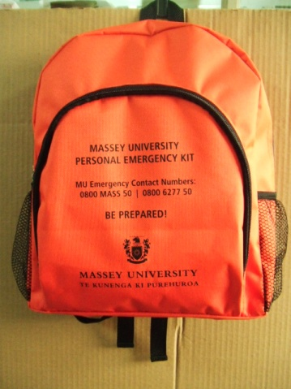
Personal Emergency Backpacks
Issued to permanent and fixed term employees
To encourage personal emergency preparedness
Opportunity to develop personal/ family emergency plans for
while you are at work
Backpacks are to remain on Campus
to ensure you have the necessary provisions if you’re caught up in an emergency while at work
to be used as a ‘Getaway’ kit in the event that we have to evacuate the campus, or you decide to head home after a natural disaster.

Slide 3
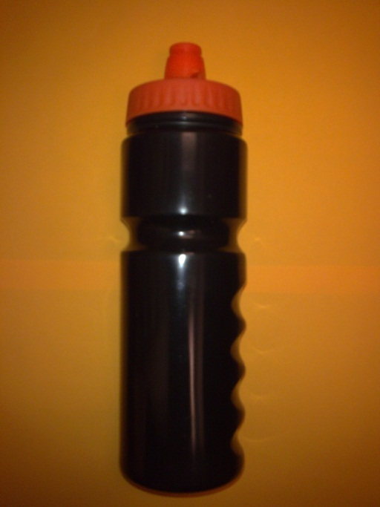
Water bottle
Your personal emergency backpack comes with a water bottle. Please ensure you fill this up as soon as you get back to your workspace.
Remember to refresh every 6 months
Water is essential to survival, we recommend that you
include extra water in your backpack.
The official recommendation is to have at least 3 litres
per person per day.
Keep as much water as you can in your backpack.

Slide 4
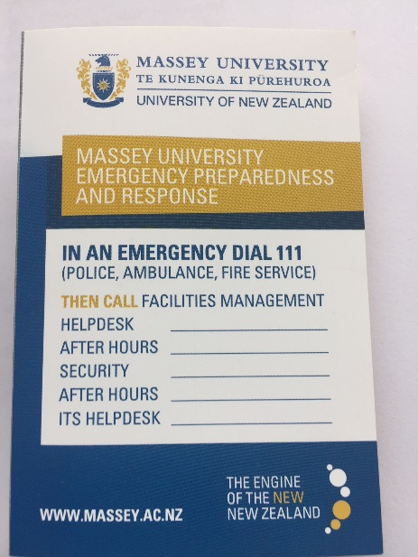
ICE Card
‘In Case of Emergency’ card.
Please fill this in as soon as you get back to your workstation. Put this card in the front pocket of your backpack, or keep it with you in your wallet or purse.
The information you put on the card could save your life if you are unable to communicate with first responders, rescuers, emergency workers or hospital personnel.
It also makes your next of kin/ emergency contact details readily available.
It is highly recommended that you also keep the ‘Yourself’ portal up to date on My Massey.

Slide 5
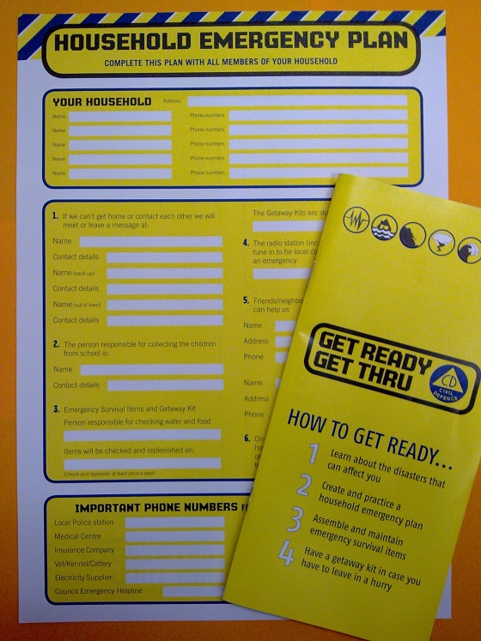
Civil Defence Information
Please read the Get Ready, Get Thru brochure & Household Emergency Plan as soon as you get the chance. The information in these documents will assist you in preparing your own personal & family emergency plan.
Having a plan can help you respond quickly and safely
when a disaster happens & being well prepared helps
alleviate fears about potential disasters.
Include your family in your planning, make sure
everyone understands the plan and what will happen
Get Ready Get Thru

Slide 6
Things to Consider
What you keep in your backpack will depend on your own circumstances and what your personal/ family emergency plan consists of;
What would you need if you were trapped in your office for several hours?
Are you likely to head home after a natural disaster? Do you know how long this could take you? What will you need for this journey? Can you make it home before it gets dark?
Will you go directly to collect your children? What might they need?
Do you live far from the Campus? Will you be staying here? What could you include in your backpack to make this stay easier/ more comfortable.
It is recommended that you are prepared to cope on your own for up to three days, or more.

Slide 7
List of some ideas
Essential medication
Personal first aid kit
Non-perishable and high energy food such as muesli bars, chocolate, dried food
Warm/wet weather clothing
Walking shoes
Additional water
Torch/radio
Batteries

Slide 8
Some extra ideas
Warm hat and gloves
Spare phone charger
Cash
Multi tool
Change of clothes
Notebook and pen
Compass
Sanitary Pads / tampons / toothpaste, toothbrush
Hand sanitiser
Copies of important documents i.e passport, insurance
Earplugs
Lighter, matches
Whiskey
Disposable gloves / heavy duty gloves
Dust mask

Slide 9
University Preparedness
The University is prepared and will respond to emergency events that may occur; however, the reality is that no matter how much effort we put into preparedness on campus, resources will always be stretched. Our success will be, in part, determined by every individuals own personal preparedness and response during an emergency.
Thank you.

