Slide 1
INFLUENCING & ASSERTIVENESS
Mark Rainier
Student Life Services (Manawatu)

Slide 2
INFLUENCING & ASSERTIVENESS
Is this important to you? Why?
How do you go about doing it?
Mark Rainier
Student Life Services (Manawatu)

Slide 3
Success in the Workplace
Graduate attributes
Communication
Critical and creative thinking
Social interaction
Independent and lifelong learning
Ethics
Social justice
Global perspective
Interdisciplinarity
In-depth knowledge of a field of study

Slide 4
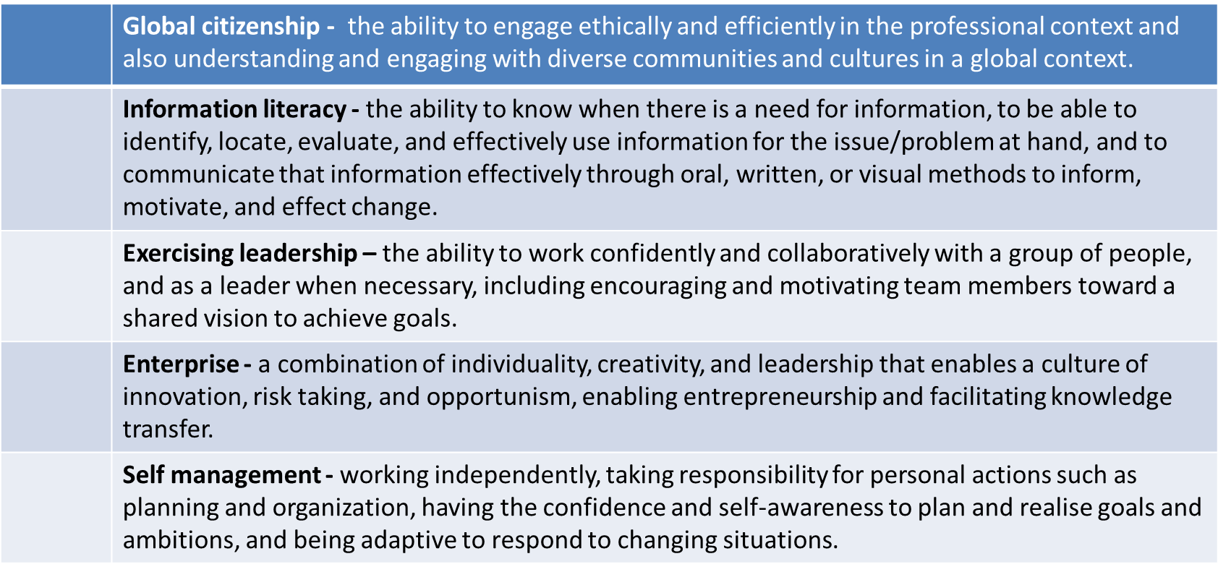
Success in the Workplace
Massey’s Employability Characteristics

Slide 5
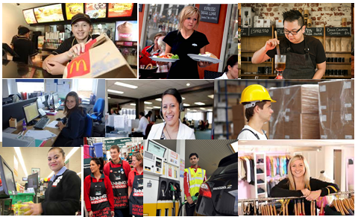
Volunteering
Part-Time Work
Clubs & Societies
Hobbies & Interests
Notes:
Developing the “Global citizenship” characteristic:
Volunteering for organisations such as Amnesty International, Language Partners, Refugee Services, sports coaching in EthKick
Working part time with people of different cultures, ages and socioeconomic backgrounds, being an RA or Massey Guide on campus.
Developing the “Self-management” characteristic through:
Being involved in clubs and having to balance work / study / play time
Working whit people who would often “push your buttons” or in challenging situations which could frustrate or annoy you so as to learn to manage your reactions in social situations
Challenging yourself to do something that takes you out of your comfort zone – climbing a mountain, talking in public, performing in a play.

Slide 6
Personal Success
IQ
EQ
Personal Success
Technical Skills

Slide 7
The Power of Emotional Competence
Research suggests attitude accounts for as much as 80% of the “success” of our lives
For better or for worse, attitudes are chosen
Attitudes directly affect our actions
Our attitude and actions, in turn, shape those around us
Therefore, choose consciously, conscientiously, and wisely!

Slide 8
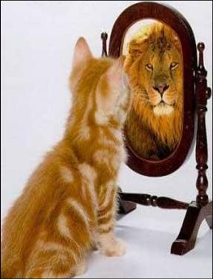
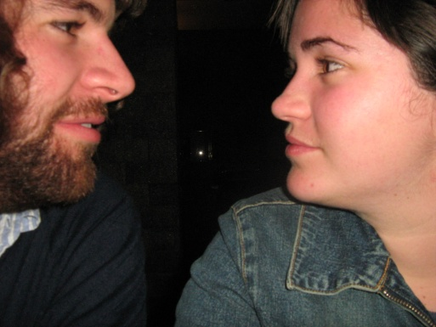
The Four Quadrants of E.Q.
Self-Awareness
Self Management
Social Awareness
Working with Others
Notes:
RACH

Slide 9
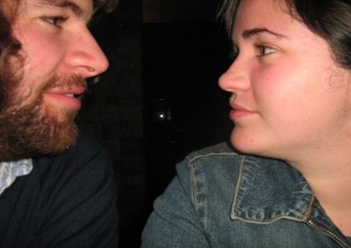
Working with Others
What sort of relationships do we want with others (colleagues, friends, partners, supervisors, employers, etc.?)

Slide 10
Working with Others
How do I see YOU? How do I see ME?
I am OK – You are OK
I am OK
I am not OK
You are OK
Assertive
Passive
Aggressive
Passive Aggressive
You are not OK

Slide 11
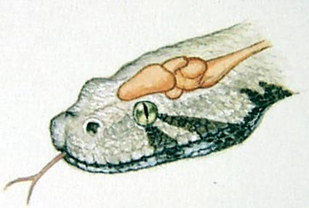
So what stops us so often?
Reptilian Brain! Fight / Flight (or Freeze!)
Stimulus – pause – response
FEAR!
Notes:
Reptilian thinking is choice limiting
Limbic system 10 x faster than neo-cortex
Six second pause – preplanned
Safety for self and for others with whom we are in a relatinship
S

Slide 12
So what stops us so often?
So what is it that you are afraid of when working with others? Your supervisor? Partner? Employer? Colleague?
FEAR!
Notes:
Reptilian thinking is choice limiting
Limbic system 10 x faster than neo-cortex
Six second pause – preplanned
Safety for self and for others with whom we are in a relatinship
S

Slide 13
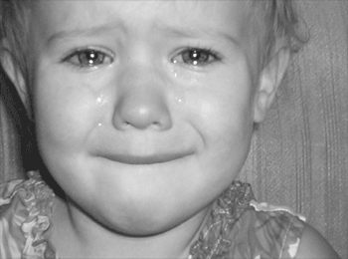
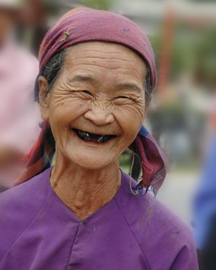
Six Universal Emotions
Notes:
Anger
Fear
Disgust
Sadness
Surprise
Joy

Slide 14
So what stops us so often?
They will think I am …
Rude
Stupid
Lazy
A push over
I think that I am …
Rude
Stupid
Lazy
A push over
Will never be successful
I believe that …
If my supervisor criticises me then that is awful and terrible
When I disagree with someone they are worthless people
I always mess things up
If I disappoint someone that is awful and means I am a bad person
I never seem to do what he / she wants
If I don’t get this job I will never be employed and will be poor and unhappy and lonely …
I remember times when I …
Was criticised
Failed
Made a fool of myself
Was rejected by others
Was scared / lonely / sad and know it will happen again
Notes:
Reptilian thinking is choice limiting
Limbic system 10 x faster than neo-cortex
Six second pause – preplanned
Safety for self and for others with whom we are in a relationship
S

Slide 15
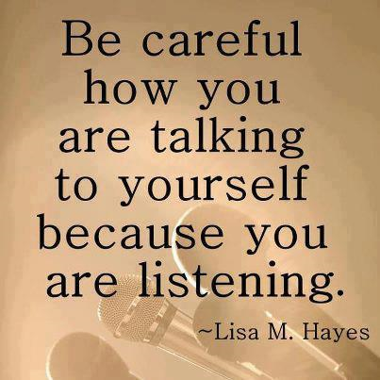
So what can we do about it?
https://www.youtube.com/watch?v=tNpKPppiL1o
Notes:
Reptilian thinking is choice limiting
Limbic system 10 x faster than neo-cortex
Six second pause – preplanned
Safety for self and for others with whom we are in a relatinship

Slide 16
So what can we do about it?
Question our assumptions (cultural bias?)
Check them out
Notice our self talk
Focus on the positive experiences, the achievements and the good things
Emotional well-being
Mindfulness
Manage emotions (especially fear!) – question it and understand it

Slide 18
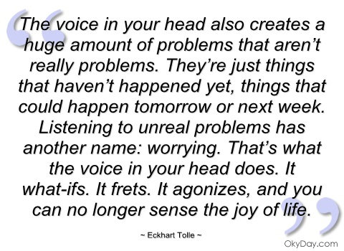
So what can we do about it?
Notes:
Reptilian thinking is choice limiting
Limbic system 10 x faster than neo-cortex
Six second pause – preplanned
Safety for self and for others with whom we are in a relatinship

Slide 19
Mindfulness
https://www.youtube.com/watch?v=DmqI1u72QLU

Slide 20
What Is Success?
To laugh often and much;
To win the respect of intelligent people and the affection of children;
To earn the appreciation of honest critics and endure the betrayal of false friends;
To appreciate beauty;
To find the best in others;
To leave the world a bit better, whether by a healthy child, a garden patch or a redeemed social condition;
To know even one life has breathed easier because you have lived;
This is to have succeeded.
Ralph Waldo Emerson

Slide 21
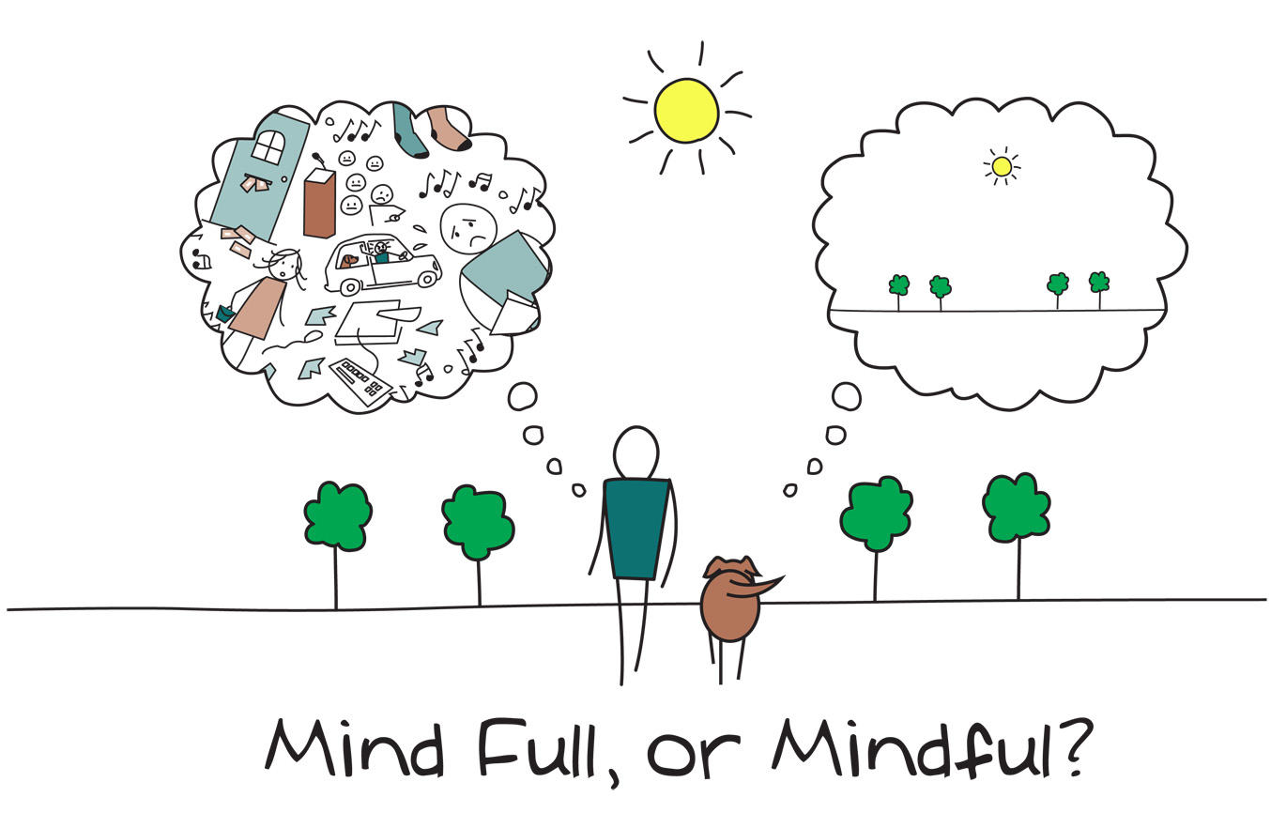
Services
Student Counselling Service
Level 1 of Registry
s.counselling@massey.ac.nz
http://crow.massey.ac.nz
350 5533 (extn 85533)
Career & Employability Service
Level 2 of Registry
careersupport@massey.ac.nz
http://careers.massey.ac.nz
http://careerHub.massey.ac.nz

