Slide 1
Research Integrity & Ethics Processes
Dr Rochelle Stewart-Withers
Chair: Southern B Ethics Committee

Slide 2
Overview
Research Integrity policy
Principles
Guidance
Research misconduct
Research ethics online processes
Principles, Massey structure
Preparing & applying
Following application

Slide 3
Research Integrity defined
Research integrity can be defined as the 'trustworthiness of research due to the soundness of its methods and the honesty and accuracy of its presentation
Draft Singapore Statement 2010
Research integrity broadly refers to the thoughtful and honest adherence to relevant ethical, disciplinary, and financial standards in the promotion, design, conduct, evaluation, and sharing of research.
The Continuum from Research Integrity to Research Misconduct,
Michigan State University

Slide 4
Principles of Research Integrity
Honesty
Reliability
Use of robust research methodologies
Impartiality and independence
Open communication
Duty of care for participants
Fairness
High standards of mentorship and supervision
Awareness of responsibilities to society

Slide 5
Research Integrity Policy structure
Part 1 Code of responsible research conduct
Principles, Responsibilities of institution, researchers
Part 2 Research misconduct
Categories of breaches, Principles for dealing with breaches, Definitions
Appendix 1 Guidance on Responsible research conduct
Nine explanatory sections
Appendix 2
Procedures for dealing with minor breaches and research misconduct
Procedures for dealing with allegations related to an external research agency with its own policy for dealing with research misconduct
Appendix 3 References

Slide 6
Appendix 1
Guidance on responsible research conduct
General guidance
Research supervision
Peer review
Conflict of interest
Collaborative research
Māori and/or Pasifika research
Research phases
Research practice
Research records and data
Dissemination, publication and authorship
Public communication

Slide 7
Research Misconduct defined
The violation of the standard codes of scholarly conduct and ethical behavior in professional scientific research
http://en.wikipedia.org/wiki/Scientific_misconduct
...(research that) deviates from practices commonly accepted in the discipline or in the academic and research communities generally in proposing, performing, reviewing, or reporting research and creative activities
The Continuum from Research Integrity to Research Misconduct
Michigan State University

Slide 8
Common types of research misconduct
Falsification – manipulating research materials, equipment, or processes, or changing or omitting research data or results, such that research is not accurately represented in the research record
Fabrication – making up research data or results and recording or reporting them
Plagiarism – the appropriation of another person’s ideas, processes, results, or words without giving appropriate credit.
[Turnitin used by Massey for assurance]

Slide 9
Question for discussion
My student is about to submit a paper to a prestigious journal. It was their idea; should I be included as an author on the paper because I am a supervisor?
Yes, always.
If the supervisor wrote a significant part of the text.
Yes, if the supervisor provided the funding.
No.

Slide 10
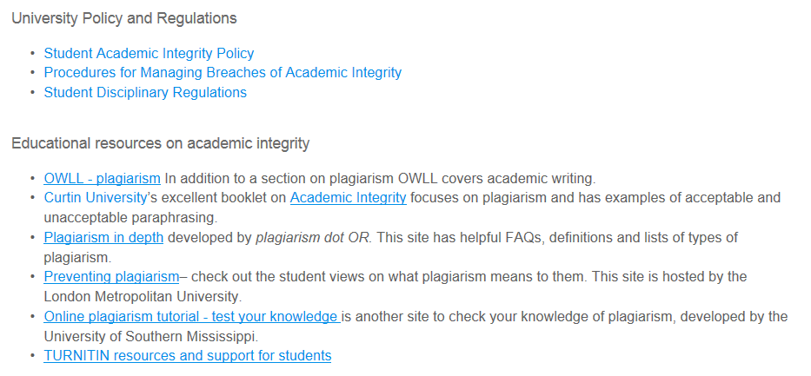
Plagiarism
https://www.massey.ac.nz/massey/staffroom/teaching-and-learning/centres_tl/centrestl-students/our-resources/academic-integrity-student-guide/academic-integrity-student-guide_home.cfm

Slide 11
Authorship
Authors named on a publication should:
Have made a creative and significant intellectual contribution to the research;
Have given their permission to be named as an author;
Not be named as an author solely on the basis of being the supervisor of the researcher or student undertaking the research, or the leader of the research group, where a creative and significant contribution has not been made to the research;
Not be involved solely in writing the publication, unless contributing to critically revising the interpretation.

Slide 12
Processes for dealing with misconduct
See Appendix 2
Informal – between staff and/or students involved (Who would you go to?)
OR, for advice
2. Formal – written message to AVC (Research, Academic & Enterprise)
Dean, Graduate Research
Professor Marlena Kruger
Student
Director, Research Operations
Dr Michael Millan
Director, Research Ethics
Dr Brian Finch

Slide 13
Code of responsible research conduct
Research Integrity
Research Ethics Codes

Slide 14
Ethical conduct for research, teaching and evaluations involving human participants

Slide 15
The Code - major ethical principles
Respect for persons
Minimisation of harm (participants, researchers, institutions and groups)
Informed and voluntary consent
Respect for privacy and confidentiality
Avoidance of unnecessary deception
Avoidance of conflict of interest
Social & cultural sensitivity to the age, gender, culture, religion and social class of participants
Justice

Slide 16
Massey research ethics structure
Assistant Vice Chancellor Research, Academic & Enterprise
Director of Research Ethics
Human Ethics Committees
Northern (most Albany applications)
Southern B (share of Manawatu & Wellington applications)
Southern A (share of Manawatu & Wellington plus any applications involving exercise regime, physiological samples)
Animal Ethics Committee
Genetic Technologies Committee

Slide 17
Overview of ethics applications, 2015
Human ethics (across 3 committees)
Low risk notifications 590 (72%)
Full applications to Human Ethics Committees 225 (28%)
Animal Ethics 115
Genetic Technologies 7

Slide 18
Human Ethics application processes

Slide 19
Processes involved in preparing and applying
i) Risk assessment sections
Risk of harm
Informed and voluntary consent
Privacy and confidentiality
Deception
Conflict of interest
Compensation
Procedural

Slide 20
ii) Identifying, discussing &
dealing with ethical issues
Identify issues by talking with several ‘experts’
Consider ‘worst case’ scenarios
Discuss design to mitigate issues, minimise problems
Further thinking about participants or procedures may be required e.g. - Unicef (2013). Ethical research involving children www.childethics.com
- Visual methodologies and confidentiality
Communicate fully -with committee in application
-with participants in Information Sheet
Aim to achieve the best research through negotiation with the Human Ethics Committee: - for you
- for participants

Slide 21
iii) Thinking ethically about cultural issues
Treaty of Waitangi section
Partnership, participation & protection
Principles of respect, informed consent and privacy apply to collectives (whanau, hapu and iwi)
Principle of research adequacy – acknowledgement of Kaupapa Māori research and ethical paradigm, a relationships rather than principlist paradigm
Bishop, R. (1996). Collaborative Research Stories: Whakawhanaungatanga. Palmerston North: Dunmore Press.
Principle of cultural sensitivity requires acknowledgement of cultural diversity, consultation & reciprocity in dissemination, as well as during data gathering

Slide 22
Human Ethics Committee decision pathways
Approved
Human Ethics Committee
Chair
Provisionally Approved
Researcher response
Approval Deferred
Researcher response
Approval Declined

Slide 23
Animal Ethics Committee decision pathways
Approved
Approved in principle
Secretary
Animal Ethics Committee
Chair
Approved provisionally
Researcher response
Approval Deferred
Researcher response
Approval Declined

Slide 24
Following approval/notification
Researcher obligations ‘ethics in practice’’
Recruitment/consent
Inform REO may be minor amendment
Changes in research design
Data generating/checking
Relationship with participants
Reflective ethical practice
Reciprocity
Consent an ongoing process
Unexpected ethical moments
Discuss with advisers/ REO
Writing
Dissemination
Participant rights to negotiate with researcher
to contact Research Ethics Office

Slide 25
Contact points
https://www.massey.ac.nz/massey/staffroom/policy-guide/research/research_home.cfm
https://www.massey.ac.nz/massey/fms/PolicyGuide/Documents/Research/Code%20of%20Responsible%20Research%20Conduct.pdf?BBD750C33827941FCA508DCB59B48210
Researcher Development Coordinator m.d.murrie@massey.ac.nz
Research Human Ethics
humanethicsoutha@massey.ac.nz
humanethicsouthb@massey.ac.nz
humanethicsnorth@massey.ac.nz
Research Animal Ethics
M.E.Thomas@massey.ac.nz

