Slide 1
‘Living’ wages: Transforming lives, transforming work?
Jim Arrowsmith
Jarrod Haar, Jane Parker, Stuart Carr, Darrin Hodgetts, Siatu Alefaio
LWMANZ AGM
25.7.18

Slide 2
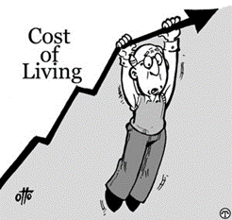
Context
  Living wages are increasingly prominent around the world due to rising living costs & growth of low-paid and precarious work.
  LWs are linked to quality of life not simply subsistence.
  Controversial! Arguments for and against are similar to MW, but more intense. Case against is usually heard loudest…
    a clumsy way to address poverty/ need given individual, and business, circumstances vary widely
    paying above ‘market’ wages leads to job losses and/or work intensification
    increases costs directly and indirectly by impact on differentials, particularly in labour-intensive (and low-margin) service sectors
    small firms are less able to absorb, pass on, or respond to cost increases through work reorganisation, especially when other costs are increasing too
    pay should recognise (and incentivise) skills and value in the labour market
    wage growth should reflect firm and individual performance…

Slide 3


Alternative case:
  low pay reflects unequal bargaining power not simple supply and demand, hence it can be exploitative and not reflect contribution or productivity
  low minimum wages and taxpayer-funded transfers such as housing and child benefits basically subsidises and sustains employers’ low pay
  ‘efficiency wages’ and motivational psychology indicate offsetting returns through better recruitment and retention; development and training; commitment; and better people management and employee relations generally, including in small firms.

Slide 4

These issues need exploring in a systematic way
From an employee perspective, how far is pay (and household income) linked to quality of life (family life, leisure and work motivation/satisfaction)?
  ahere, if any, is/are the tipping point/s?
The prevalence of small firms and service work in NZ means most employers do not pay > LW. However, little is known about employer attitudes around low pay and the LW.
  are low-paying employers favourable in principal but restricted in practice? Or could they pay more but choose not to? What explains differences in attitudes and practice – e.g. size, sector, ownership, competition, unionisation, management choice….?

Slide 5

The research project
  Two main questions
    is there a LW range that enables people to prosper and thrive in Aotearoa/NZ?
    what are the main barriers to, and facilitators of, employers’ implementation of LW rates?
  Supported by Marsden Fund
    established by the Government in 1994 to support excellent fundamental research; administered by the Royal Society of New Zealand
  Three years, commencing March 2018
    nationally-representative panel survey of 1,000 workers in low-income occupation (up to $60,000), Yrs 1 and 3
    employer (and other stakeholder) interviewes at sector/policy level (Yr1)
    employer (and employee/rep) company-level interviews and case studies (Yrs 2-3)
  Useful timing: increases to MW, fair pay agreements….

Slide 6

Builds on previous study (funded by Massey University), 2014-15
Worker survey
  1,183 employees (online/mobile phone; convenience sample)
  quality of life (wellbeing) and job satisfaction measures all ‘spike’ at around the LW rate, and at household income range $30-40,000
  supported by both quantitative and qualitative analysis
Organisational case studies
  scope for discretion around pay: LW employers tend to be smaller, motivated by ethics; corporates risk-averse, keen to show returns, link to skills

Slide 7

(Very!) initial results – Survey
Income is strongly related to wellbeing for low earners
  three distinct groups ($20k/40k/60k)
  those with lowest income have very low wellbeing across a range of measures
  they score particularly low on satisfaction with personal health, community, future

Slide 8
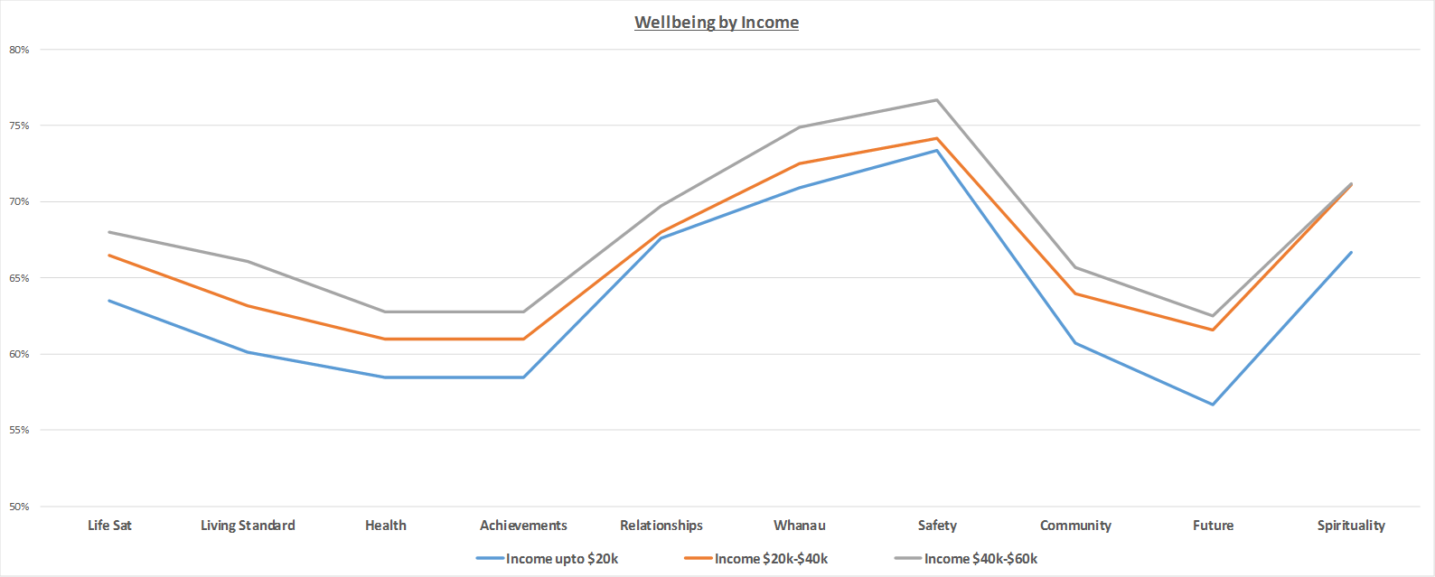

Slide 9
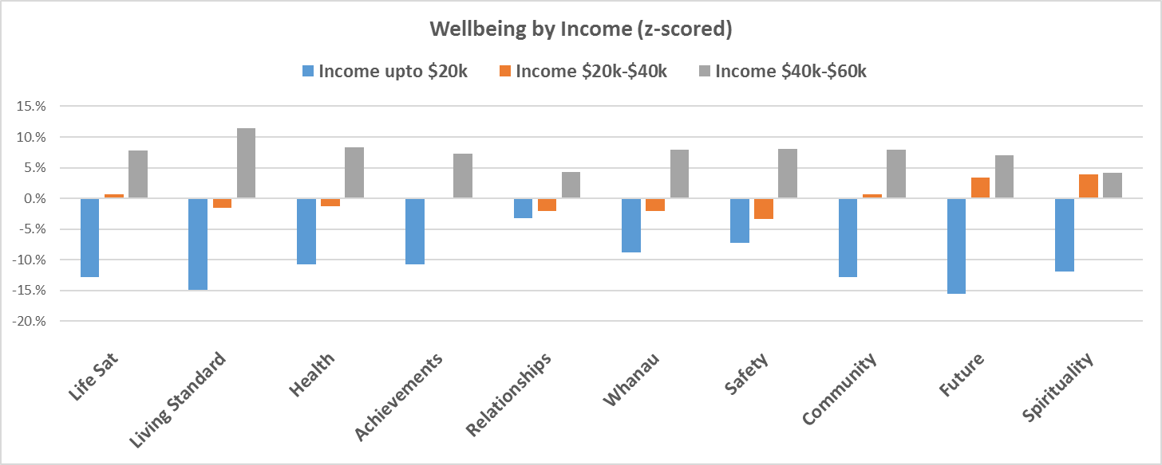

Slide 10
(Very!!!) initial results – Interviews
A big worry is compression of dividend to skills/experience (impact on those above MW/LW; reduced incentives to progress)
Business uncertainty/volatility constrains pay but can also lead to long hours (reluctance to hire) [workers negatively impacted twice!]
Most organisations don’t want low pay, and living costs are high, especially in Auckland. Many employers could and should value workers, and pay them, more (e.g. road haulage; sector floor under pay might help). But for most, you have to earn it before you can spend it.
Regional issues eg CHCH: construction industry sucking in people from other sectors that can’t raise wages even though need to in order to retain/recruit labour
Increased labour costs may encourage automation (in labour intensive sectors); upskilling; revised hiring patterns (e.g. away from student/casuals)
Reticence about LW includes signing up to uncertainty (e.g. changes to benefits may cause it to leap)

Slide 11
