Slide 1
Tuakana-teina
e-Belonging
A model of learning and support
Caroline Rawlings
Te Kura Wānanga - Māori Office
Te Kuratini Tuwhera - Open Polytechnic
2012

Slide 2
What is tuākana-tēina e-Belonging?
• Online mentoring space
• Establishing relationships
• Support learning and cultural needs
• An opportunity to be Maori

Slide 3
Values underpinning programme
• Whakapapa - our identity
• Whanaungatanga - a sense of belonging
• Whānau - working collaboratively
• Whangai - learning to adapt
• Manaakitanga - to look after each other
• Tūrangawaewae - a place of belonging

Slide 4
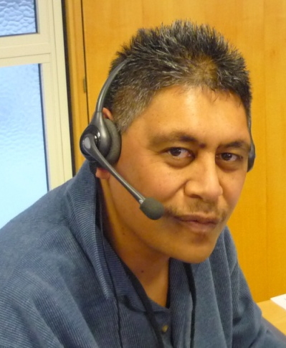
Theoretical framework
• Māori pedagogy
• Māori-centred approach
• Critical theory
• Student support

Slide 5
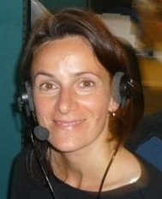
Kaupapa linked to ...
• Māori Strategy Plan
• OP Strategy Plan
• OP Investment Plan
• TEC Tertiary Education Strategy
• Teaching and Learning Ako Strategy

Slide 6
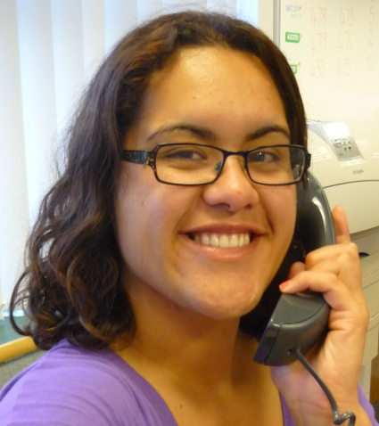
Training tools and principles
• Whakapapa - relationship building
• Tautoko - support
• Āhuatanga - essential qualities
• Whakatūnga - strengthening the role
• Manaakitanga - responsibility
• Whanaungatanga - sense of belonging

Slide 7
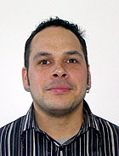
Designing an online mentoring space
Karaitiana Wilson
Ngāti Tuhoe
• Flexible Learning Advisor
• Designer
• Moodle platform
• Māori space known as iWhare

Slide 14
Developing a sense of belonging
Tools for training student to student mentoring
“I can’t wait to see where this journey takes me. I decided to participate in this project to help support and guide other students through their learning journey.”
Tuakana voice…
“

