Slide 1
PISA 2012
Financial Literacy results – New Zealand in an international context
Notes:
Introduction – Lynne to do slide 1
The Programme for International Student Assessment – PISA is an international study that assesses and compares how well countries are preparing their 15 year-old students to meet real life opportunities and challenges
In December 2013, PISA released results that provided countries with information on their students’ reading, mathematical and scientific literacy.
On the 9th of July this year the OECD will release results on the Financial Literacy component of the study. New Zealand along with 17 other countries assessed financial literacy.
This presentation is an overview of Financial Literacy achievement to show New Zealand results in an international context.
Students in the study are 15 years-old. 958 15 year-old students students took part in the financial literacy component
In the core PISA subjects Over half a million students from 65 countries and economies took part around the world. Just over 4,000 (4,291) New Zealand students from 177 schools took part in core PISA subjects.
For us to better understand student achievement within a country and across countries these results were related to student and family background factors; school-level factors; teaching and learning; and system-related factors.

Slide 2
PISA definition of financial literacy
“the process by which financial consumers/investors improve their understanding of financial products, concepts and risks, and, through information, instruction and/or objective advice, develop the skills and confidence to become more aware of financial risks and opportunities, to make informed choices, to know where to go for help, and to take other effective actions to improve their financial wellbeing.”
Notes:
SLIDE: Definition
Angela to cover slides 2-4
The PISA FL definition aligns comfortably with the notion of financial capability which is captured in the NZC, and apirations for students expressed in the Graduate Profile of the Te Marautanga o Aotearoa (Māori-medium curriculum).
The NZC describes financial capability as the skills, knowledge and dispostions to make well informed financial decisions throughout life.
By dispositions we mean things such as values, and key competencies of thinking and self-management and motivation, & participating and contributing. FL is recognised as an important capability for citizenship to enable social and economic well-being.

Slide 3
What did students do in this option?
A subset of the students participating in PISA 2012 answered:
financial literacy items (on money and transactions; planning and managing finances; risk and reward; financial landscape) in diverse formats including prose, diagrams, tables, charts and illustrations
a background questionnaire that sought information about themselves, their homes, their school and learning experiences including attitudes. Questions on students’ behaviour towards money matters were also included.
In New Zealand 957 students took part in this option
Notes:
The new NZC FC Progressions of Learning
The learning outcomes described in the Ministry’s new FC progressions of learning very much reflect the items in PISA.
The development of the progressions were informed by the PISA 2012 framework and other models of effective financial literacy practice, as well as the broader desired outcomes of NZ curriculum policy and relevant subject curricular, like economics and mathematics.
The 2 frameworks speak to each other in many respects – for example, “planning and managing finances” (PISA) is captured under the FC strand of Setting Goals, both identify money, income and risk as key items.
The 3 NZC FC strands are:
Managing Money, Setting Goals, Managing Risk

Slide 4
Financial Capability Progressions Learning
Notes:
The Ministry of Education’s collection of online resources to support schools to include financial literacy in cross-curricular contexts, for all students at all levels of schooling, is housed on TKI (Te Kete Ipurangi).
The collection includes tools and resources to help schools understand how this is an important life-skill or competency that all students should be given opportunity to develop, as well as how they design programmes which embed financial capability in the wider school curriculum.
A central feature is the FC Learning Progressions –these are a description of the big ideas and skills and knowledge, they are like a roadmap which details desired learning outcomes specific to students becoming financially capable. The progressions are not a programme of learning. They are PART of the wider collection.
Acknowledge input and expertise that contributed to their development who are attending today, and historical investment of NZBA.

Slide 5
How did New Zealand students perform?
On average New Zealand students demonstrate higher financial skills and knowledge compared with the average performance of students in all participating countries
New Zealand’s average score is 520 points compared to the average score of the 13 participating OECD countries – 500
New Zealand has 1 in 5 students in the most advanced level of proficiency for financial literacy compared with the OECD average of 1 in 10
New Zealand has 16 percent of students in the lowest level of proficiency compared with the OECD average of 15 percent
New Zealand’s challenge is the wide spread of achievement in financial literacy
Notes:
Lynne to do remainder of data slides (5-28)

Slide 6
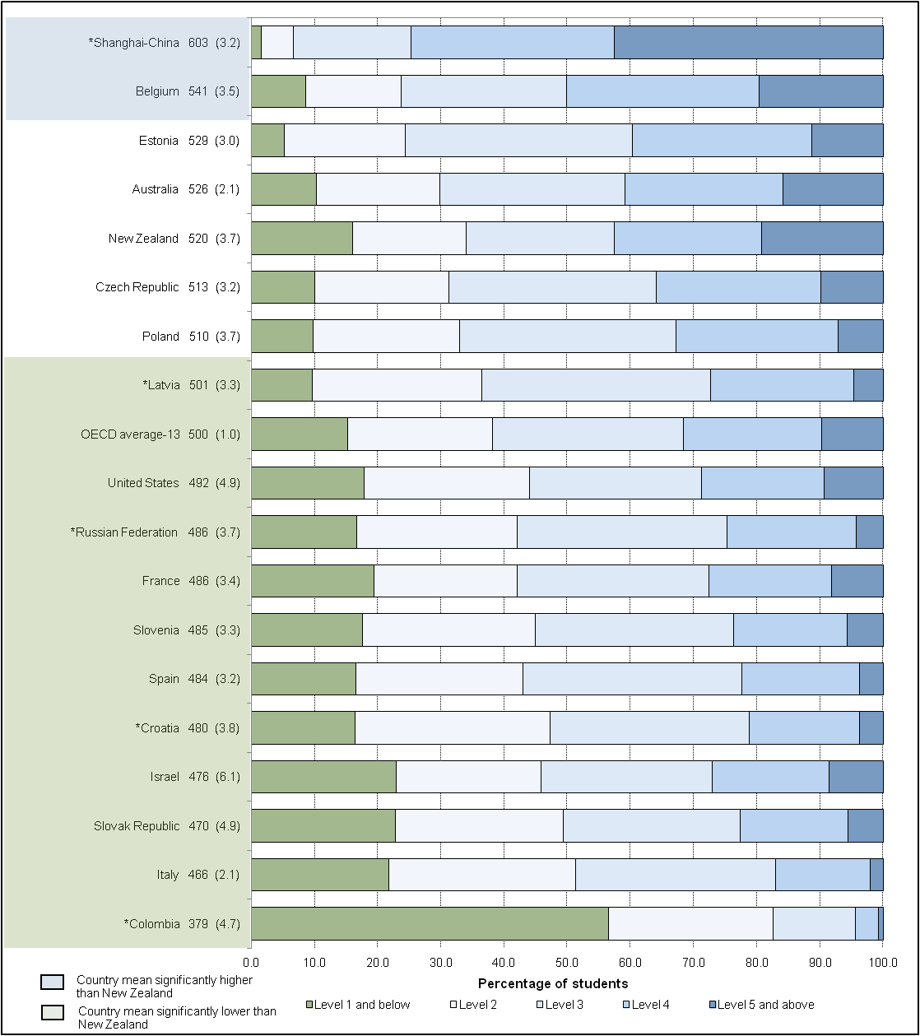
New Zealand results in an international context
Notes:
New Zealand’s average score is 520. The scores range from 379 to 603 across the 18 countries taking part in this financial literacy option. New Zealand’s average score is above the OECD average (13 OECD countries). The average score for Australia is 526.
New Zealand ranks between 4th and 6th among the 18 countries. Shanghai-China is the top performing country.
There are five levels of financial literacy proficiency. New Zealand has:
19% top performers (Level 5). Only two countries have a higher proportion)
23% of students at Level 4
23% of students at Level 3
18% of students at Level 2
16% with poor skills and knowledge (Level 1 and below). This is relatively high for a country above the OECD average in financial literacy

Slide 7
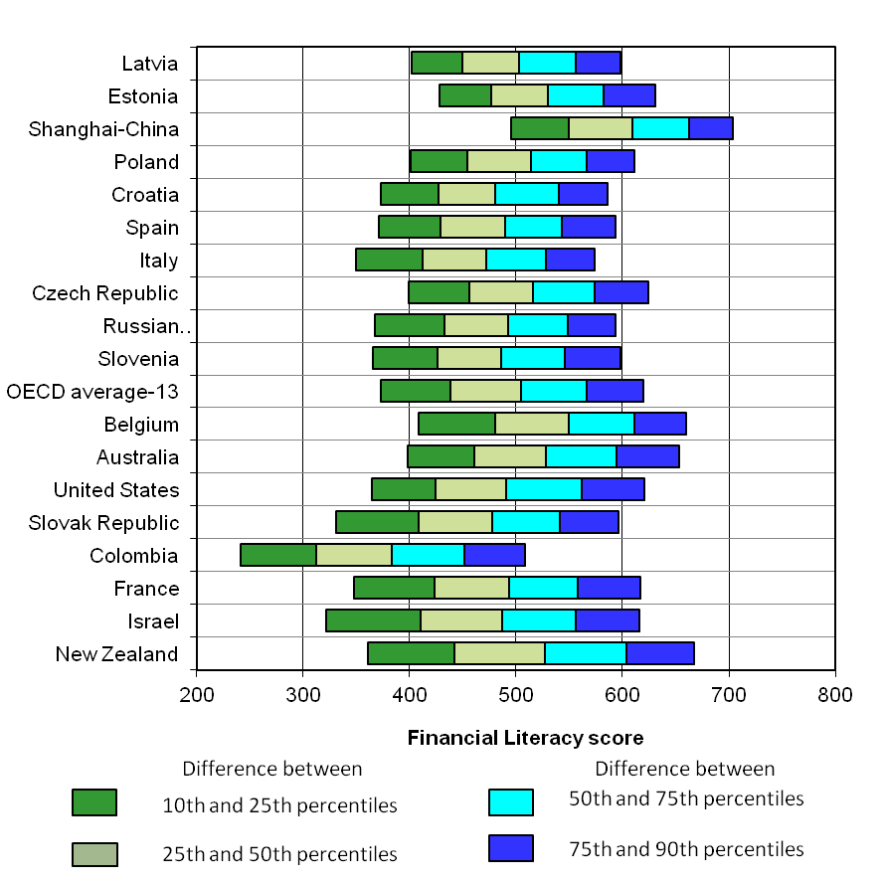
The spread of scores was one of the widest
Notes:
SLIDE:Consistent with maths, reading and science the spread of performance among New Zealand students in financial literacy is relatively wide. There is a difference of 306 score points between those students at the 10th percentile and those at the 90th percentile.

Slide 8
Was there a gender difference?
There is no difference between the average performance of boys and girls in New Zealand
Boys achieved an average of 521 points and girls 519 points
however ...
a higher proportion of boys (22%) than girls (16%) have advanced skills and knowledge
a higher proportion of boys (18%) than girls (14%) have relatively poor financial skills and knowledge
Notes:
SLIDE:

Slide 9
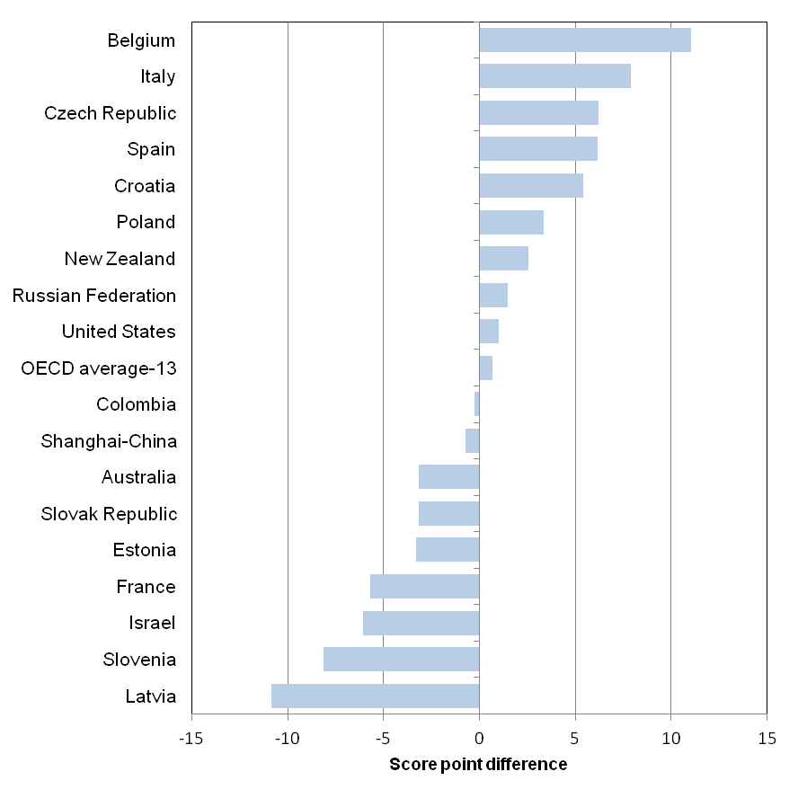
How did girls and boys perform – on average?
Boys do better
Girls do better
Notes:
There is no difference between the performance of boys (521) and girls (519). This is consistent across most participating countries. (only Italy has a significant gender difference)

Slide 10
How did boys and girls perform - proficiency?
Notes:
However girls are less likely to be top performers (but also less likely to be among the poor performers)
This also means that boys are overrepresented among the poor performers and more likely to be top performers.
This pattern is similar to the OECD overall but slightly more prounced in New Zealand

Slide 11
Relationship - SES & achievement
In PISA socio-economic status is derived from students’ responses to questions about the parents’ occupations, education levels and possessions in the home
The relationship between New Zealand students’ socio-economic status and achievement in financial literacy is the strongest among the 18 countries participating in this international option by a relatively wide margin
Those students who are socio-economically disadvantaged score on average much lower than those students who are socio-economically advantaged
Notes:
SLIDE:

Slide 12
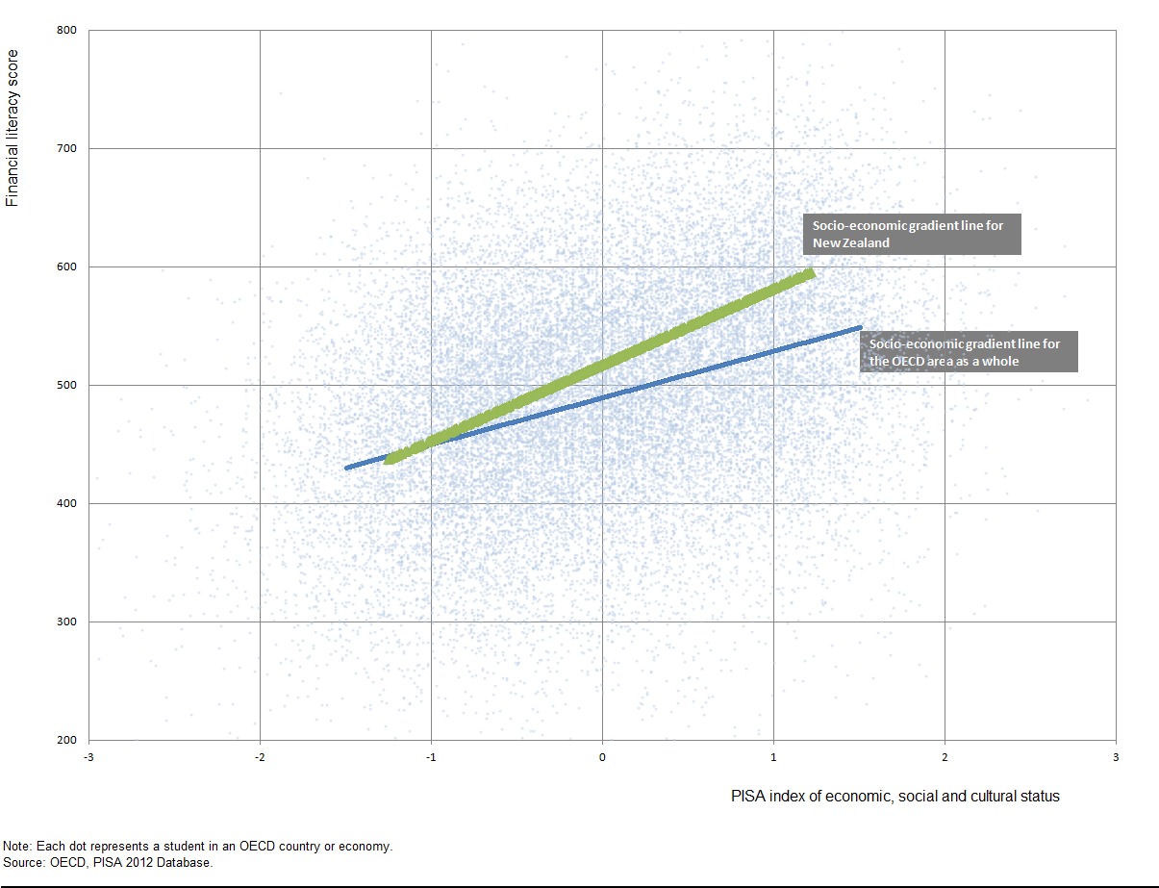
Relationship - SES & achievement
Notes:
In New Zealand the relationship between ESCS and FL is the strongest among all 18 participating countries by a long stretch. The slope representing the score point difference associated with a one-unit increase in the ESCS index is 64. The closest is 50. Australia is 42. The lowest is 24.

Slide 13
Relationship - school decile & achievement
The biggest achievement gap between schools of difference deciles occurs between decile 1 and 2 schools (average score 396 points) and deciles 3 and 4 schools (average score 492 points)
In PISA this difference of 96 points represents a difference of about 2 to 3 year’s progress in a subject
The achievement gaps between the remaining decile pairs is not as pronounced
The achievement gap between deciles 9 and 10 schools (average score 558) and independent schools (average score of 604) was equivalent to about one year’s progress
Notes:
SLIDE:

Slide 14
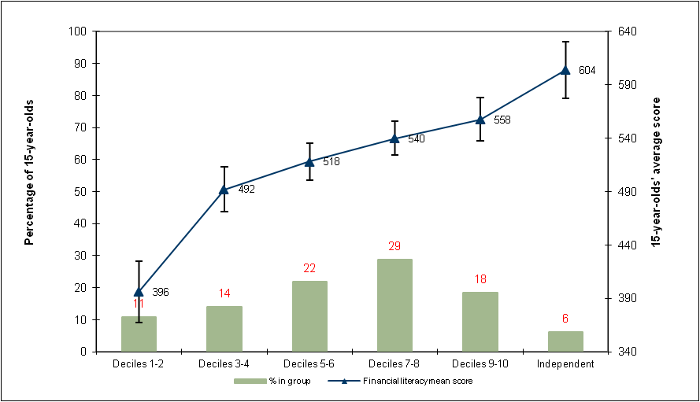
Relationship - decile & achievement
Notes:
In New Zealand we can also look at the relationship between school decile and financial literacy achievement.
Students in decile 1 and 2 schools was nearly 100 points below that of decile 3 and 4 schools
(note: error bars give an indication of the precision of the average (overlapping error bars usually mean that differences are not significant)

Slide 15
Relationship - ethnicity & achievement
On average Māori students (466 points) and Pasifika students (424 points) scored well below the average for all New Zealand students (520 points)
27 percent of Māori students
44 percent of Pāsifika students
had scores that placed them at the most basic levels of financial skills and knowledge
Part of the above differences is likely to be explained by the confounding of ethnicity and socio-economic status in New Zealand
Notes:
SLIDE:

Slide 16
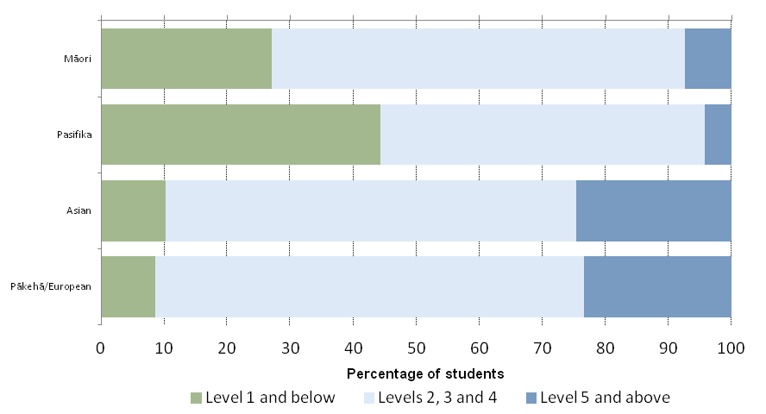
Relationship - ethnicity & achievement
Notes:
27% of Maori and 44% of Pasifika are among the poor performers (Level 1 and below) in financial literacy
25% of Asian and 23% of Pakeha are among the top performers
Note: ethnic identity is self- reported by the students and some students identify with and are reported for multiple ethnicities.
The proportion of Maori and Pasifika among the top performers is indicative only (due to small sample numbers for these groups)

Slide 17
Home language & immigrant status
Fifteen percent of participating students in New Zealand spoke a language other than English most of the time
Those students who spoke English most of the time at home achieved higher on average (535 points) than those who spoke another language at home (472 points)
In New Zealand policy making immigration is a smaller consideration than other background characteristics, but in PISA it is reported on to allow international comparisons
About a quarter of participating students in New Zealand had an immigrant background
Students from an immigrant background (504 points) did not score as well on average as those who were not (533 points)
Notes:
SLIDE:

Slide 18
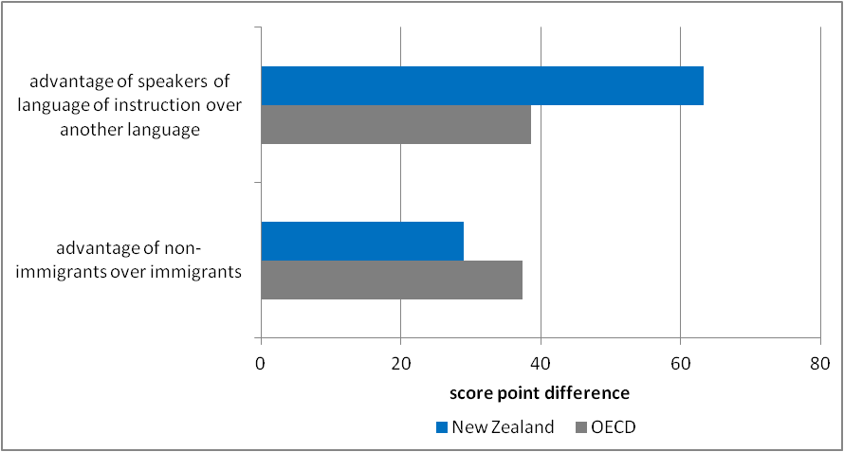
Home language & immigrant status
Notes:
There is a 63 score point difference between students where English is spoken at home most of the time and students where another language is spoken at home. In other countries the advantage of speakers of the language of instruction over another language is generally not as large ( Slovak republic and France are larger than NZ) (OECD difference 39 score points)
The advantage for non-immigrants over immigrants in New Zealand (29 score points) is not as large as the OECD average (37 score points)

Slide 19
PISA reading and maths & financial literacy
Students were assessed in reading and maths as well as financial literacy
The relationship between reading and financial literacy and maths and financial literacy is expressed as a correlation
In New Zealand the relationship between reading and financial literacy is very strong (0.86) and between maths and financial literacy is very strong (0.85)
This has implications for the types of resources that are used to build capability for students with poor financial skills and knowledge
Notes:
SLIDE:

Slide 20
Parents’ education & occupation
Those New Zealand students who had at least one parent with a tertiary education achieved higher on average (548 points) than those who did not (509 points)
Those New Zealand students who had at least one parent working in a skilled occupation achieved higher on average (552 points) than those who did not (477 points)
The advantage for New Zealand students who had at least one parent working in a skilled occupation was larger than that for OECD students
Notes:
SLIDE:

Slide 21
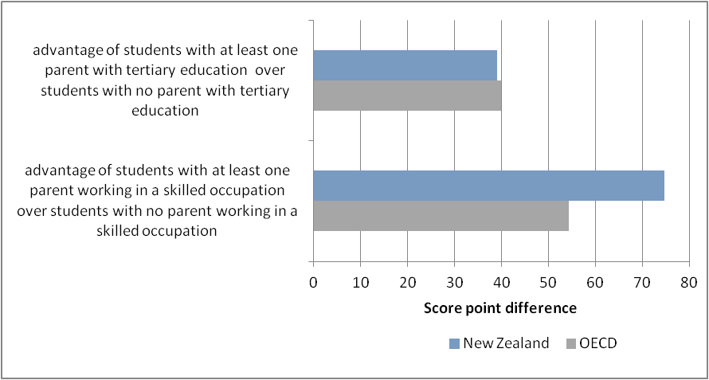
Parents education & occupation
Notes:
Similar to the OECD average NZ students who have at least one parent with a tertiary education have about a 40 score point advantage over students with no parent with a tertiary education.
The score point difference for students with at least one parent in a skilled occupation (eg professional (doctor, nurse , teacher etc), or managerial ) for New Zealand (75 score points) is larger than most other countries (only Israel; has higher)

Slide 22
Talking with parents about money matters
New Zealand students vary quite a bit in the extent to which they discuss money matters with their parents
On the whole ... those students who discuss money matters with their parents about once a month (551 points on average) or once a week (541 points) tend to achieve better than those students who hardly ever do (502 points) or who discuss them almost every day (521 points)
Notes:
SLIDE:

Slide 23
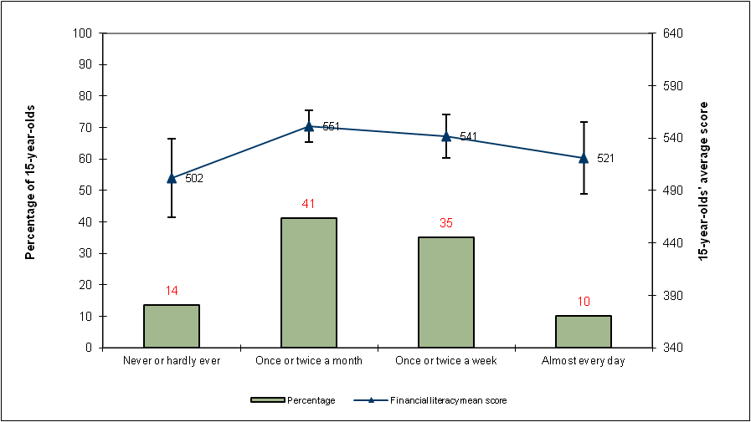
Talking with parents about money matters
Notes:
Unfortunately there was a large amount of missing data among some of the background questions relating to financial literacy, one of the questions where there is sufficient data was how aften students discuss money matters with their parents.
The graph shows there is not a simple relationship between the frequency with which money matters are discussed and performance in financial literacy.
While there are no significant differences between the groups the graph indicates that students who never or hardly ever and students who discuss money matters every day tend to have slightly lower scores on average than students who discuss money matters at least once or twice a month

Slide 24
Students’ experience with money - bank accounts
About 90 percent of New Zealand students reported they had a bank account
This was higher than in all but one of the 18 countries
The difference in score between New Zealand students who held a bank account (543 points) and those who did not hold a bank account (437 points) was by far and away the biggest difference (106 points) among the 18 countries
The next biggest difference was 54 points (Slovenia)
In Australia the difference was 26 points
Notes:
SLIDE:

Slide 25
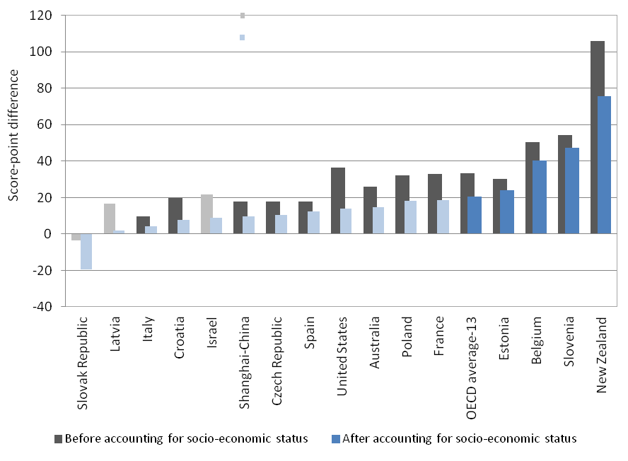
Students’ experience with money - bank accounts
Notes:
89% of New Zealand students reported holding a bank account. This was higher than all but one country (Slovenia) and similar to Australia (81%)
New Zealand stands out as having the largest difference in financial literacy performance (106 score points) between students who own a bank account and those who do not.
Even after accounting for Socio-economic background this difference is still very large (76 score points)

Slide 26
How student attributes relate to achievement
We can look a the relationship between attributes - such as not giving up easily when confronted with a problem (perseverance) and liking to solve complex problems (openness to problem solving) – and achievement in financial literacy
Not only was there an achievement advantage for those students who did not give up easily on problems and who like to solve complex problems over those who did not – but this advantage was bigger than in the OECD on average, particularly in the case of perseverance.
This finding is consistent with other findings on the relationship between achievement and perseverance.
Notes:
SLIDE:

Slide 27
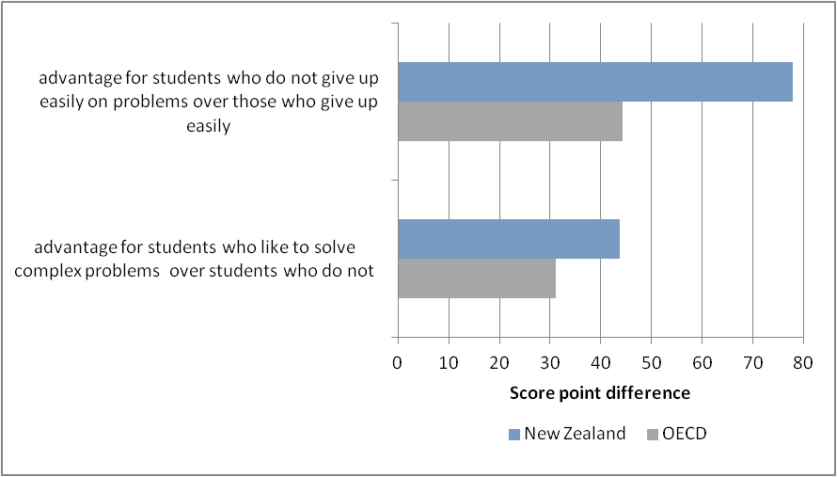
Perseverance and openness to problem solving
Notes:
This graph looks at some of the behaviours and attitudes related to financial literacy
Students reported their response to two statements:
“When confronted with a problem, I give up easily” and
“I like to solve complex problems”
New Zealand students stood out as having one of the largest differences between students who do not give up easily on problems (78 score points) and those who do not (only United states with similar difference (78 score points)
Similarly compared to other countries, New Zealand had the largest difference between students who liked to solve complex problems and those who do not (44 score points)

Slide 28
Contact Details
Lynne Whitney
Research, evidence, data and knowledge group.
Mobile: 027 249 5372
Email: lynne.whitney@minedu.govt.nz
Angela Clemens
Curriculum, teaching and learning group.
Mobile: 027 208 8803
Email: angela.clemens@minedu.govt.nz

