Slide 1
From stress to strength: building resilience under pressure
Gaynor Parkin
Psychology @ Victoria
Notes:
Mention my role at Vic – Clinical teaching Fellow – but speaking today as PhD student.
Run resilience training in my role as MD at Umbrella.
I also have a personal interest in resilience – 11 year old twins!

Slide 2
Overview
What promotes psychological resilience?
Current study
Observations
Notes:
I will be focusing on how to improve individual resilience – what can organisations do to support/strengthen.

Slide 3
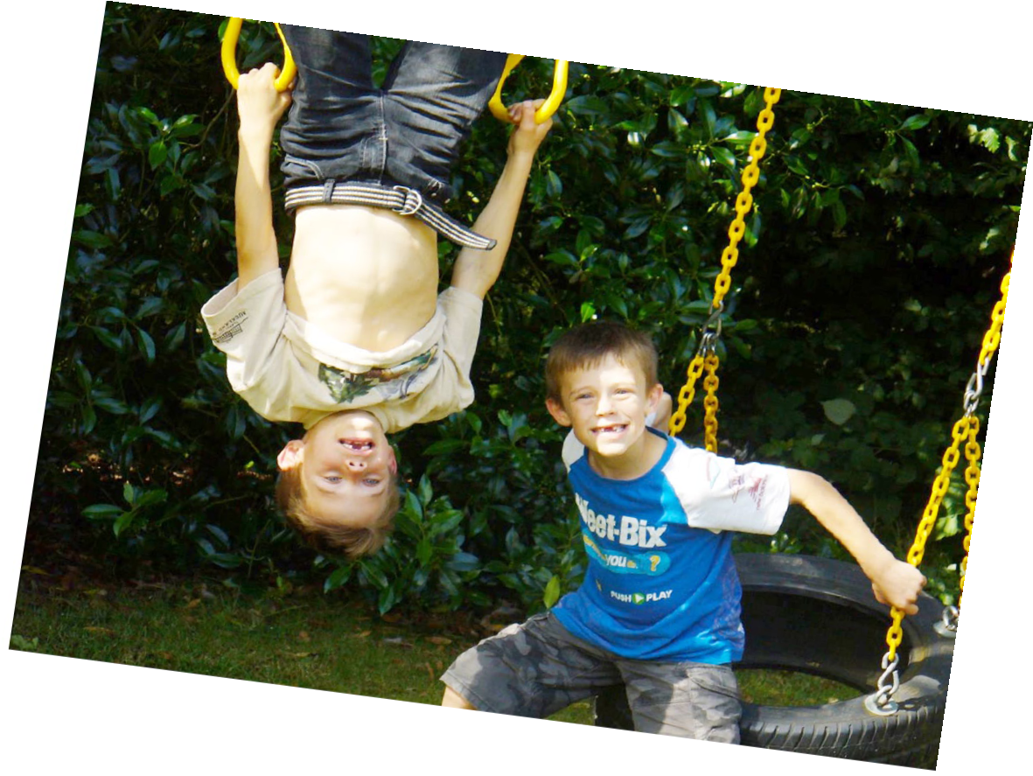

Slide 4
Psychological resilience
Ability to adapt and recover well after stress, adversity or change
“Bouncing back”

Slide 5
“You can’t stop the waves but you can learn to surf “
Jon Kabat-Zinn

Slide 6
“Resilience is built through the everyday, every minute habits and exercises that punctuate our daily lives.”
Lynda Gratton, Professor, London Business School

Slide 7
Previous research
Child development
Trauma – post traumatic growth
Neuroscience
Positive Psychology
Notes:
Again this research is focused on individual resilience

Slide 8
Evidence to date
Physical fitness and recovery – role of stress hormones
Meditation/Mindfulness
Emotion regulation skills
Experiencing positive emotions

Slide 9
Evidence to date
Cognitive flexibility
Realistic optimism
Problem solving skills
Connectedness

Slide 10
Evidence to date
Cognitive flexibility
Realistic optimism
Problem solving skills
Connectedness

Slide 11
Current study
(Thanks MSI R&D $)!
6 participating organisations: all under pressure
Does resilience training make a difference?
Notes:
Face to face groups facilitated by clin psychs

Slide 12
Current study
Face to face vs. etraining
Block vs. spaced
Impact of follow up
Notes:
Face to face groups facilitated by clin psychs

Slide 13
Study measures
Perceived Stress Scale
Brief Mindfulness Measure
Work and Well-Being Survey (UWES)
Connor-Davidson Resilience Scale
Life Orientation Test Revised
Adult Coping Scale
Health measures

Slide 14
Measures of performance
Tricky!
Each organisation uses different measures – or not
Suggestions welcome
More focus on this in phase 2

Slide 15
Training modules 1-4
Stress – mind-emotion-body responses
Resilience – from psychological research
Physical wellbeing
Flexible thinking

Slide 16
Training modules 5-8
Realistic optimism
Strong relationships
Emotion regulation and positive emotion
Recovery and mindfulness tools

Slide 17
Progress to date
289 participants completed training (face to face)
269 completed pre and post measures
Poor response rate at follow up
More focus on this in phase 2

Slide 18
Participant feedback
Request for more follow up
Helpful to understand science behind tools
Want leadership support

Slide 19
Participant feedback
Has the training helped improve your resilience?
Health?
Performance at work?
Coping with stress at work/home
Relationships with others
Notes:
Generally very positive

Slide 20
Barriers
Changing org. priorities
High staff turnover
Perceptions of resilience training

Slide 21
Solutions?
SLT engagement and participation
Invite to participate in training and who attends first important
Feedback and changing attitudes

Slide 22
Solutions?
Follow up at all levels critical
Make resilience habits routine
Address disconnect between performance/productivity and well-being initiatives
Notes:
Individual, team and organisational

Slide 23
Questions?
Your comments and suggestions are very welcome!

