Slide 1

Can organisational resilience be taught?
Angela Atkins, GM, Elephant & Auckland HRINZ Branch President

Slide 2

What is organisational resilience?

Slide 3

An organisation cannot be taught, but the people in it can learn

Slide 4

There are 2 key factors for this to occur:
1. The Leaders at the top, their strategy and decisions
2. Rigorous processes and managers who can drive these processes

Slide 5

Case study 1: PPGL
Family business
Mail order dropping off – retail much stronger
Family wanting to retire

Slide 6

Case study 1: PPGL
Leadership made the decision to list & change the business model
Structured process: new IT systems, management team, shut down mail order, purchase two other businesses.

Slide 7

Case study 1: PPGL
Shares have dropped significantly since listing but dividends have been paid
Company have continued to evolve – consolidating Support Office and gone back to core
So has been resilient

Slide 8
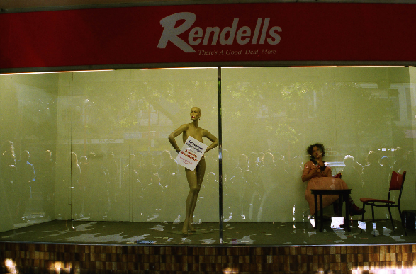
Case study 2: Rendells
Leaders weren’t given authority to make decisions
Processes were a little archaic!
The company did not bounce back

Slide 9

Case study 3: Hanover
Before GFC business doing well as economy boomed
Still got a lot of press coverage due to shareholders
Then GFC hit…..

Slide 10

Case study 3: Hanover
Freeze on funds
Leadership made the call to divest businesses & propose options to investors
Came up with a new repayment plan – new processes & managers had to drive this
Very strong in group as hated by media/public

Slide 11

Case study 3: Hanover
Couldn’t continue making repayments so came up with share plan
This ended up failing too and Hanover reached the end of the road
Hanover was far more resilient than many other finance companies

Slide 12

Case study 4: Manufacturing
Company going to start manufacturing product in Asia
Leadership made hard decision to make 4/5ths of the organisation redundant
2 year structured process to map all processes, change them and support staff leaving with gradual shut down

Slide 13

Case study 4: Manufacturing
Elephant came on board to help with HR strategy going forward
Leaders training for new structure and scope of roles
Employees given training, new vision, reviews & celebrated
New culture built. Company continues to grow sales in new environment.

Slide 14

So can organisational resilience be taught?
No-one was standing teaching
Leaders made hard decisions
Managers put those into place
The company learned to be resilient

Slide 15

And who is responsible for making this happen?
The HR team of course!
That’s my opinion. Feel free to email me on angela@elephanthr.co.nz

