Slide 1
The Living Wage in Aotearoa New Zealand
Jim Arrowsmith
Jane Parker, Jarrod Haar, Stuart Carr, Darrin Hodgetts, Siatu Alefaio
MPOWER/CLEW Seminars
Auckland and Wellington
November 2019

Slide 2
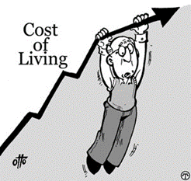
Context
LW internationally prominent due to rising living costs & low-paid/ precarious work
Defined by ‘quality of life’ not basic subsistence
A worker should be able to have some access to recreation/ culture; provision for emergencies (savings, insurance); and provide for dependents
NZ rate calculated by the Family Centre Social Policy Research Unit as the hourly wage which if earned by 1.5 fulltime adult workers would be sufficient for a household of 2 adults and 2 children ‘to live modestly and participate in society’
2019 rate is $21.15 (would have been around $2 more without the uplift in disposable income via the Families Package). Current MW is $17.70
LWs are voluntary. There is a rapidly growing number of ‘accredited’ employers in NZ
Most are small firms and NGOs with a strong ethics/ CSR commitment. Also a couple of local councils (Dunedin, Wellington) and some corporates (e.g. Vector, Westpac, ANZ) with a relatively small proportion of low-paid workers
Other employers publicly ‘shadow’ the LW (e.g. Smiths City, Warehouse, Auckland City Council, Porirua City Council). Obstacles to accreditation are uncertainty over future rates, as well as the obligation to extend compliance to sub-contractors (which can be complex)

Slide 3
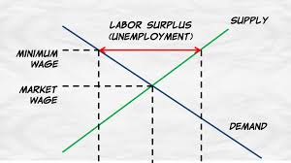
Arguments for and against: similar to MW
Case against…
paying above ‘market’ wages leads to job losses and/or work intensification
wage growth should reflect firm and individual performance
clumsy way to address poverty or need given wide variation in individual circumstances and regional living costs
problem is less one of low pay than high living costs, especially housing
disproportionately negative impact on small firms and service sector
labour intensive, low margin
other costs such as rent, rates rising fast too
indirect impact on wage costs as skilled/experienced staff seek to restore differentials with entry-level workers
less able to absorb or pass on cost increases, or respond through efficiencies/ work reorganisation

Slide 4
Alternative views…
low pay reflects unequal dependency and bargaining power not simply supply and demand
may not reflect contribution or productivity; can be exploitative
‘efficiency wage’ and psychology theories - positive returns to higher pay
better recruitment; retention; development and training; commitment; and better people management and employee relations generally, including in small firms
targeted taxpayer-funded transfers such as housing and child benefits subsidise low pay
higher pay for lower earners has beneficial macroeconomic multiplier effect
higher wage floor encourages competition based on innovation and quality not simply cost

Slide 5
Issues need exploring in a systematic way
From an employee perspective, how far is pay (and household income) linked to quality of life (work satisfaction + family life, leisure)?
where, if any, are the tipping points?
The prevalence of small firms and service work in NZ means many employers do not pay > LW. However, little is known about employer attitudes around low pay and the LW
are low-paying employers favourable in principal but constrained in practice? or could they pay more but choose not to?
what explains differences in attitudes and practice – e.g. size, sector, ownership, competition, unionisation, management choice….?

Slide 6
The research project
Two main questions
is there a LW range that enables people to thrive in Aotearoa/NZ?
what are the main barriers to, and facilitators of, employers’ adoption of LW?
Supported by Marsden Fund
established by the Government in 1994 to support excellent fundamental research; administered by the Royal Society of New Zealand
pilot study funded by Massey University (VC’s Discretionary Fund)
Three years, commencing March 2018
nationally-representative panel survey of 1,000 workers in low-income occupation (up to $60,000), Yrs 1 and 3
employer (and other stakeholder) interviews at sector/policy level (Yr1)
company-level interviews and case studies (Yrs 2-3)

Slide 7
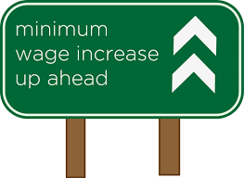
Fortuitous Timing - increases to MW
Median hourly earnings 2019
clerical/ admin $25.2
technicians/ trades $25.0
machinery operators/ drivers $22.5
community/ personal service $21.3
sales workers $20.0
labourers $19.2

Slide 8
Employee Survey
Sample approximates to low-paid workforce with a range of ages, ethnicity, regions, jobs
modal age 30-35
69% female
61% NZ European, Māori 11%, Asian 11%, Indian 7%, Pacific 6%, 3% other
most (77% men, 65% women) work in the private sector, for a range of different size employers, with 18.1% in the public sector. Only 15% are union members
A third of female and nearly half (45%) of male respondents are sole household earners
12.9% receive Working for Families benefit; 7.4% Accommodation Supplement; 6.5% pension; 3.7% a sickness or disability benefit
49% men and 44% women are on MW, and 14% had more than one job
a quarter worked <20 hours per week; 13% of men and 5% women worked 46 or more.
Three in five live in rental accommodation

Slide 9
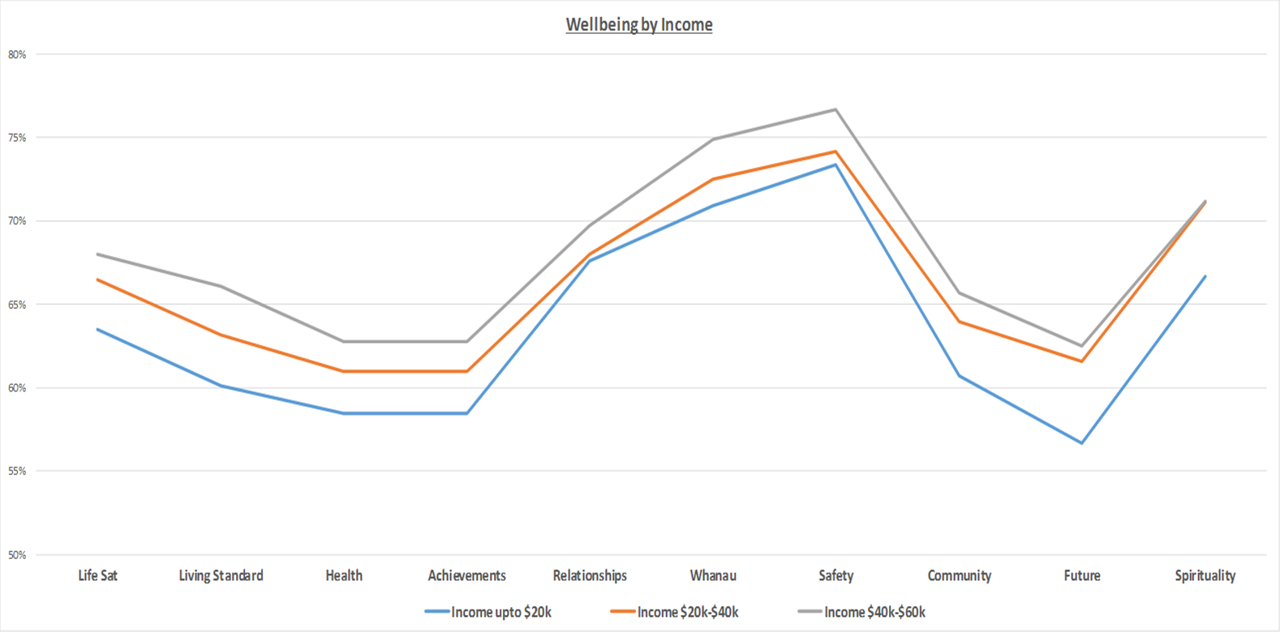
1. Income is related to stress and wellbeing
lower earners particularly low on satisfaction with e.g. health, achievements, future
worry about the future is also a big relative difference

Slide 10
Stress is related to working time, insecurity, working conditions as well as pay
It is a constant struggle to stay afloat. Wages are barely crawling upwards to meet the demands
I think for the work I do I should be paid a few dollars more. There is a high workload/stress and I also work unsocial hours
I feel like it’s not enough, the fact that basic needs in Auckland is pretty high such as housing and food
My job may go at any time. This causes a lot of stress for me... My hourly rate is good, but the hours I am given to do the jobs in is not enough
I work in a dark dusty environment the size of an average master bedroom… we work there with no fresh air able to enter the room, only an air conditioner and no natural light. I hate it and my health and life is suffering for it, but I can’t leave because struggling to pay the bills is better than not paying the bills at all
He offers $30 per hour, but there is no employee benefits like sick/annual leave, etc. Because my rent is low at the moment, I am only getting by. But I know my savings are slowly depleting

Slide 11
2. Low pay and job attitudes are strongly related
Used established scale measures of Job Satisfaction; Work Engagement ; Career Satisfaction; Meaningful Work; Affective Commitment; Organizational Citizenship Behaviours; and Work–Life Balance
Related these to household income (and composition) and individual pay
statistically significant relationship between pay and job attitudes
all 7 pivot upwards between the then MW ($15.75) and LW ($20.55)
bigger shift for those in lower income households
no moderation by number of dependents
few gender differences
Though, overall, women…
are more likely to say they are often exhausted by work (50.7%/39.7%)
have low influence over decisions concerning their job (51.2%/ 39.6%)
are less likely to say wage/ salary meets their needs (46.1%/56.2%)
are slightly more stressed (5.72, 5.18 on 10pt scale, p=.001) and slightly less happy (6.10, 6.37, p=.075)

Slide 12
Employer perspectives
First wave: Series of interviews in 2018
Employer associations
Business NZ, Manufacturing NZ, EMA, Retail NZ, Tourism Industry Association, Hospitality NZ, Food Grocery Council, Federated Farmers, Horticulture NZ, NZ Aged Care Association
Chambers of Commerce
Hawkes Bay, Otago, Auckland, Wellington, Manawatu
Consultants and other stakeholders
Strategic Pay, Premium Business Solutions, CTU, HRINZ, LWMANZ, Wellington and Auckland councils

Slide 13
1 Little opposition in principle...
Sector associations see LW as partial response to enduring labour shortages, re-branding careers
New Zealand Tourism Industry Association – ‘Sustainability Commitment’ includes being a ‘quality employer’ and paying a ‘fair wage’ - “One of the commitments we’re asking businesses to do is to pay a fair wage to staff… this might be the minimum wage for a new starter with no skills, but look different for an experienced employee. One of the default mechanisms for a fair wage is the living wage”.
Federated Farmers: latest Workplace Action Plan considering advising members on ‘aspiring to the Living Wage…(for) the ones that can afford it - in order to recruit staff you really have to make an attractive proposition for them’
….but individual employers in a bind
experiencing upwards wage pressures due to low unemployment (including regional pressures e.g. ChCh) but many firms have limited manoeuvre to raise productivity or pass on costs
international competition – manufacturing
dependence on key customers – food processing
acute price sensitivity with online comparisons – retail
price takers - farming
”A lot of our members don’t have a problem with a living wage concept. I recall a story from an Auckland manufacturer with two of his machine operators lured away by a bigger company offering better salary. He said, ‘I wish I could have matched that, but I just can’t, but I don’t berate the guys because their rent has just gone up from $700 to $750 a week and they’ve got a young family.’ The high cost of living in Auckland, which is specifically tied to the high cost of accommodation, it just really drives up not only wage expectations, but also objective wage pressures. But, the problem is that the money has got to be earned before it's spent” – Manufacturers Network

Slide 14
2. Responses to rising MW
Reduced hours/ workers
“some of our clients have done things like changed the contracts so people are working less hours; some people have gone from 40 to 38, so effectively it's a pay increase, but it doesn’t cost the organisation anymore and they’re looking for ways to get the work done. Some are just cutting staff numbers, particularly supervisory staff” – Strategic Pay
Training and job enlargement
e.g. WN council brought parking services in house: “We changed them much more from being just ticket revenue collectors and compliance officers, to having a role in the city that was a bit more ambassadorial. And, so our recruitment processes became a lot more rigorous. We put staff through assessment centres. …I think it has helped us attract a better calibre of person”
Automation
the predicted [MW] and cost changes are making automation more affordable. With automation you don’t have all the other challenges of dealing with human beings; some of the warehouses within our membership that I visit now, you don’t even keep the lights on” - FGC
“Over the last six years [Sistema] have both heavily automated and increased their workforce, and what they’ve done in a very good way is basically trained people who used to do manual work to become machine operators… That’s a good example for automation not leading to job losses. What it will do is separate well-managed companies from poorly managed companies in a more dramatic way; so, what you will see is not an overall loss of jobs, but you will see a shift in what kind of jobs are being offered” – Manufacturing NZ

Slide 15
Conclusions
LW is likely to improve wellbeing and translate into job commitment
more so for those in poorest households
less so where jobs are of poor quality
Low pay often a product of structural constraints rather than agency
Increased labour costs may encourage a range of responses
automation
work intensification
upskilling
revised hiring patterns
Further research needed into employer attitudes and practices
next up – longitudinal case studies
employer survey?

