Slide 1
MPOWER-The Warehouse Group Ltd Collaboration Launch Business Leadership: Business and Modern Practice
Professor Jarrod Haar
(Ngati Maniapoto, Ngati Mahuta)
Massey University (Albany)
Acknowledgement: Massey University Strategic Innovation Fund (NP 97971)

Slide 2
Leadership & Leaders
“Someone who has followers”
“Capacity to translate vision into reality”
“Those who empower others”
Context: How might we select future leaders?
Same old approach? Or something different?
Will it make a difference? To what!?
And how? Candidate selection…

Slide 3
Research Study Overview
Part 1: 31 Māori leaders – interviews [qualitative]. Identifying five key characteristics
Part 2: 250 NZ-representative employees [quantitative] – do these characteristics link to leadership styles? Which ones?
Part 3: 122 NZ-representative employees [quantitative]- do these characteristics and leaders styles link to employees own wellbeing, and job attitudes and behaviours?

Slide 4
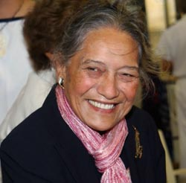
Findings: Altruism
Altruism = selfless concern for the well-being of others

Slide 5
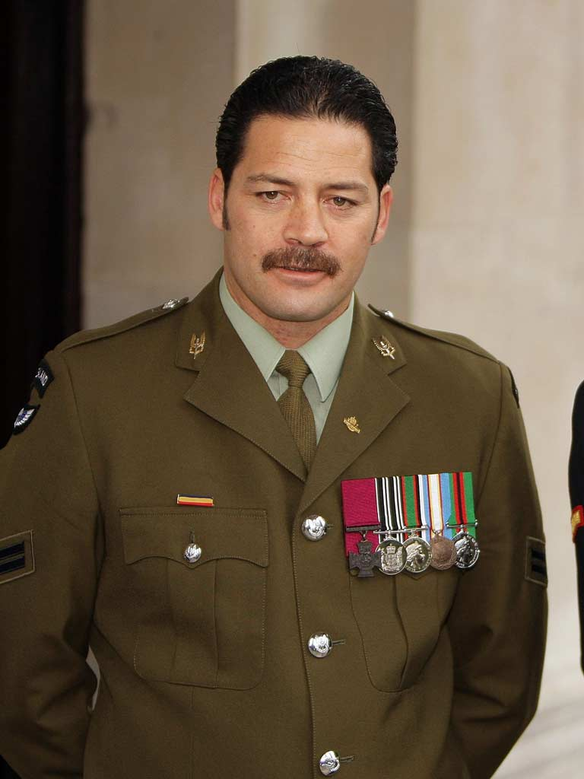
Findings: Humility
Humility = the quality of having a modest view of one's importance

Slide 6
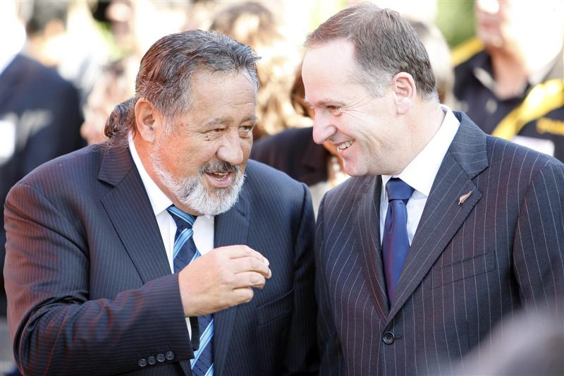
Findings: Collectivism
Collectivism = group priority over the individual (‘we’ over the ‘I’)

Slide 7
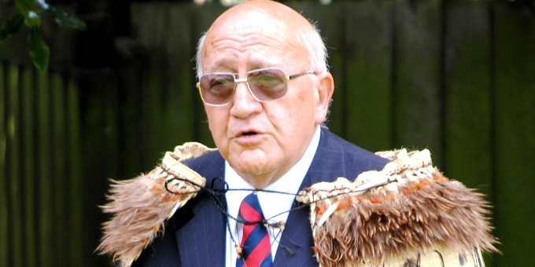
Findings: Long Term View
Long Term View = attribute that emphasises the future, thrift and persistence

Slide 8
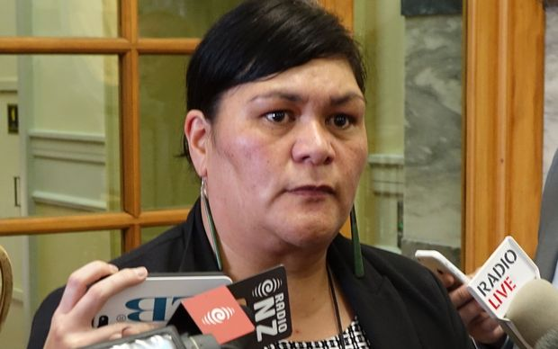
Findings: Cultural Authenticity
Cultural Authenticity = condition of being authentic, trustworthy, or genuine towards one’s own culture

Slide 9
Study 2 Findings
These 5 characteristics were positively linked to positive leadership styles:
Authentic Leadership
Transformational Leadership
Servant Leadership
Ethical leadership
Relational Energy
And Leader effectiveness

Slide 10
Study 3 Findings
These 5 characteristics and the aforementioned leadership styles enhanced the following:
Employee wellbeing (life sat, work-life balance, job burnout, mental health)
Employee work attitudes (engagement, commitment and satisfaction: job & career)
Employee work behaviours (job performance and lower turnover)
Universal!? No gender diffs in characteristics! Age and ethnicity? both older & Maori sig related to altruism only

Slide 11
Key Points
Good leadership extends beyond the bottom line. Good profits and employees ☺
Findings generalise to all NZ employees and their leaders (albeit professionals)
Thus, seek leaders who are: altruistic, humble, collectivistic , have a long-term view, and are culturally authentic…
These leaders are more likely to have a positive leadership style and be better to work for! Their followers are more engaged, satisfied, work harder and are happier!

Slide 12
Key Points
Māori leadership provides us with a pathway to understanding and improving leadership in all New Zealand workplaces
However…beware the humble & collectivistic candidate, e.g. imagine a Willie Apiata…
“oh, really it was a team effort!”
Hence: candidate selection might require 360 degree interviews…

Slide 13
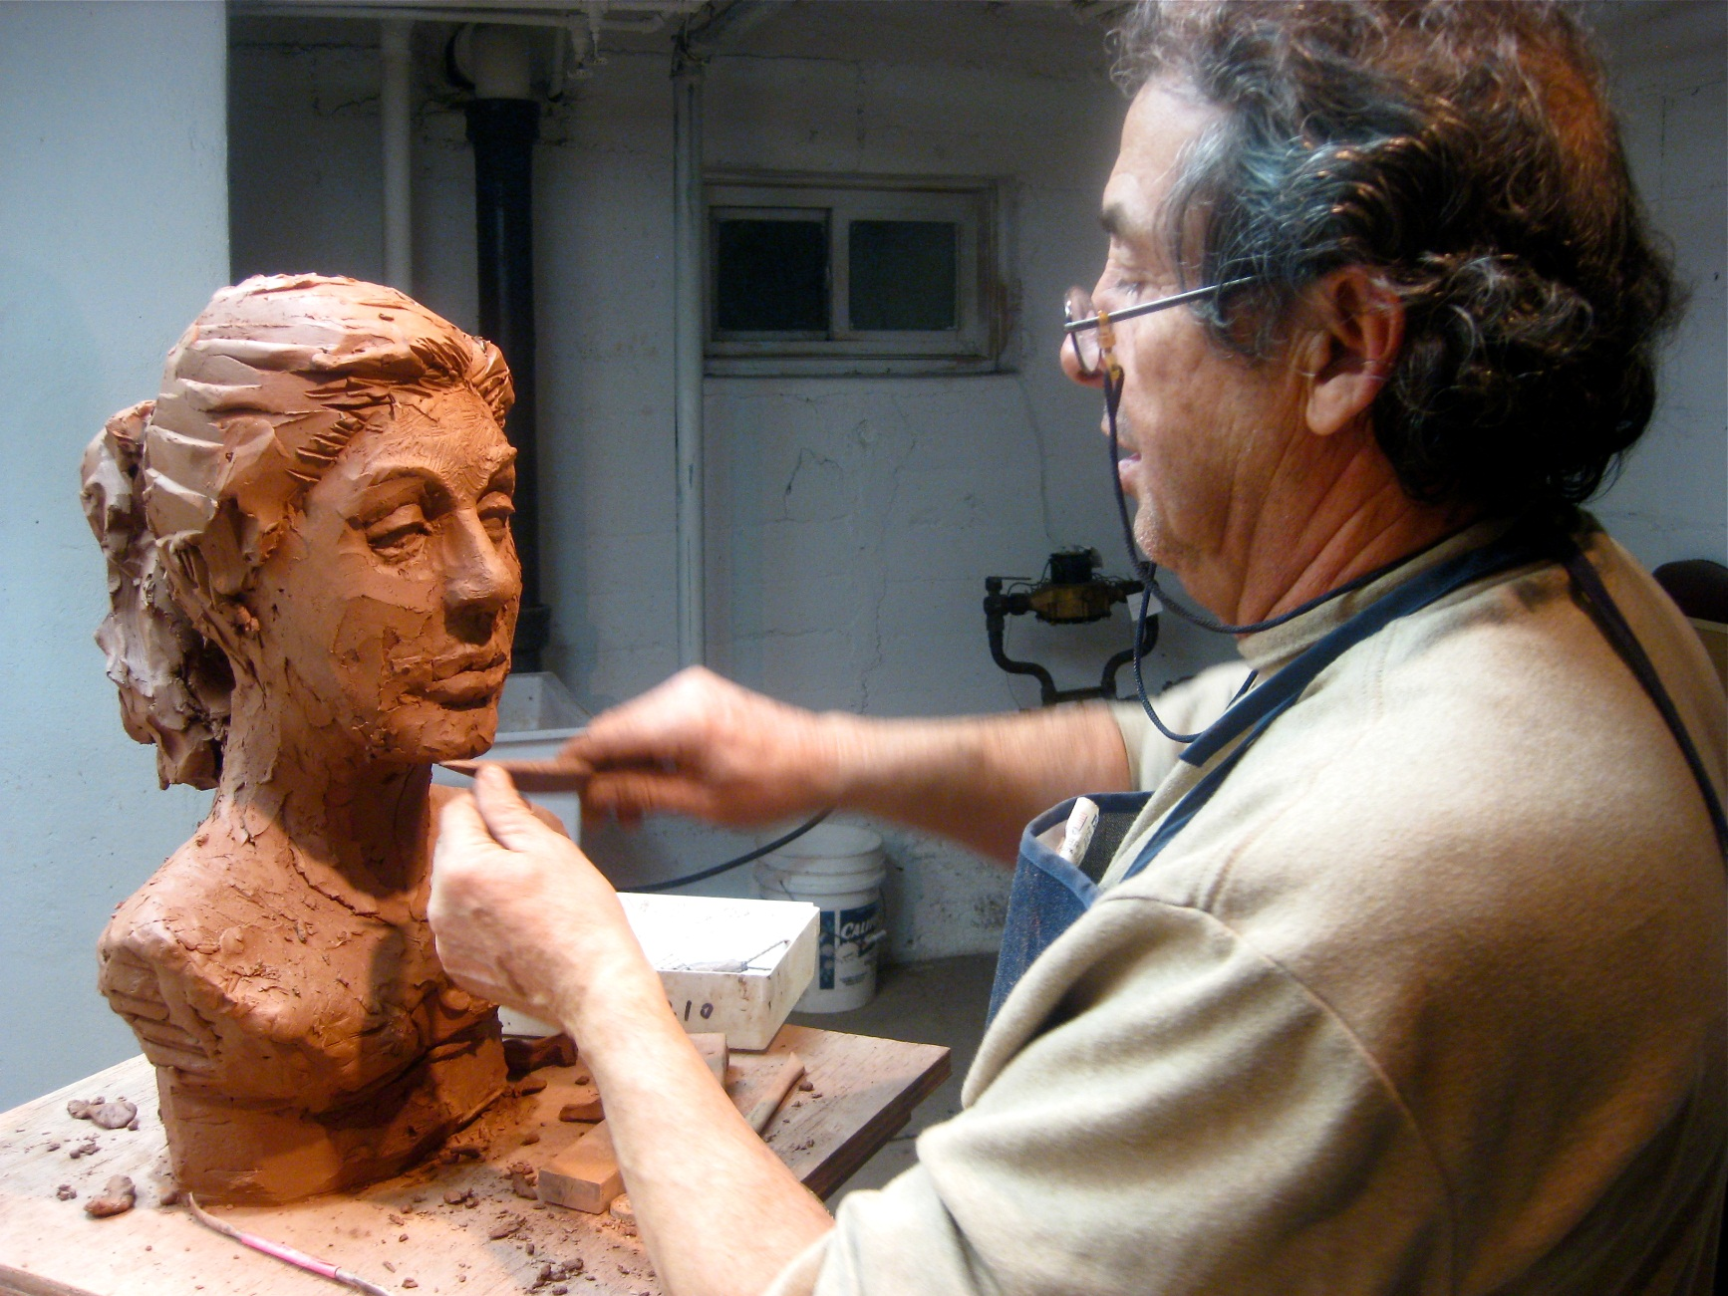
Clay Analogy: Select to Build/Shape

