Slide 1
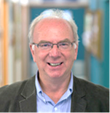
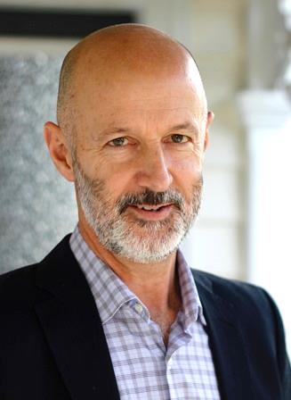
MPOWER RESEARCH SEMINAR
SCHOOL OF MANAGEMENT
MPOWER seminar:
Health and Safety at Work: Leading Issues
Speakers:
Ian Laird, Massey University
Ian is Associate Professor in Occupational Health and Safety in the School of Public Health at Massey University, Palmerston North. He has served on many government committees’ including the provision of advice on occupational health to the Ministers of Health and Labour. Currently, Ian is a member of the Occupational Health Advisory Group, which provides advice to the Board of Worksafe NZ. Ian leads the Occupational Health and Safety programme at Massey University and is a Fulbright Fellow and Visiting Scientist at the Harvard School of Public Health.
David Tappin, Massey University
David is senior lecturer in the School of Management and a member of the Healthy
Work Group at Massey University. Before joining Massey in 2011, he was a researcher with Scion (a crown research institute), and prior to this, a co-director of the consultancy and research company SPE Ltd. Most of his time in these roles has involved injury prevention research and consultancy in primary industries, primary processing, manufacturing and residential construction. David’s current research focus is the reduction of psychosocial risks in work and the development of sustainable work.
This seminar session will encompass the shift from occupational health to creating healthy workplaces; global and national strategies for occupational health; and the future of occupational health.
DATE: WEDNESDAY 15TH MARCH 2017
TIME: 10:00 am – 1:00 PM
VENUE: Room GLB 2.04 (Massey Manawatu Campus)
FORMAT: 10.40 Introduction: Professor Jane Parker
10.50 Speaker 1: Associate-Professor Laird
11.15 Speaker 2: Dr David Tappin
11.40 Q&A
12.00 Light lunch
Please RSVP to mpower@massey.ac.nz for catering purposes

