Slide 2
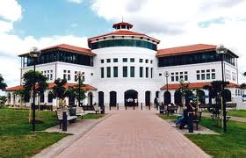
Conference Summary
Mason Durie

Slide 3
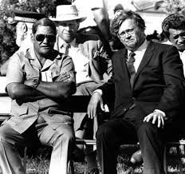
The Broad Aims
To reflect on the significance of the 1984 Hui Taumata
To consider pathways for Māori development into the future

Slide 4
Ngā Mihi - the Sponsors
He Kai kei aku ringa
Crown-Māori Economic Growth Partnership

Slide 5
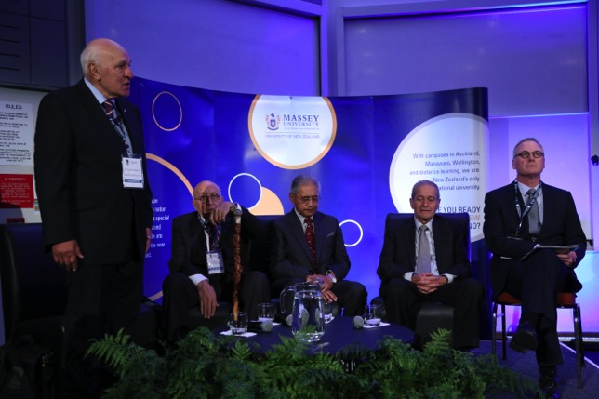
Ngā Mihi - Speakers & Participants
Key Note Speakers
Panelists
Conference organisers
PARTICIPANTS

Slide 6
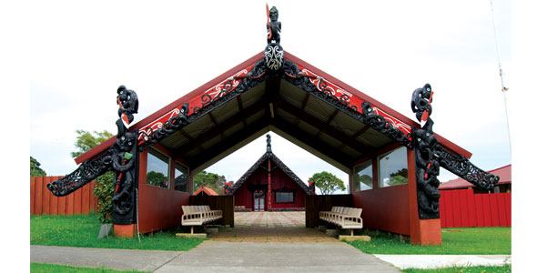
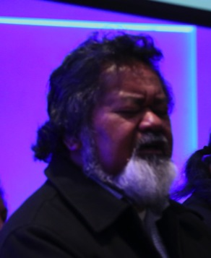
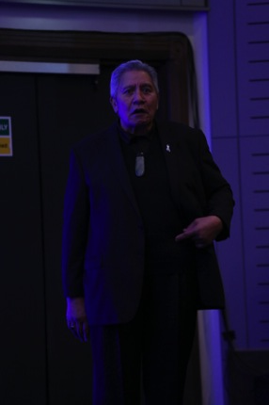
Te Whakatau
Na koutou te karanga,
te reo powhiri
Haahi Walker
Ngāti Whatua
Pita Pou

Slide 7
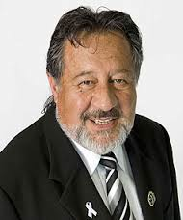
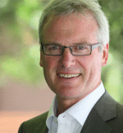
Opening Session
‘There is an obligation to create a society where Māori can flourish and take the world with them.’
‘Our future will be transformed by education & new technologies.’ ‘The architects of the future must not fail to listen to the collective voices from all our people.”
‘This conference is about how a world view articulated by Māori in 1984 and again in 2014
can become central to New Zealand in the 21st century .’
Hon Pita Sharples
Sir Tumu Te Heuheu
Chair
Dr Selwyn Katene
Hon Steve Maharey

Slide 8
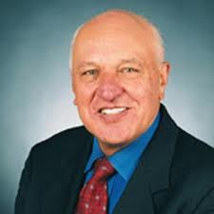
The 1984 Hui Taumata: A 30 Year Retrospective
The 1984 Hui Taumata discussed the parameters for a future Māori economy
The major outcomes that followed were:
Treaty of Waitangi legislation in 1986
Māori Language Act 1987;
the return of Māori lands
the Iwi Runanga Act 1989;
the continuation of social programmes
new economic initiatives
Sir Tamati also discussed the ‘Māori Loans Affair’ and the unfounded and unjust accusations that followed.
Key Note Speaker
Sir Tamati Reedy
Chair
Robin Hapi

Slide 9
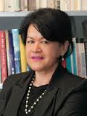
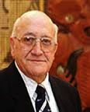
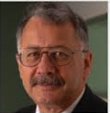
The Significance of the Hui Taumata Panel Perspectives
Māori economic growth saw the establishment of a number of entities including MANA, FOMA and MTV; but the vital question for the future will relate to the common good & opportunities for whānau
‘The real question is how Iwi see their futures without a grievance that can distort the vision’. ‘We need to be clear about designing a world that we want- a world that will be home to our mokopuna and their children.’
Ripeka Evans
Sir Tipene
O’Regan
Chair
Robin Hapi

Slide 10
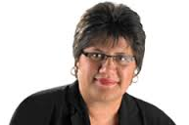
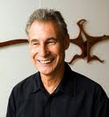
Balancing Iwi Aspirations & Whānau Hopes
There need not be trade-off between Iwi and whānau aspirations . The hopes of whānau and the aspirations of Iwi can be woven together. ‘The key is not leaving whānau to be left in the wilderness.’
Te Puni Kokiri has restructured so that it can focus greater attention to realising results
for whānau and for Iwi.
Key Note Speaker
Michelle Hippolite
Chair
Professor
Ross Hemera

Slide 11
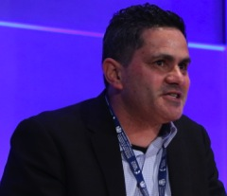
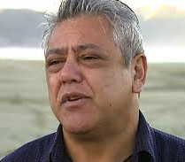
Iwi Aspirations & Whānau Hopes Panel Discusssion
Economic development is only one aspect of whānau development alongside others such as an environmental ethic.
A key role for Iwi is to empower whānau by enhancing mana, tapu, te Ao Turoa, mātauranga Māori, whakapapa.
And the involvement of rangatahi in Iwi can be strengthened by Rangatahi summits and leadership.
Transformation not transaction should guide interactions.
Dr Will Edwards
Haami Piripi
Chair
Professor
Ross Hemera
Nancy Tuaine

Slide 12
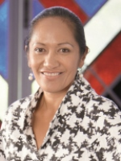
An Integrated Development Agenda: Balancing quadruple aims
‘Kia Tupu, Kia Hua, Kia Puawai’
Drawing on the experiences of Tainui Waikato an integrated development agenda that has social, cultural, environmental and economic dimensions was described.
Whakatupuranga 2050 takes a long term view of development –The strategic framework covers kingitanga, tribal identity, tribal success and social wellbeing.
Key Note Speaker
Parekawhia McLean
Chair
Professor
Jarod Haar

Slide 13
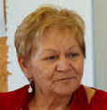
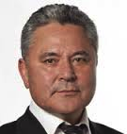
An Integrated Development Agenda: Panel Discussion
‘Aotearoa has an opportunity to become world leader in integrated development.’
‘The power of the State sector sets terms for economic engagement. The transfer of resources into Maori hands should be a goal so that realities can be properly addressed’
‘We now need to address the context of society of which political decision making is a dominant part. And a second dimension is the machinery of Government. Understanding both will be essential if progress is to be made.’
Naida Glavish
John Tamihere
Chair
Professor
Jarod Haar
Sir Wira Gardiner

Slide 14
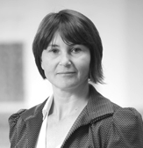
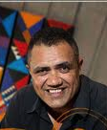
‘Finding Te Pae Roa’
Raising Living Standards for Tangata Whenua
5 steps to success were identified
1 Clear pathways for young people including strong governance & management skills
2 Risk management, reducing risks without undue risk aversion
3 Supporting active ownership that brings in the wider community
4 Strengthening with growth – resilience, innovation, people investments
5 Building relationships with the wider community
Vicky Robertson
Chair
Professor
Rawiri Taonui

Slide 15
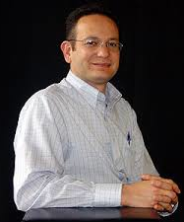
‘The Pae Roa Lecture’ ‘The New Indigeneity: the Tangata Whenua of Tomorrow”
The four themes of Māori history;
The search for Survival
The quest for Social Justice
The desire for Cultural Revitalisation
The achievement of Creative Potential (Mana)
Creative potential is about what we have, not what we have lost.
Our future is inextricably connected to the natural world
Tino rangatiratanga should be liberated out as a model to guide the nation
Professor
Charles Royal
Chair
Professor
Rawiri Taonui

Slide 16
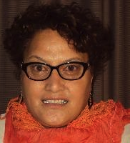
Whitiwhiti Kōrero: Open Forum
‘An enjoyable day. To know how we have progressed is reassuring especially knowing that the progress continues’
‘Inspirational leadership is here today. It bodes well for us as tangata whenua. Developing a new world view deserves a badge of courage.’
‘Our constitutional position needs to be discussed. And how can we collaborate among ourselves at a national level.’
‘Focusing on need rather than right can undermine the point of the Treaty of Waitangi.’
Chair
Dr Mereana Barrett

Slide 17
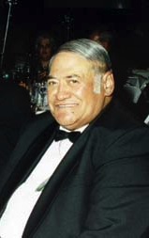
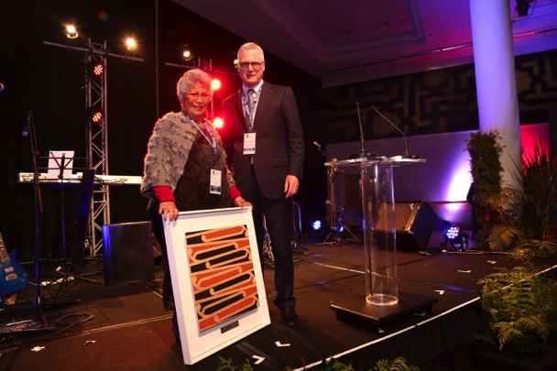
Te Pae Roa Award
Hon Koro Tainui Wetere CBE

Slide 18
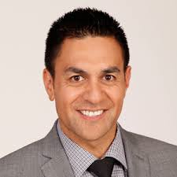
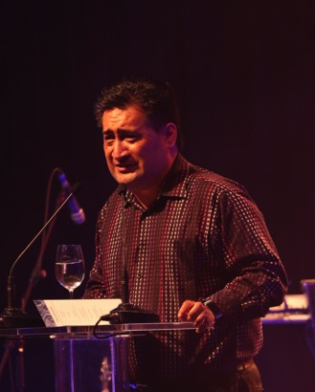
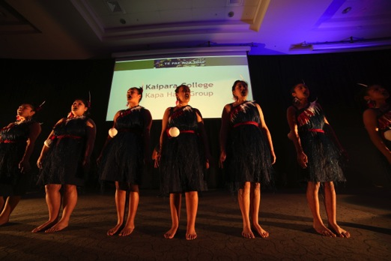
The Dinner
The Dinner
MC
Julian Wilcox
Kingi Biddle
Finding the paradise
Kaipara College
Kapa Haka Group

Slide 19
Day 2 Commencement
Haahi Walker

Slide 20
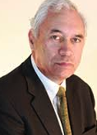
Day 2 Opening Session
‘Our greatest challenge in the future will be harnessing the potential of a million Māori’
And to meet that challenge, successful education will be vital.
Education builds social, cultural & economic strength - leaders for a 21st century economy
Pathways should be available to meet differing student needs & aspirations.
4 top success factors are: Quality teaching practice and leadership in schools; as well as
Parental and whanau engagement and high community expectations
Key Note Speaker
Hon Hekia Parata
Chair
Dr Selwyn Katene

Slide 21
The Intergenerational Challenge: Balancing Present & Future Needs -
‘Guardians of the future against claims of the present’
Can be over- enthralled by our past rather than being fully involved in our future
A shift is occurring; collaborative v adversarial
An increasing asset base & decreasing wellbeing
80% Maori land is under-utilised – requires investments to increase the value & leadership
Māori Inc + NZ Inc = Aotearoa Inc
Te Tumu Paeroa Mission
‘Mobilising Māori land and assets to create this generation’s legacy’
Key Note
Speaker
Jamie Tuuta
Chair
Assoc.Prof.
Helen
Moewaka Barnes

Slide 22
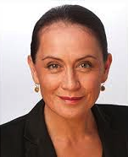
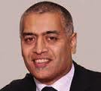
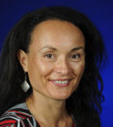
Balancing Present & Future Needs Panel Discussion
To actively improve quality of life need to rethink approach to leadership - Māori as global leaders
Ngāti Porou experience is that we need to maintain economic activity so that our communities and our lands can survive. There is a need to collaborate –partners that share our vision. ‘We need to learn from the past so that we can endure in the future.’
Māori generations are intertwined. We have survived – can we thrive. 3 points consideration
‘Champion rangatahi’ – our economic resource
‘Connect our whanaunga’ – transnational indigenes
Reverse ‘The growing divide within’
Traci Houpapa
Matanuku
Mahuika
Chair
Assoc.Prof.
Helen
Moewaka Barnes
Tahu Kukutai

Slide 23
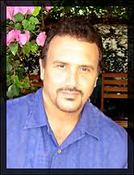
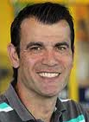
Balancing Indigenous World views with Global Perspectives
Kanaka Maoli Advancements
Globalisation disconnected indigenous peoples from each other reduces political strength
Since 2000, despite a renewed attack on Hawaiian people and institutions, there have been significant demographic, economic, cultural gains
Challenges remain including lack of consensus on self determination
Moving forward requires
re-contextualising values & practices,
re-empowering values and perspectives,
re-visionary leadership,
re-solute action
Key Note Speaker
Professor
Keawe’aimoku
Kaholokula
Chair
Dr Geoff Kira

Slide 24
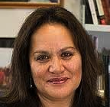
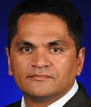
Indigenous World views & Global Perspectives – Panel Discussion
Māori progress & confrontations since 1984. DRIP began in 1985. Some articles reflected Māori concerns. 2010 Govt endorsed DRIP. ‘By Māori for a better world’
Different world views should be celebrated. DRIP article 3 – self determination – e.g. Ngāti Apakura.
Balanced Governance:
traditional, transactional,
transformational, translational, &
spiritual.
Governance starts at the whānau level.
Aroha Mead
Dr Robert Joseph
Chair
Dr Geoff Kira

Slide 25
Building Capability: Balancing the Workforce
1 Building capability in whānau is an intergenerational challenge 3-4 generations
2 An internship programme for Iwi:
Highlighted the varying skill bases of Iwi & the value of on-site training
3 1984 –racial bias in School C; Kohanga Reo emerged as a force. Showed the challenge of implementing change.
4 Representing hapū for Treaty settlements
Coping with suspicion, gaining trust, re-engaging minds.
What we need is well educated whanau – innovation goes beyond resilience
Key Note Speaker
Professor
Linda
Tuhiwai Smith
Chair
Assoc. Prof
Te Kani Kingi

Slide 26
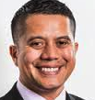
Balancing the Workforce Panel Discussion
Iwi aspirations – science ICT, design, creativity
Workforce trends – demographic trends, diversity, mismatch, global and mobile talent
Future capability – incentivise; pathways; investments; MIBs, Asian bridges
Iwi investments in higher education
A College for thought leadership @ Hopuhopu
Partnerships; collaborations, growing leadership
MBA, Governance training.
Te Wānanga o Aotearoa & the importance of second chance learning. Approach to workforce planning has been ad hoc. Need a plan.
Diverse workforce needs in Ag sector. Priority is for ‘best Maori for the role.’
Selwyn Hayes
Dr Sarah Jane
Tiakiwai
Chair
Assoc. Prof
Te Kani Kingi
Hinerangi Raumati

Slide 27
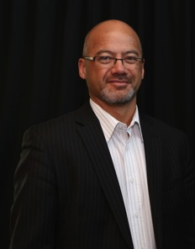
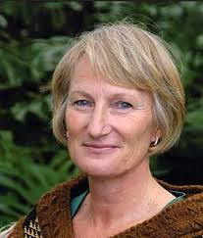
A 2040 Destination: Balancing the Nation
The Treaty was a pathway for a balanced nation
Correcting the imbalance must be a priority so we can ensure that our houses are strong and lasting
Unless it is accepted that NZ has two founding cultures and peoples, then nothing will change.
We need to find pathways that will take us to where we want to go.
We need new visions, a path of potential, hope and faith where the promise of the Treaty can be realised
Over the past 60 there have been substantial changes for Maori. Greater complexities in the future will demand new approaches. There will be greater competition for leadership status.
The most positive changes for Māori must be driven and led by Māori.
Speaker
The Ngati Whātua Experience
Judge Craig
Coxhead
Chair
Margaret Kawharu

Slide 28
What conclusions can be drawn from the past 2 days ?
The journey to 2040 is well underway
It started a millennium ago,
Was boosted along the way,
And is now in sight of tomorrow

Slide 29
What conclusions can be drawn from the past 2 days ?
The generation of Māori who prescribed the Decade of Māori Development in 1984 can be rightly proud of the many achievements
It is now the turn of a new generation to take the vision further so that it will be relevant to 2040

Slide 30
Accelerants to speed the journey
Speakers and panelists at Pae Roa 2040 have reiterated five accelerants that will speed the journey
Balance – Taurite
Inclusiveness - Tūhono
Enlightenment - Whakamārama
Navigation - Tatai Whetū
Reaching the Destination – Tae ki Uta

Slide 31
Balance Taurite
A waka that is too heavy in some parts or too light in others will capsize
Balance:
across generations, Iwi, whanau,
across economic, social, cultural & environmental priorities;
across Iwi, local, national & global priorities;
across the Māori workforce
across the nation

Slide 32
Inclusiveness Tūhono
Pae Roa 2040 is about a journey for all Māori
It is not just for the hui participants, or the knights and the dames, or the Iwi Chairs, or the graduates, or the Runanga, or the Committee members, or the Trustees, or the politicians or the Hui participants
This is a journey for all whānau, all hapū, all iwi, all marae
‘No-one must be left out or left behind’
And it is a journey that other New Zealanders might join
As well as others in the Pacific and beyond

Slide 33
Enlightenment Whakamārama
Heading to Te Ao Mārama
Strengthened by Māori world views
Confident, secure, and able to draw on the insights of earlier generations
Able to turn dreams into realities without losing a Māori heart

Slide 34
Navigation Tātai Whetū
We will need youthful, talented, smart, reliable and committed Rangatahi
We need to have navigators who are ready for the job
We need to have navigators who know where we are going
A major conclusion from this Conference is that there is already a wealth of Maori talent, expertise ,knowledge, and energy all of which are increasingly defining Maori in the 21st century

Slide 35
Reaching the Destination Tae ki Uta
It is important to know where the destination lies
If we don’t know where we are going it is unlikely that we will get there
We will have reached the destination when
all Māori are thriving as Māori
whānau are flourishing
Iwi are forward looking and globally connected
te reo Māori, tikanga, and marae are strong & vibrant
the Māori economy is booming
the natural environment has regenerated
The Aotearoa NZ constitutional arrangements have been rebalanced

Slide 36
Preparing for the next phase of the journey to 2040
Sharing a common vision
Today’s problems, grievances, and discontents should not obscure the vision for tomorrow or distort the shape of the destination
And in order to share a common vision we need to strengthen links and forge connections

Slide 37
Preparing for the next phase of the journey to 2040
Based on a common vision we need to extend alliances
alliances between like-minded people
alliances built on common agendas and a shared sense of purpose
alliances where joint impact outweighs disparate efforts
alliances that do not require loss of identity or autonomy

Slide 38
What if ?
What if all Māori land owners were able to form an alliance that created the biggest farm in the country?
The alliance would not undermine the retention of hard fought titles and the identity that goes with land, but would realise the benefits that come with economies of scale.

Slide 39
And what if ?
What if all Māori-centred schools formed an alliance that balanced institutional loyalty with loyalty to students
Pride in contributing schools would be retained but a greater pride – in Māori futures – could pave the way for the navigators we need to reach the 2040 destination

Slide 40
Another What If
What if all members of Parliament who represented Māori were able to balance loyalty to Party with loyalty to future generations of Maori?

Slide 41
And What If ?
What if all Māori-centred services adopted the Whānau Ora collective model and agreed to a national alliance that could realise the full potential of young and old by 2040 ?

Slide 42
And (another) What If ?
What if all Iwi added value to the post-settlement experience by forming alliances with neighbouring Iwi, with Iwi throughout the country, & with indigenous peoples across the globe, to establish an economic and political force that could guarantee Māori a smooth passage to 2040.

Slide 43
What if all the ‘What if’s’ actually happened?
The journey to 2040 would reach the destination

Slide 44
Getting to 2040
Accelerants to speed the journey
Balance Taurite
Inclusiveness
Tūhono
Enlightenment
Whakamārama
Navigation
Tātai Whetū
Reaching the destination
Tae ki Uta
Preparing for the journey
Creating a shared vision and a common agenda
Forming alliances

Slide 45
2040
KIA MAIA KIA ORA

