Slide 1
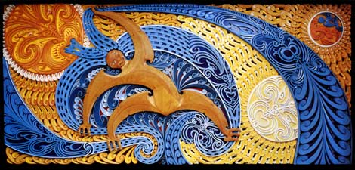
Toi Hauora kōrero o te wā
Pūrākau about Tāwhirimātea explains respiratory issues
The COVID-19 illness includes respiratory symptoms. A Māori understanding of our connection to air can be sourced from pūrākau (narratives) about Tāwhirimātea, atua (primal energy source) of hau (wind and weather).
It is the hau of Tāwhirimātea that brought Hineahuone (first human form) to life, and continues to bring life to our pēpi when they are born and take their first breath. In the whakataukī ‘Hokia ki ō maunga kia purea koe e ngā hau o Tāwhirimātea’ (Return to your ancestral mountains to be cleansed by the winds of Tawhirimatea) hau is a means of cleansing and replenishing oneself – spiritually, emotionally, mentally.
Ngā hau o Tāwhirimātea can also threaten life. It was also Tāwhirimātea who took revenge on his siblings for separating their parents Ranginui and Papatūānuku. Tāwhirimātea caused great damage to the forests, and the oceans, and frightened kūmara and fern root to burrow beneath the earth for protection.
However, when he attacked Tūmatauenga, atua of war and humans, he was overpowered with karakia (incantations) to cause favourable winds and fair weather. The struggle between the brothers continues today. As wuth all connections with atua, we have to work in balance with ngā hau o Tāwhirimātea in order to ensure success in human endeavours.
Physical distancing and taking shelter indoors is the most effective way to protect ourselves from the spread of the virus through respiratory droplets. However, we also need fresh air to exercise and to feel the kiss of the winds on our skin to help cleanse ourselves. Getting the whole whānau outside can also provide relief from the confines of being indoors and in each others close proximity.
Karakia is another way that we can protect ourselves.
We will consider how to maintain balance in our taha hinengaro in the next Toi Hauora Kōrero o te wā.
This mural by Cliff Whiting depicts the struggle of Tāwhirimātea to control his children, the wind and weather (the blue spiral forms). Retrieved from Te Ara - the Encyclopedia of New Zealand, http://www.TeAra.govt.nz/en/artwork/8255/tawhirimatea-and-children

Slide 2
Resources about ?
Karakia before bed by Scotty and Stacey Morrison https://www.facebook.com/groups/Maori4GrownUps/permalink/10158157928707628/
Dr Ihirangai Heke’s explanation of Tāwhirimatea and aerobic training from Atua Matua framework https://www.youtube.com/watch?v=7ObzHwx6GAo&feature=youtu.be
Example of Tāwhirimatea aerobic exercise from Māori movement http://www.maorimovement.co.nz/courses/tawhirimatea

