Slide 1
AN INTEGRATED DEVELOPMENT AGENDA “Kia Tupu, Kia Hua, Kia Puawai” To Grow, To Prosper, To Sustain
2nd September 2014

Slide 2
INTEGRATED DEVELOPMENT
Social, cultural, environmental, economic
Coordination
Alignment
Collaboration

Slide 3
WHAKATUPURANGA 2050
Being proud, committed to uphold their tribal identity and integrity
A diligence to succeed
Self-determination, social and economic independence

Slide 4
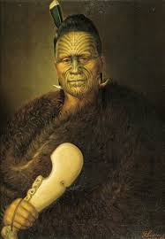
OUR VISION
Maaku anoo e hanga i tooku nei whare, ko ngaa pou oo roto he maahoe, he patete. Ko te taahuhu, he hiinau.
Me whakatupu ki te hua o te rengarenga
Me whakapakari ki te hua o te kawariki
I shall fashion my own house. The support posts shall be of maahoe, patete. The ridgepole of hinau. The inhabitants shall be raised on rengarenga and nurtured on kawariki.
Kiingi Taawhiao

Slide 5
WHAT WE DESIRE FOR OUR TRIBAL MEMBERS
I am committed to Kiingitanga, fluent in te reo Maaori, strong in my tikanga, healthy, well-educated and financially secure.

Slide 6
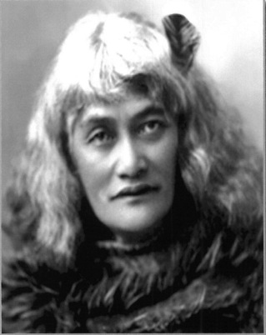
OUR MISSION
In the words of Te Puea…
Kia tupu, kia hua, kia puawai
To grow, to prosper, to sustain.

Slide 7
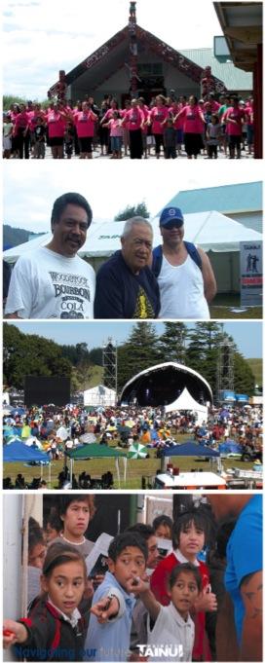
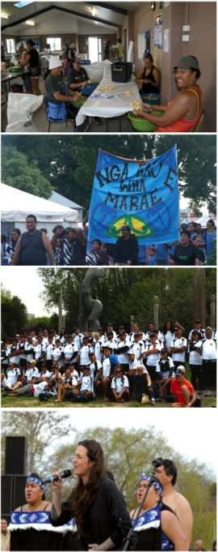
ONE TEAM, ONE DIRECTION
Our Purpose…
To grow a prosperous, healthy,
vibrant, innovative and culturally strong iwi.

Slide 8
OUR TRIBAL STRUCTURE
Te Kauhanganui
Tribal Parliament
68 Marae
Te Arataura
Tribal Executive
11 Member Executive
Tribal Management
Waikato Raupatu Lands Trust
3 Representatives per Marae
10 elected from Te Kauhanganui
1 appointed as a representative of the King
Waikato Raupatu River Trust
Waikato-Tainui College for Research and Development
Tainui Group Holdings Ltd

Slide 9
STRATEGIC FRAMEWORK
WHAKATUPURANGA 2050
KIINGITANGA | TRIBAL IDENTITY |  | TRIBAL SUCCESS |  |  |  | SOCIAL & ECONOMIC WELLBEING
TE ARATAURA STRATEGIC PRIORITIES 2013 – 2016 One Team, One Direction
EMPOWERING OUR PEOPLE |  | STRENGTHENING RELATIONSHIPS |  |  |  | TRIBAL PRIDE
TE ARATAURA OUTCOMES
HEALTH & WELLBEING Tribal members are healthy and active. The health and wellbeing of our Tuupuna Awa is restored |  | EDUCATION & TRAINING Tribal members are well educated, qualified and prepared to engage at all levels of society |  |  | EMPLOYMENT Tribal members are benefitting from the development of targeted employment opportunities
CULTURE Tribal reo, tikanga and heritage is preserved for future generations |  |  |  | TRANSFORMING OUR WHARE Governance structures and constitutional arrangements support tribal development

Slide 10
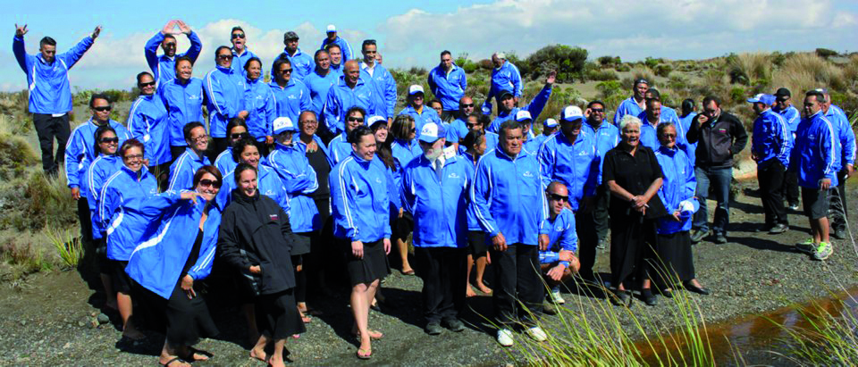
MANA TANGATA

Slide 11
MANA TANGATA

Slide 12
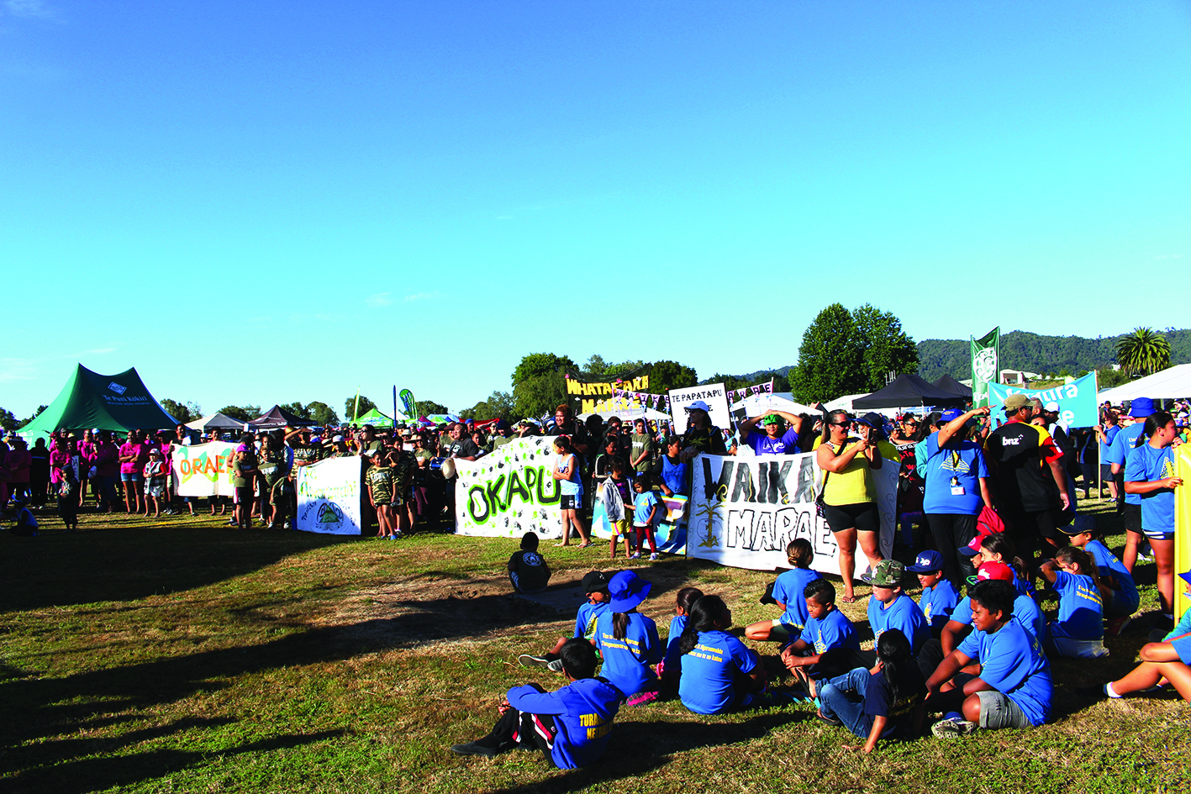
MANA TANGATA

