Slide 1

JAPAN CAMP
May 3rd ~ 4th 2014
名前

Slide 2
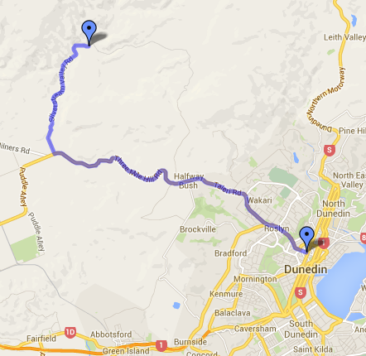

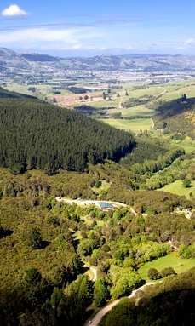
Purpose of the camp
Waiora Scout Camp
Japan camp is a two-day experience filled with Japanese activities including, games, workshops, and food. It is a place to meet new people with an interest in Japan, practice our Japanese language, and deepen both our knowledge and understanding of Japan together in a fun and enjoyable environment!
ジャパンキャンプとは、日本の文化や日本語について楽しみながら学ぶ2日間のキャンプです。日本に興味がある人たちと知り合ったり、日本についての理解を深めながら、皆で一緒に楽しい時間を過ごしましょう！
Group Members
Name | Contact Number
A mere 15 minutes from the heart of Dunedin, in the beautiful Silverstream Valley, lies the Waiora Scout Camp.
Surrounded by 35 hectares of native bush and parklands, it has access to the adjoining Silverpeaks countryside.

Slide 3
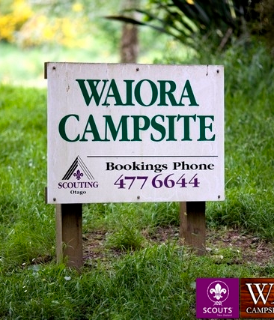
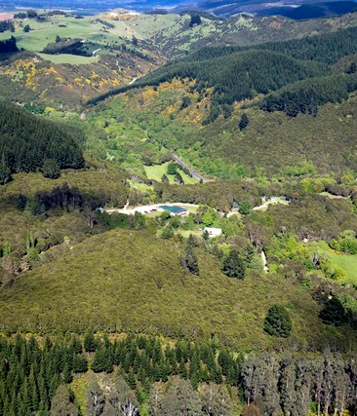
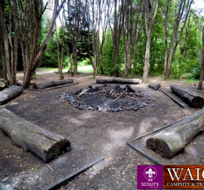
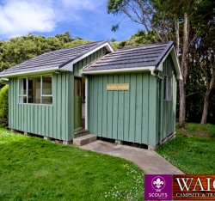


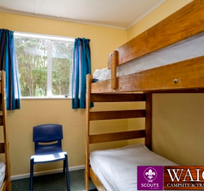
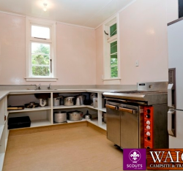


10:30 | Assemble in front of OUSA clubs & socs building
10:45 | Bus leaves campus
11:30 | Welcome remarks/ introduction
12:00 | Lunch (Please bring your own)
13:00 | Team building activities Obstacle course challenge
15:30 | Free time
16:00 | Dinner preparation
18:00 | Dinner – Japanese curry + free time
20:00 | 肝試し (kimodameshi-ghostwalk) Glowworm watch
22:00 | Campfire
24:00 | Bedtime (Feel free to go to bed anytime before this!!)
5月3日 スケジュール
5月4日 スケジュール
7:30 | Wakeup
8:00 | ラジオ体操 (radio taiso) Breakfast
9:00 | Workshop x 4 空手 - Karate 書道 – Shodo アーチェリー – Archery 日本の伝統的な遊び＋漫画 – Traditional games + Manga
12:30 | Lunch preparation
13:00 | Lunch – yakisoba + gyoza Free time
15:00 | Bus leaves camp site
15:30 | Arrive back at campus
NOTES
NOTES
Campfire site
Cabins
Shodo
Archery
Bunkbeds
Kitchen
Karate class
Japanese games

Slide 4
To bring list - 持ち物チェック
Important Points - 注意事項
チェック | 持ち物
 | Sleeping bag or Duvet (a mattress and pillow will be provided)
 | Lunch for Day 1
 | Towels
 | Sleeping wear
 | Toiletries
 | Torch (if you have one)
 | Clothing: Warm clothing - It can be very cold and wet at the campsite! More than two sets of clothing- incase some gets dirty! Track pants (optional) – for the Karate class
 | Mudslide clothes (optional)
 | Sturdy shoes (they may get dirty)
 | Alcohol (Please be sensible)
 | Snacks
Alcohol
You are welcome to bring your own alcohol for Saturday night, but please be sensible with the amount that you bring. Also, please be sensible with how much you drink according to your own tolerance level. Juice and soft drink will be provided.
Expectations
Keep the campsite clean and tidy.
Listen to the instructions given by the JCAL committee members.
Let one of your group members know if you are going away from the group.
Do not go too far from the group in your free time.
Be at all scheduled activities on time.
Important Contacts
Blake Turnbull | 0273517940
Saki Takagaki | 0212322807
Notes

Slide 5
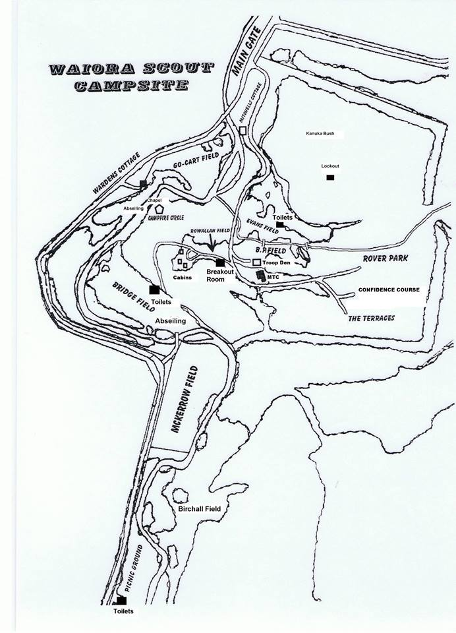
Notes

