Slide 1
Project Management
Getting Started
July 2017
Research & Enterprise

Slide 2

How do you eat an elephant?
Notes:
Project Management is a great skill to have whether you are planning to stay in academic research or pursue a different career. This workshop explores how organisations manage projects including how they:
Define success for a project
Develop clear and detailed scopes for projects
Manage the interactions with the stakeholders of the projects
Set up management structures to ensure that the project team works well together
Develop time-lines for complex projects
Manage uncertainty in the project process
Monitor progress of the project
Budgets will not be covered, nor will evaluation

Slide 3
Why Project Management?
“the knack for all research students regardless of discipline is to pinpoint what is required and model your work accordingly” (Burnham, 1994:33)
Thesis whisperer
Grad Hacker
Notes:
Because a PhD largely involves self-directed learning – self-management is critical. PhD is an opportunity to develop an effective and highly efficient process for working.
Estimate how long each task will take
Use planning tools to establish important sequences
Enter start dates, milestones and completion dates in your diary
Review and revise regularly
Write down everything you can so that you do not need to keep it in short-term memory
Hopelessly inaccurate estimates are much more efficient than no estimates at all
Make a list of your technological needs now (e.g. laptop, knowledge of Endnote, SPSS) and work out how you’re going to get them.

Slide 4
Session objectives
Work through a process for planning projects
Understand how to relate these to your research project
  Reflect as we go along
  Discuss after this session
Apply these to conference planning
Apply these to fellowship or funding applications
Notes:
Objectives for the participants
Project Management is conceptually very simple but a lot more difficult to put into practise. What this session will do is to try and outline some of the tools and techniques commonly used in project management – this is a key transferable skill and therefore being able to demonstrate the application of these techniques will be helpful when job hunting etc.

Slide 5
What is ‘Project’
Has a clear and specific objective
Is someone’s responsibility
Is any sort of planned undertaking which is finite and bounded
Notes:
Simple definition

Slide 6
Project constraints/risks
Most projects operate under constraints
What are the constraints on your project ?
Notes:
Projects always operate under constraints – what are the constraints of your PhD? the key is to balance these constraints.

Slide 7
Possible constraints
Time
Clarity of scope
Access to literature / resources
Access to supervisor
Funding
‘Publishable quality’

Slide 8
Scope of your project
What are you trying to achieve in your project ?
Are you clear on the limits of your investigations ?
How will you know when the project is complete ?

Slide 9
Beneficiaries
Who will benefit from your work ?
Who do you want to influence ?
What impact do you want your work to have ?
Notes:
For your research area, who are the key beneficiaries ?
Think ahead to the impact you want your research to have on your career - who needs to know you and what you are doing ?

Slide 10
Project Management Tools
Mind Map
Drill Down
Gantt Charts
Risk Analysis

Slide 11
Mind Map
Useful at the earliest stage of a project
Set out all possibilities and issues
Helps gives structure to project
Makes linkages more evident

Slide 12
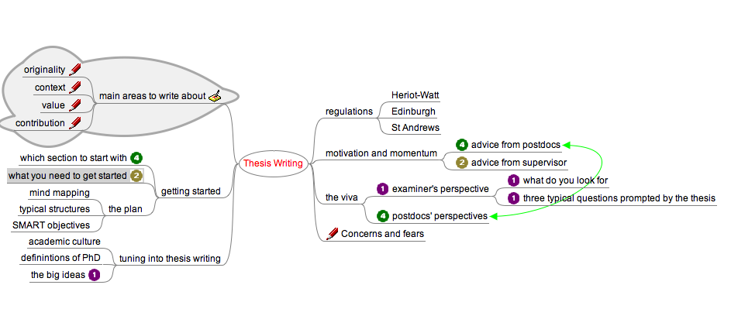

Slide 13
Use single words or simple phrases - print ?
Use colour to separate different ideas
Use symbols and images
Using cross-linkages
http://www.mindtools.com/pages/article/newISS_01.htm
In the centre of the page, write a phrase which summarises your research idea
Now allow your ideas to flow..

Slide 14
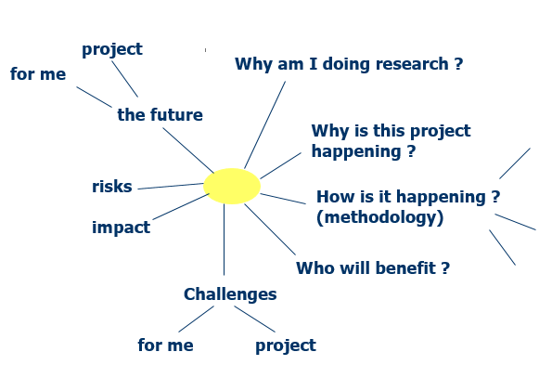

Slide 15
Drill down
A technique to identify all tasks associated with a project
Start on the LHS with the project objective
Identify obvious tasks
Break these down into smallest parts
List questions or points to clarify
Notes:
To plan a project in detail - essential when you need to allocate funding or resources - you will need to analyse it in detail.
The drill down technique enables you to do this. It is a simple technique for breaking complex problems down into progressively smaller parts.
To use the technique, start by writing the project aim down on the left-hand side of a large sheet of paper. A little to the right of this, write down a list of points relating to the project. These may be reasons for doing the project, ideas about methodology, plans for evaluation. This process of breaking the problem down into its component part is called 'drilling down'.
For each of these points, repeat the process. Keep on drilling down into points until you fully understand the factors contributing to the project. If you cannot break them down using the knowledge you have, then carry out whatever research is necessary to understand the point. Alternatively, discuss this with your supervisor - you will have a focus for your early research meetings.
Drilling into a question helps you to get a much deeper understanding of it. The process helps you to recognise and understand the factors that contribute to it. Drill Down prompts you to link in information that you had not initially associated with a problem. It also shows exactly where you need further information.

Slide 16
And now to you
A novel way to fund your PhDs!
It will require careful planning
Together we can drill down through the problem to identify the key tasks and questions...

Slide 17
The Heist
Thieves in Brazil have stolen up to $65m (27m NZD) after tunnelling into a bank in what police say could be the country's biggest bank heist.
The thieves dug a 200m (656ft) tunnel into the bank from a nearby house in the northern city of Fortaleza.
Neighbours said between six and 10 men worked at the house, rented in the name of a company making artificial turf.
The theft happened over the weekend, but was not discovered until Monday morning because the bank was closed.
Neighbours reported seeing vanloads of material being removed each day.
"It's something you see in the movies... They dug a tunnel that goes underneath two [city] blocks. They've been digging for three months," investigator Francisco Queiroga told the Reuters news agency.
The Banco Central said the robbers opened five containers with 50 real ($22) bills.
The value of the stolen bank notes has not been determined. However, police sources said the heist may have yielded as much as 150m reals, which would make it the biggest bank robbery in Brazil's history.

Slide 18
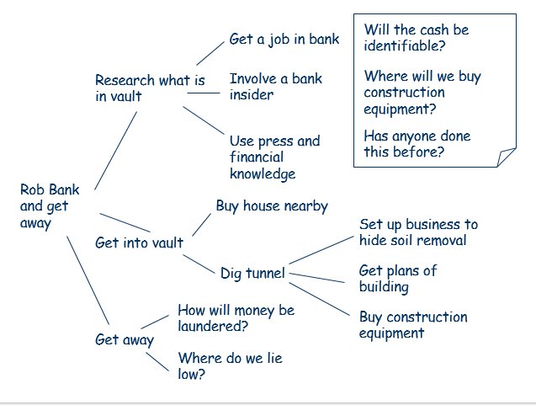

Slide 19
Something closer to home
You are required to plan and organise a conference
Drill down the different tasks which must be achieved for a successful event

Slide 20
Projects and Risks
Identify sources of risk
Assess likelihood of risk
Assess magnitude of risk
Develop response/ mitigation

Slide 21
Risk associated with Bank Heist were…
Get caught digging tunnel
Tunnel collapses
Route blocked by pipes / rock
Getting grassed on, dobbed in
Vault empty / disappointing
Forensic evidence left
All potentially and rightfully resulting in arrest and jail

Slide 22
Sources of Risk in a PhD
Discover that someone has already done it !
Data management issue: Laptop with records is stolen, pen drive through the wash…
Unable to get hold of a key source
Supervisor leaves
Supervisory issues
External pressures
Internal pressures
Loss of motivation…

Slide 23
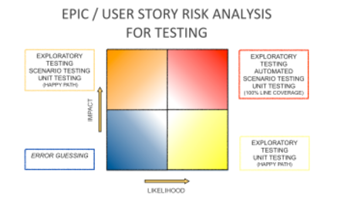
Risk analysis

Slide 24
Risk analysis of PhD
To identify potential risks
  Review regularly and recognise slippage
  Talk to supervisor/s, other PhD candidates
Next map these against potential impact and likelihood
Finally, eliminate, minimise or develop contingency plans

Slide 25
Gantt chart development
Use list of tasks to start Gantt Chart
Identify relationships between tasks
Estimate time for each task
  include: project management, detailed planning, liaison with experts, meetings, information gathering
Ask for feedback on your plan
https://www.smartsheet.com/blog/gantt-chart-excel01
Notes:
Drill down is useful for identifying all the tasks involved, but one of the most difficult elements of project planning is the allocation of time to each task.
It is important to get time estimates right for two main reasons:
Time estimates drive the setting of deadlines for delivery of projects, and hence peoples' assessments of your reliability
They often determine the allocation of resources and hence their efficiency.
Usually people vastly underestimate the amount of time needed to implement projects. This is true particularly when they are not familiar with the task to be carried out. They forget to take into account unexpected events or unscheduled high priority work. People also often simply fail to allow for the full complexity involved with a job.
At this stage you are learning the skills of research management so ask for input from more experienced researchers about your plan.

Slide 26
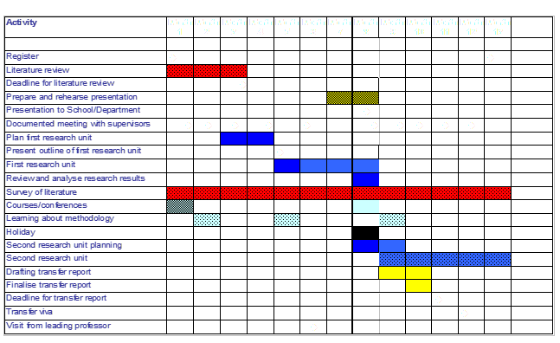

Slide 27
Gantt Chart
lay out the tasks that need to be completed
show when these tasks should be carried out
assist the allocation of resources
help you to work out the critical path for a project where you must complete it by a particular date
Notes:
Gantt Charts are useful tools for analyzing and planning more complex projects. They:
help you to lay out the tasks that need to be completed
give you a basis for scheduling when these tasks will be carried out
allow you to plan the allocation of resources needed to complete the project,
help you to work out the critical path for a project where you must complete it by a particular date.
When a project is under way, Gantt charts help you to monitor whether the project is on schedule. If it is not, it allows you to pin-point the remedial action necessary to put it back on schedule.

Slide 28
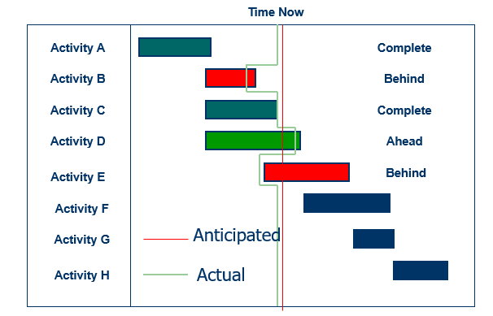
Notes:
Once the project is under way it is important to monitor progress.
Benefits:
you can fine tune or reschedule tasks if your time estimates were not realistic
you can see which tasks are falling behind and allocate extra resources or investigate why
you can report on progress at any time
as well as reviewing the project, you are reviewing your plan, so you can improve your planning skills for next time

Slide 29
Identify issues early – solve early
Report the implications of delays
Discuss changes in plans
Direct resources
Respond early
Be flexible
Involve your supervisor(s) and others
Notes:
If you discover or anticipate a delay it is essential to take action
Report the implications of delays - other projects or work may be depending on the outcome of your project so give people time to react
Discuss changes in plans - involve others so they can make suggestions
Direct resources - use the CPA to see what tasks need to be completed
Avoid persecution - if someone else is telling you about problems, be constructive - or next time they may not tell you until it is too late
Respond early - so there is time to get back on track or re-think
Be flexible - use your project plans to find alternatives
Involve the client and stakeholders - they may have ideas or be prepared to be flexible too

Slide 30
Final thoughts
Project management is a set of tools not a straightjacket!
It should be dynamic, but have regular, fixed reviews of progress
It can help with communication and to check on common understanding
  Between you and your supervisor / funders / colleagues
It can be difficult to apply these ideas at the very start of your PhD, but you should be able to identify scope, constraints, risks, time structure fairly soon…
Vitae – Project Management Tools for Researchers

