Slide 1
Do energy efficient buildings help cut emissions?
Environmental assessment of energy efficient refurbishment of the existing commercial office building stock in New Zealand.
Agneta Ghose, Sarah J. McLaren and David Dowdell
Global Climate Change Week- Massey University, October 2017

Slide 2
Climate change and the existing building stock
Building sector’s energy use - 33 % of total global energy use; one-third of carbon emissions and other greenhouse gas emissions
60% of emissions related to building’s operational energy use
38 % of the energy-related emissions in New Zealand’s cities are due to the heating and cooling needs of commercial (office) buildings.
NZ 2050 target- reduce energy related greenhouse gas emissions by 50% compared with 1990 levels.
Annual energy use per capita by region and building type in 2007 (kWh/capita/ yr) Source: Data from IEA online statistics, 2007
Notes:
Existing building stock –environmental issues?
Role of energy efficiency refurbishment as climate change mitigation policy
Why do we need Life Cycle Assessment to analyse energy efficiency refurbishments?

Slide 3
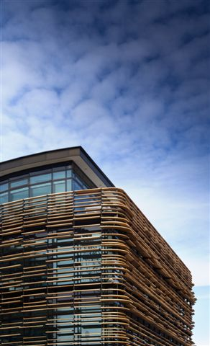
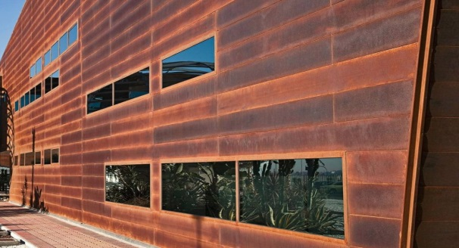
Deep Energy Refurbishment- “Major building refurbishment project in which site energy use intensity, including plug loads, has been reduced by at least > 50% from the pre-renovation baseline” is described as a deep energy refurbishment” (IEA EBC, 2015)
-60% annual energy consumption
Reduce Wall to Window ratio
Change single glazed windows to low-e double glazed windows
Add insulation to walls and roof
Add solar shading on north, west and east facades
Change HVAC from boilers and chillers to Air source heat pumps
Change lighting devices from Compact fluroscent luminaires to LED luminaires
Source: Cory, 2016

Slide 4
Research Objectives
Identify the potential impacts associated with the adoption of deep energy refurbishment in the existing office building stock.
Identify the potential environmental impacts or benefits associated with operation of the refurbished office building stock in comparison to non- refurbishment of the entire office building stock, in New Zealand between 2017 and 2050.
Identify the potential influence of strategies such as resource and waste management or the installation of PV on the performance of refurbished buildings.
Identify the potential influence of prospective changes to New Zealand’s electricity generation.

Slide 5
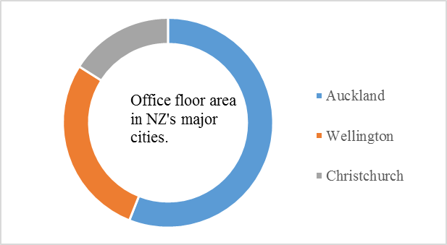
New Zealand’ existing office building stock
5700 existing buildings (approx.)
7 million m² total office floor area (approx.)
80 % of the total office floor area was constructed pre-2000 (Cory, 2016)
75 % of the total exsiting office floor area is in the three major cities (Auckland, Wellington and Christchurch).
Large buildings (>3500 m²) consist of 53 % of the total existing office floor area

Slide 6
Material and Methods
Life Cycle Assessment
Stock Aggregation Analysis

Slide 7
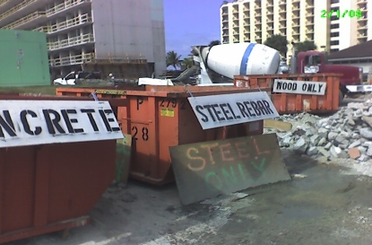
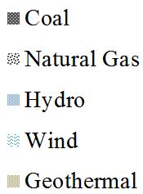
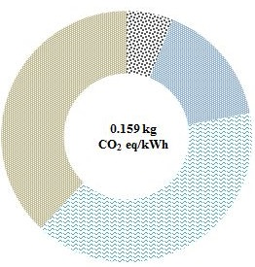
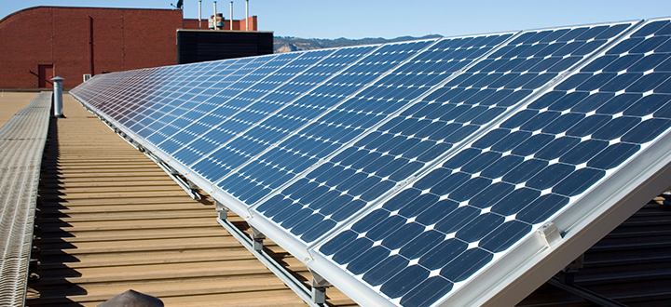
Refurbishment Strategies
Electricity generation scenarios
Building refurbished based on status quo
Adoption of resource and waste management during refurbishment
Installation of on-site PV on refurbished buildings.
New Zealand’s electricity grid mix (phasing out coal power in future)
BAU Based on 2013 electricity grid mix
Based on Scenario 2040 mixed renewables

Slide 8
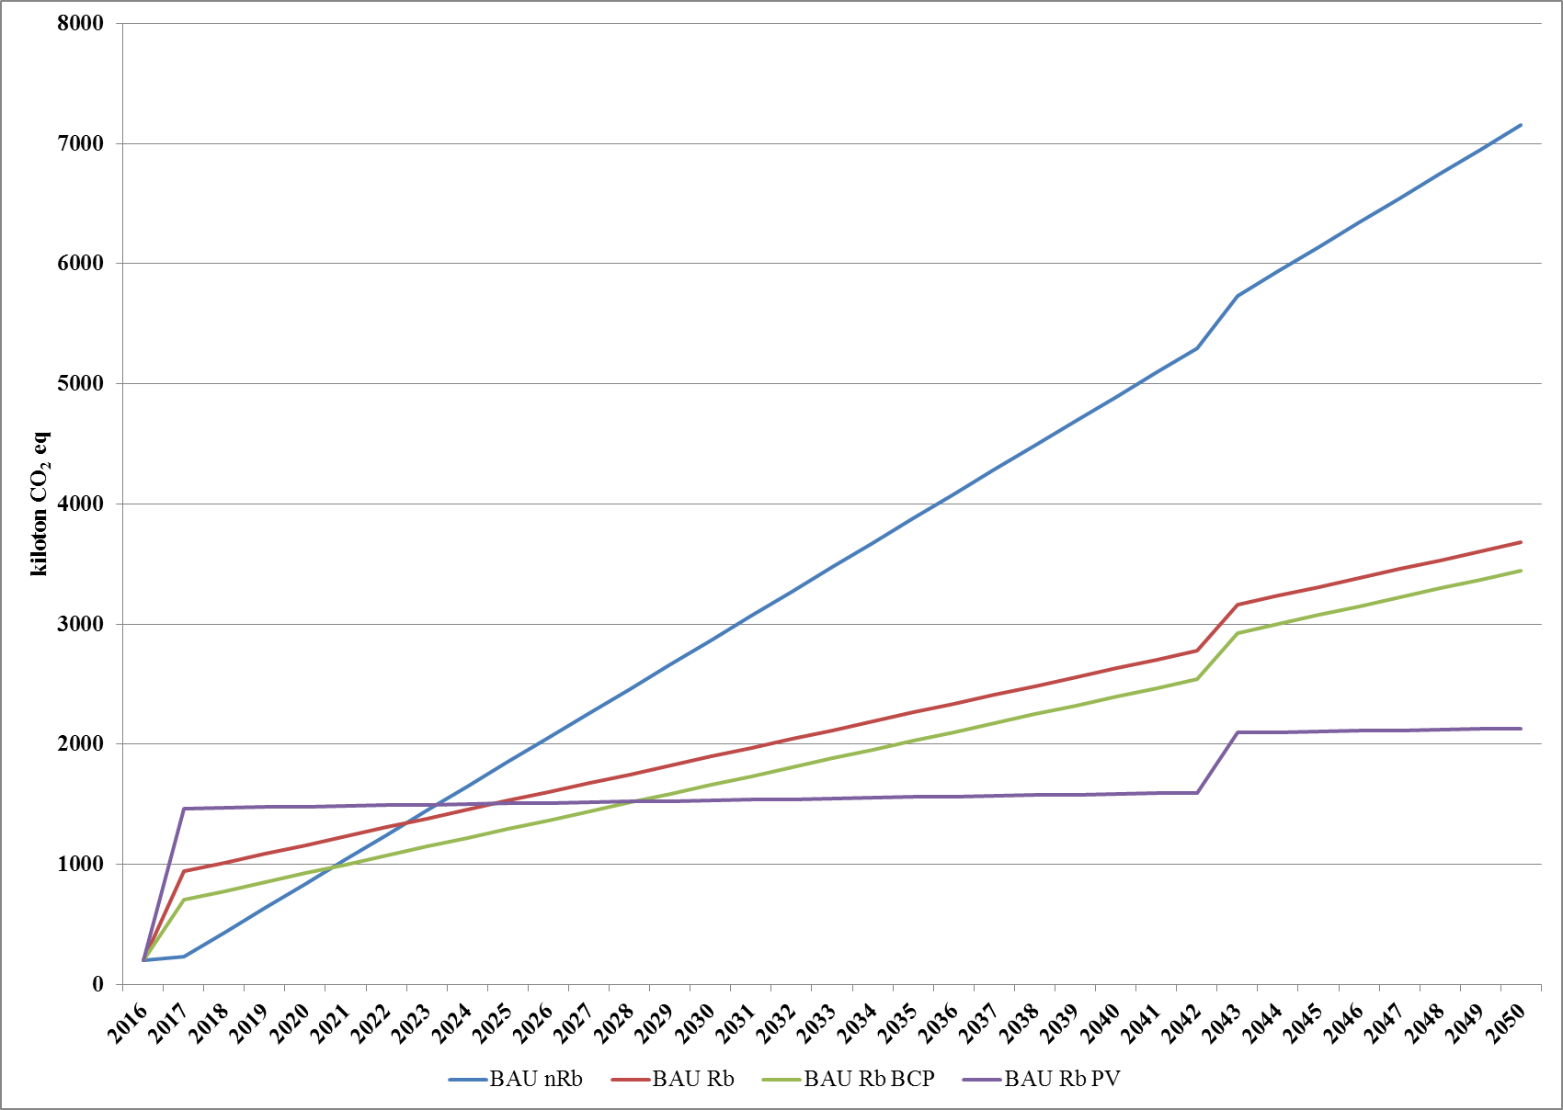
Results- Climate Change
GWP in 2050 of whole office building stock with respect to New Zealand’s 2050 target. The ‘+’ and ‘-ʼ signs indicate the increase and decrease in GWP as compared to 1990 emissions, respectively.

Slide 9
Other environmental impacts
Impacts to toxicity
Resource Depletion

Slide 10
2050 Climate Mitigation Target
Refurbishing buildings in specific regions
Refurbishing buildings of specific sizes

Slide 11
Interpretation and Implications
Achievability of New Zealand’s 2050 target with respect to the performance of existing office building sector – Adopting energy efficiency measures should be promoted
Grid electricity generation plays an important role in determining performance of the building stock.- National policies for increased renewable electricity generation should be promoted
Substantial emissions are embodied in materials associated with refurbishment which lead to an increase in all environmental impacts in the year of refurbishment.- Future work required on the adoption of materials with low embodied impacts
Best available resource and waste management measures contributes to substantial benefits across most environmental categories as compared to installation of on-site PV.- Promote waste management and planning
Prioritizing the refurbishment based on building size or location can help in substantial emission reduction without increasing the embodied impact of the entire building stock.- Large buildings or building stock in major cities

Slide 12
Acknowledgements
Thank You!
Building Research Association New Zealand (BRANZ)
New Zealand Life cycle management (NZLCM)
Massey University Dissemination Grant

