Slide 1







Association between traffic intensity and atopy at age 8 years in children born in Sydney in the Childhood Asthma Prevention Study (CAPS)
Anna Hansell*, Nick Rose†‡, Christine Cowie†‡, Elena Belousova†, Kitty Ng†, Brett Toelle†, Guy Marks†‡
†Woolcock Institute of Medical Research, Sydney
‡The Cooperative Research Centre for Asthma and Airways
*MRC-HPA Centre for Environment and Health, London
Imperial College
London
© Imperial College London

Slide 2

Study aim
To investigate cross-sectional associations between traffic exposure intensity and allergy and asthma at age 8 years in ~500 children with a family history of asthma
MRC-HPA Centre for Environment and Health
Imperial College
London

Slide 3
HEI report on Traffic-Related Air Pollution
Executive summary
“With a few inconsistent exceptions, results based on the skin-prick test reactivity
or allergen-specific IgE failed to show associations with any of the traffic-exposure surrogates. Inconsistent results with self reported symptoms were also noted.
The Panel concluded that there is “inadequate and insufficient” evidence to infer a causal association, or even a non-causal association, between exposure to traffic-related pollution and IgE-mediated allergies. Overall, the lack of consistency across epidemiology studies might have reflected a failure to identify susceptible subgroups.”
Notes:
Further work
Analyses will be repeated stratifying by atopy for lung function, and questionnaire reported diagnoses and symptoms
Repeated analysese using a random effects model to allow for possible clustering effects by household (38 children had a sibling in the study)

Slide 4
Background
Toxicological and controlled human exposure studies have shown strong evidence for a relationship between diesel particle exposure and IgE-mediated allergic responses
Grass pollen has been shown to bind to diesel exhaust particle in vitro (Knox 1997)
Pre-exposure to diesel exhaust particles has been shown to enhance nasal sensitisation in humans (Diaz-Sanchez 1999)
Human exposure to diesel exhaust in exposure chambers results in bronchial inflammation and cytokine and chemokine production (Salvi 2000)
Exposure to diesel and traffic exhaust fumes in a real-life setting (the Oxford St study) results in inflammation and lung function decrements in mild asthmatics (McCreanor 2007)

Slide 5


The Childhood Asthma Prevention Study (CAPS)
Set up in 1997 as a birth cohort
  Mothers living in Sydney and New South Wales
  All children had a parent or sibling with asthma
  Initially set up as an intervention study assessing impact of house dust mite avoidance and fish oil supplementation implemented from birth to age 5 years on asthma development
  Followed up at age 18 months, 3 years, 5 years, 8 years and 11 years
Notes:
Toelle 2010 paper in J All Clin Immunol

Slide 6
Recent papers using the CAPS cohort
Garden et al. Infant and early childhood dietary predictors of overweight at age 8 years in the CAPS population. Eur J Clin Nutr. 2011;65:454-62
Ayer et al. Lung function is associated with arterial stiffness in children. PLoS One. 2011;6(10):e26303
Marshall et al. Snoring is not associated with adverse effects on blood pressure, arterial structure or function in 8-year-old children: the Childhood Asthma Prevention Study (CAPS). J Paediatr Child Health. 2011 ;47(8):518-23
Almqvist et al. Effects of early cat or dog ownership on sensitisation and asthma in a high-risk cohort without disease-related modification of exposure. Paediatr Perinat Epidemiol. 2010 Mar;24(2):171-8
Ayer et al. Dietary supplementation with n-3 polyunsaturated fatty acids in early childhood: effects on blood pressure and arterial structure and function at age 8 y. Am J Clin Nutr. 2009 Aug;90(2):438-46.
Ayer et al. HDL-cholesterol, blood pressure, and asymmetric dimethylarginine are significantly associated with arterial wall thickness in children. Arterioscler Thromb Vasc Biol. 2009 Jun;29(6):943-9
Tovey et al. Nonlinear relationship of mite allergen exposure to mite sensitization and asthma in a birth cohort. J Allergy Clin Immunol. 2008;122:114-8

Slide 7
Follow-up at age 8
Follow-up at age 8 (2005-8) included
  Respiratory symptoms and asthma diagnosis assessed by interviewer administered questionnaire to parents
  Spirometry, methacholine challenge, eNO
  Skin prick tests
  Total and specific IgE levels
  House dust mite specific cytokines
  Plasma fatty acid
  Bed dust for Der p 1 concentrations
  Address available from age 8 onwards

Slide 8
Eight-year outcomes of the Childhood Asthma Prevention Study (Toelle J et al. Allergy Clin Immunol 2010)
Data available for 450 (73%) of original 616 particpant children
No difference in prevalence of all clinical outcomes at age 8 years between active and control groups for either diet or HDM reduction to age 5 years except higher prevalence of wheeze in active diet group (31.7% vs. 23.2%)
No evidence for interactions between the two interventions
HDM avoidance was associated with absolute risk reduction of 10.6% prevalence of poor asthma control in atopic children compared with control

Slide 9
Traffic intensity exposure measures
Weighted road density within 50m or 75m radius of address of main residence
Road density = weighted sum of the lengths of road
  Motorways, arterial roads and primary roads weight = 3
  Distributor roads weight = 2
  Local roads weight = 1
Validation against measured NO₂ in 2006 & 7
  NO₂ prediction r² = 0.56
  NO₂ prediction using traffic counts gave r² = 0.59
Notes:
Model developed for 2006-7. Road maps for 2001, Measured NO2 for 2006 and 2007
Referenced piece of work was about defining a traffic measure which was useful in the absence of having traffic counts or modelled estimates.

Slide 10
Descriptive results at age 8 years
FIGURE shows weighted road density within 50m radius of home
1unit = 100m local road or 33.3m of motorway
Mean (median) road density 50m = 103m (88m) local road/ 34m (29m) M’way
Mean (median) road density 75m = 257m (240m) local road/ 86m(80m) M’way
Notes:
Mean weighted road density within 75m radius of home was equivalent to 257m of local road or 86m motorway (median 240m local road or 80 m motorway) and within 50m radius was equivalent to 103m of local road or 34m of motorway (median 88m local road and 29m motorway)
382 children with clinical info and geocoded address in NSW
Mean road density within 75m radius of home was equivalent to 257m of local road or 86m motorway (median 239m local road or 80 m motorway)
Egg white
D. pteronyssinus
Egg Yolk
Cat
Dog
Cockroach
Rye grass
Aspergillus
Salmon
Tuna
Alternaria
Grass Mix
Peanuts

Slide 11
Descriptive results at age 8 years
560 of original 616 (91%) children were successfully geocoded
419 of the 560 (75%) had questionnaire results and 382 (68%) had results for skin prick tests
173 (45%) SPT positive (≥ 3mm) to any of 11 inhalant or food allergens
137 (36%) were SPT positive to house dust mite (HDM)
197 (40%) had asthma diagnosed by a doctor 18 months, 3, 5 or 8 years
114 (27%) had wheezed in the last 12 months

Slide 12
Analytic analyses
  OUTCOMES
  Questionnaire reports of asthma, wheeze, eczema
  Atopy – skin prick tests, total and specific IgE, HDM specific cytokines
  Lung function, AHR, eNO
  Plasma fatty acids
Univariate and multivariate Poisson regression with robust error variance (linear regression for linear outcomes)
Analyses for lung function included age at testing, height and sex
A priori stratification by atopy for lung function, eNO and questionnaire-reported diagnoses and symptoms
Multivariate analyses were restricted to outcomes with statistically significant (p<0.05) univariate associations with traffic density within 75m and/or 50m of hom

Slide 13
Confounders
Confounders considered:
  Sex
  Environmental tobacco exposure during pregnancy and childhood
  Breast-feeding to age 6 months
  Dog ownership
  Cat ownership
  Gas heating
  Maternal education
  Paternal education
Confounders were retained if they altered the regression coefficient by >10%
The original interventions were not considered as confounders

Slide 14
Univariate results
Positive associations with weighted road density for almost all SPTs, total IgE and all specific IgEs but NOT HDM specific cytokines
No significant associations were seen with lung function, eNO and questionnaire outcomes on the whole dataset
When stratifying by atopy, statistically significant relationships were seen with current and ever doctor-diagnosed asthma, wheeze and current rhinitis in atopics and with AHR in non-atopics.
Notes:
I think results here would look better as graphs
measured by both skin prick test and specific IgE
if (DP_8y ge 3 and DP_8y>glycerine_8y) or
(Cockroach_8y ge 3 and Cockroach_8y>glycerine_8y) or
(Cat_8y ge 3 and Cat_8y>glycerine_8y) or
(Alternaria_8y ge 3 and Alternaria_8y>glycerine_8y) or
(Salmon_8y ge 3 and Salmon_8y>glycerine_8y) or
(Peanuts_8y ge 3 and Peanuts_8y>glycerine_8y) or
(EggWhite_8y ge 3 and EggWhite_8y>glycerine_8y) or
(EggYolk_8y ge 3 and EggYolk_8y>glycerine_8y) or
(RyeGrass_8y ge 3 and RyeGrass_8y>glycerine_8y) or
(GrassMix_8y ge 3 and GrassMix_8y>glycerine_8y) or
(Tuna_8y ge 3 and Tuna_8y>glycerine_8y) then anyatopy_8y_3mm=1;
else if (DP_8y = . and Cockroach_8y= . and Cat_8y=. and Alternaria_8y =. and salmon_8y = . and Peanuts_8y= .
and Eggwhite_8y=. and Eggyolk_8y=. and RyeGrass_8y=. and GrassMix_8y=.
and Tuna_8y =. )then anyatopy_8y_3mm=.;
else anyatopy_8y_3mm=0;

Slide 15
Results
 | Road density within 75m |  | Within 50m
Total IgE
Total IgE ( kU/L) † | 1.217*** | (1.057 - 1.400) | 1.274 | (0.936 - 1.734)
Specific IgE
House dust mite >=0.35 kU_{A}/L (n+=138) | 1.091** | (1.015 - 1.172) | 1.208** | (1.031 - 1.416)
Ryegrass >=0.35 kU_{A}/L (n+=91) | 1.045 | (0.935 - 1.168) | 0.932 | (0.698 - 1.244)
Alternaria >=0.35 kU_{A}/L (n+=63) | 1.178*** | (1.070 - 1.297) | 1.066 | (0.773 - 1.468)
Cat dander >=0.35 kU_{A}/L (n+=29) | 1.141 | (0.942 - 1.381) | 1.261 | (0.819 - 1.942)
Positive skin prick tests
Any atopy 3mm (n+=173) | 1.069** | (1.010 - 1.132) | 1.092 | (0.939 - 1.269)
Inhalant allergens (n+=170) | 1.082*** | (1.022 - 1.145) | 1.121 | (0.962 - 1.307)
House dust mite (n+=137) | 1.069* | (0.993 - 1.151) | 1.281*** | (1.088 - 1.509)
Ryegrass (n+=47) | 1.171** | (1.037 - 1.322) | 0.981 | (0.679 - 1.419)
Alternaria (n+=36) | 1.034 | (0.813 - 1.314) | 0.925 | (0.542 - 1.579)
Cat dander (n+=17) | 1.211* | (0.979 - 1.497) | 1.136 | (0.532 - 2.426)
Notes:
N=300-350

Slide 16
Results – AHR and questionnaire variables
 | Road density within 75m |  | Within 50m
AHR in non-atopics | 1.280*** | (1.062 - 1.543) | 1.706** | (1.044 - 2.789)
Questionnaire variables in atopics
asthmadx_ever | 1.019 | (0.930 - 1.117) | 1.252** | (1.031 - 1.522)
Currentasthma_dxonly_8y | 1.027 | (0.908 - 1.162) | 1.308** | (1.002 - 1.709)
wh12_8y | 1.017 | (0.912 - 1.134) | 1.274** | (1.010 - 1.608)
Current rhinitis | 1.078* | (0.991 - 1.171) | 1.274** | (1.029 - 1.577)

Slide 17
Discussion
Associations were seen between a measure of traffic exposure and allergic sensitisation in children aged eight years, who are at increased risk of sensitisation
Traffic exposure was also associated with reported asthma, current wheeze and current rhinitis in atopic children and with AHR in non-atopic children

Slide 18
Issues
Suggestive but not fully consistent findings
  In two German cohorts (Morgenstern 2008) – significant associations between specific IgE and distance from road at age 6 years
  In the PIAMA cohort Gehring 2008) – non-signifcant but positive associations between specific IgE and PM2.5 at age 8 years(
Small numbers
Weighted road density was used as air pollution monitoring was not available for all areas of NSW state
Cross-sectional
Sensitive to unnecessary adjustment (Schisterman et al, 2009)
Multiple testing

Slide 19
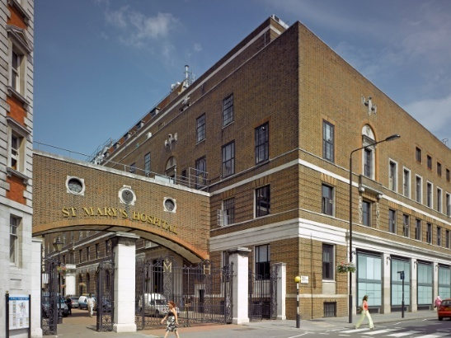
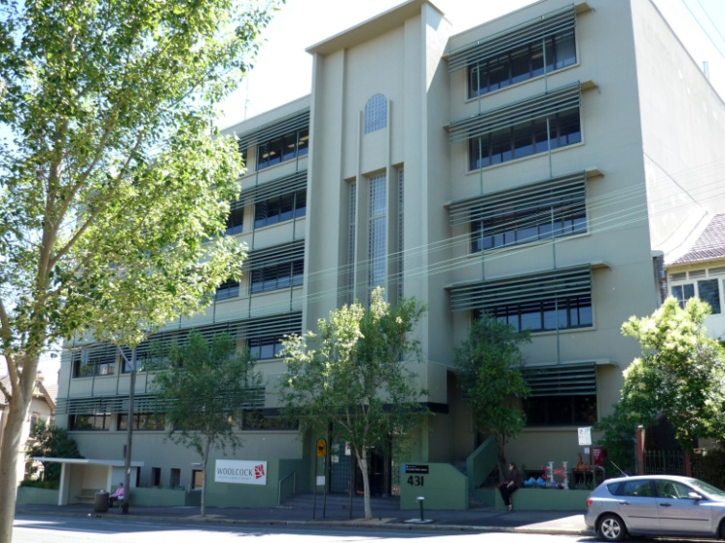
ACKNOWLEDGMENTS
This work formed part of a Visiting International Fellowship
Anna Hansell was funded through Wellcome Intermediate Clinical Fellowship, Wellcome Trust grant 0775883

Slide 20
Relative risk (RR) of selected allergic outcomes at age 8 years in relation to traffic density within a 50m radius of home, stratified by dietary intervention to age
 | RR | 95% CI |  | RR | 95% CI | p-value for interaction term for supplement intervention (separate model)
 | Fish and canola oil supplement |  |  | Placebo oil supplement
Specific IgE
House dust mite >=0.35 kU_{A}/L (yes/no) | 1.099 | (0.871 - 1.388) |  | 1.344 | (1.106 - 1.634) | 0.193
Ryegrass >=0.35 kU_{A}/L | 0.656 | (0.436 - 0.987) |  | 1.202 | (0.842 - 1.716) | 0.049
Alternaria >=0.35 kU_{A}/L | 0.726 | (0.450 - 1.173) |  | 1.529 | (1.076 - 2.172) | 0.022
Cat dander >=0.35 kU_{A}/L | 0.578 | (0.252 - 1.330) |  | 1.575 | (0.915 - 2.709) | 0.113
Positive skin prick tests
Any atopy 3mm | 1.005 | (0.807 - 1.252) |  | 1.292 | (1.083 - 1.542) | 0.105
Inhalant allergens | 1.046 | (0.837 - 1.306) |  | 1.314 | (1.102 - 1.567) | 0.114
House dust mite | 1.106 | (0.872 - 1.402) |  | 1.537 | (1.257 - 1.879) | 0.038
Ryegrass | 0.375 | (0.154 - 0.912) |  | 1.427 | (0.988 - 2.061) | 0.004
Alternaria | 0.600 | (0.305 - 1.183) |  | 1.637 | (0.934 - 2.869) | 0.048
Cat dander | 0.274 | (0.0821 - 0.911) |  | 2.166 | (0.943 - 4.972) | 0.007

Slide 21

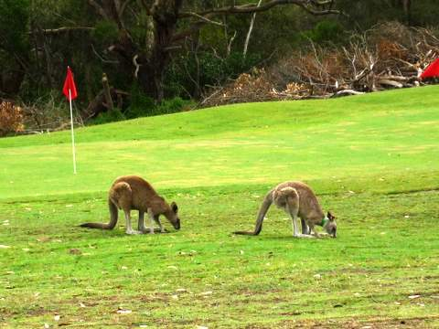

Page 21
© Imperial College London

Slide 22
ADDITIONAL SLIDES

