Slide 1
Radiofrequency Electromagnetic Fields; evaluation of cancer hazards
Robert A Baan PhD

Slide 2
The IARC Monographs on the evaluation of carcinogenic risks to humans
Non-ionizing radiation, Part II,
Radiofrequency Electromagnetic Fields
Volume 102 of the IARC Monographs
Evaluation of cancer hazards by an international Working Group of experts that convened in Lyon
24-31 May 2011

Slide 3
The IARC Monographs
The IARC Monographs are an authoritative series of scientific reviews that identify environmental factors that can increase the incidence of cancer in humans
This cancer-hazard identification is a first step in cancer-risk assessment and cancer prevention
Each Monograph includes a critical review by an ad-hoc Working Group of the pertinent scientific literature, and an evaluation of the weight of the evidence that the agent can increase cancer incidence in humans

Slide 4
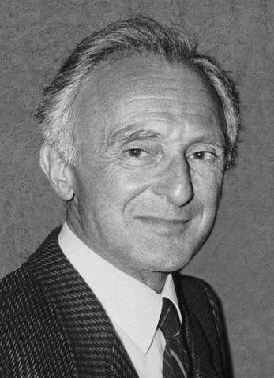
The IARC Monographs
“The WHO encyclopaedia of carcinogens”
The IARC Monographs evaluate
  Chemical agents and complex mixtures
  Occupational exposures
  Physical agents, biological agents
  Personal habits and household exposures
Nearly 950 agents have been evaluated
  107 are carcinogenic to humans (Group 1)
  59 are probably carcinogenic to humans (Group 2A)
  267 are possibly carcinogenic to humans (Group 2B)
National and international health agencies use the Monographs as a source of scientific information on known or suspected carcinogens and as scientific support for their actions to reduce or prevent exposure to these agents
Dr Lorenzo Tomatis (1929-2007)
Founder of the IARC Monographs

Slide 5
The IARC Monographs
Selection of agents
Agents are selected for review on the basis of two main criteria:
(a) there is evidence of human exposure
(b) there is some evidence or suspicion of carcinogenicity
Ad-hoc Advisory Groups convened by IARC every five years since 1984 made recommendations as to which agents should be evaluated in the Monographs series. Recommendations are available on the Programme’s website
http://monographs.iarc.fr

Slide 6
The IARC Monographs
Data for the Monographs
Each Monograph provides a review of
all pertinent epidemiological studies of cancer in humans
Cohort and case-control studies relate individual exposures under study to the occurrence of cancer, and provide an estimate of effect (relative risk, odds ratio) as the main measure of association
all long-term cancer bio-assays in experimental animals
All known human carcinogens that have been studied adequately for carcinogenicity in experimental animals have produced positive results in one or more animal species

Slide 7
The IARC Monographs
Data for the Monographs (contd)
mechanistic and other relevant data
Mechanistic and other relevant data may provide evidence on how cancer may develop and also help in assessing the relevance and importance of findings of cancer in animals and in humans.
information on exposure, chemico-physical properties, etc.
Definition and detailed description of the agent under review.
Only reports that have been published/accepted for publication in the openly available scientific literature are reviewed

Slide 8
Evaluating human data
Evidence in
humans
– Preamble Part B, Section 6(a)
Evidence in
experimental animals
Mechanistic and
other relevant data
 Sufficient evidence
Causal relationship has been established
Chance, bias, and confounding could be ruled out with reasonable confidence
 Limited evidence
Causal interpretation is credible
Chance, bias, or confounding could not be ruled out
 Inadequate evidence
Studies permit no conclusion about a causal association
 Evidence suggesting lack of carcinogenicity
Several adequate studies covering the full range of exposure levels are mutually consistent in not showing a positive association at any observed level of exposure
Conclusion is limited to cancer sites and conditions studied

Slide 9
Evaluating experimental animal data
Evidence in
humans
Evidence in
experimental animals
– Preamble Part B, Section 6(b)
Mechanistic and
other relevant data
 Sufficient evidence
Causal relationship has been established through either:
- Multiple positive results (2 species, studies, sexes of GLP)
- Single unusual result (incidence, site/type, age, multi-site)
 Limited evidence
Data suggest a carcinogenic effect but: (e.g.) single study, benign tumours only, promoting activity only
 Inadequate evidence
Studies permit no conclusion about a carcinogenic effect
 Evidence suggesting lack of carcinogenicity
Adequate studies in at least two species show that the agent is not carcinogenic
Conclusion is limited to the species, tumour sites, age at exposure, and conditions and levels of exposure studied

Slide 10
The IARC Monographs
IARC Monographs classification (default) of agents on the basis
of the strength of evidence of carcinogenicity to humans and to
experimental animals
HUMAN Sufficient Limited Inadequate (or lack of data)
ANIMAL
Sufficient 1 2A 2B
Limited 1 2B 3
Inadequate 1 2B 3
(or lack of data)

Slide 11
Radiofrequency Electromagnetic Fields
(Exposure)
Human exposure to RF-EMF can occur from
Environmental sources
broadcast antennas, base stations, medical devices, smart meters
Occupational sources
high-frequency dielectric and induction heaters, radars
Personal devices
cordless telephones, mobile telephones, Bluetooth
The general population receives the highest exposure to RF-EMF from sources in close vicinity to the body

Slide 12
Radiofrequency Electromagnetic Fields
(Exposure, contd)
Holding a mobile phone to the ear can result in high specific absorption rate (SAR) values in the brain, depending on the positioning of the phone and its antenna and the quality of the link with the base-station.
For children, the average deposition of RF energy from a mobile phone is about two-fold higher in the brain and up to 10-fold higher in the bone marrow of the skull.
It is noteworthy that the use of hands-free kits lowers exposure to the brain to <10% of the value resulting from use at the ear, although it may increase exposure in other parts of the body.

Slide 13
Radiofrequency Electromagnetic Fields
(Epidemiological data)
Occupational exposure to RF-EMF involves
military and security personnel using walkie-talkies
radar operators and maintenance personnel
radio/TV antenna maintenance and repair workers
workers in dielectric welding, and in sealing of plastics
physiotherapists applying diathermy treatments
Only very few studies made an attempt to verify or measure exposure to RF-EMF, and in many studies there may have been also exposure to ELF-EMF

Slide 14
Radiofrequency Electromagnetic Fields
(Epidemiological data, contd)
Occupational exposure to RF-EMF: some positive signals
Brain cancer cases/controls relative risk (95%CI)
Thomas et al. 1987 435/386 1.7 (1.1-2.7)
A death-certificate-based case-control study, with job title as proxy for exposure to RF-EMF. The excess risk disappeared when those exposed to soldering fumes or lead were excluded, with OR, 1.4 (0.7-3.1).
Grayson et al. 1996 230/920 1.39 (1.01-1.90)
A large case-control study among US Airforce personnel exposed to equipment producing RF-EMF. Exposure assessment relied on job title and time of deployment, cancer cases were taken from hospital discharge records, but were not confirmed.

Slide 15
Radiofrequency Electromagnetic Fields
(Epidemiological data, contd)
Occupational exposure to RF-EMF: some positive signals
Leukaemia/lymphoma cohort relative risk (95%CI)
Lagorio et al 1997 682 5.0 (1.3-27.9)
A mortality study among workers in a plastic-ware industry, with exposure to RF-EMF (during sealing), and to vinyl chloride monomer. The study is small, possible confounding is not addressed.
Degrave et al 2009 2932 7.2 (1.1-48.9)
Cause-specific mortality study among Belgian soldiers in batallions equipped with radar. Follow-up problematic; co-exposure to ionizing radiation suggested
Testicular cancer cases/controls relative risk (95%CI)
Hayes et al. 1990 271/259 3.1 (1.4-6.9)
Hospital-based case-control study. Controls had cancer, but not in the genital tract. Exposure classification was based on self-reporting, probably with substantial misclassification.

Slide 16
Radiofrequency Electromagnetic Fields
(Epidemiological data, contd)
Environmental exposure to RF-EMF
Ecological and case-control studies have been carried out to investigate potential associations of brain cancer with RF emissions from transmission antennae.
These studies are generally limited by reliance on measures of geographic proximity to the antennae as an exposure surrogate. Substantial exposure misclassification is unavoidable.
For the same reason, no conclusions can be drawn from the limited data that were available on risk for leukaemia, lymphoma, or a number of other cancers.

Slide 17
Radiofrequency Electromagnetic Fields
(Epidemiological data, contd)
Three types of study addressed the question of increased cancer risk and mobile phone use
Ecological studies on time trends of disease rates
These analyses covered the period of the late 1990s and early 2000s, i.e. before mobile phone use became widespread
Cohort study
A total of 257 cases of glioma were found in 420,095 subscribers to two Danish telephone companies, with 253.9 expected. Subscription was taken as a surrogate for phone use.
Case-control studies
Overall, these studies provide the most robust evidence

Slide 18
Radiofrequency Electromagnetic Fields
(Epidemiological data, contd)
Case-control studies on mobile phone use
Muscat et al 2000, Inskip et al 2001, Auvinen et al 2002
Early studies in the period of increasing use, with exposure assessment by self-reported history or by subscription records, and imprecise effect estimates.
Phone type Odds ratio (95%CI)
Glioma all phones 1.5 (1.0-2.4)
(n=398) digital 1.0 (0.5-2.0)
analog 2.1 (1.3-3.4)
from: Auvinen et al, 2002

Slide 19
Radiofrequency Electromagnetic Fields
(Epidemiological data, contd)
Case-control studies on mobile phone use
The INTERPHONE study, a multicentre case-control study, is the largest investigation so far of mobile-phone use and brain tumours, including glioma, acoustic neuroma, and meningioma.
The pooled analysis included 2708 glioma cases and 2972 controls (participation rates 64% and 53%, resp). Ever/never use of a mobile phone yielded an OR of 0.81 (0.70-0.94). ORs were uniformly below or close to unity for all deciles of exposure except the highest decile (>1640 hours of cumulative call time) with an OR of 1.40 (1.03-1.89).

Slide 20
Radiofrequency Electromagnetic Fields
(Epidemiological data, contd)
Case-control studies on mobile phone use (contd)
In a recent study (Cardis, 2011, Occ Env Med), estimates of RF energy deposition at the centre of the brain tumours were used as a measure of RF dose. An increased risk for glioma was seen in the highest quintile, and an increasing trend with increasing RF dose for exposures >7 years in the past.
TCSE (J/kg) OR (95% CI)
<76.7 1.11 (0.61-2.02)
76.7- 1.53 (0.85-2.78)
284.1- 1.50 (0.81-2.78)
978.9- 1.69 (0.91-3.13)
3123.9+ 1.91 (1.05-3.47) (ptrend = 0.01)

Slide 21
Radiofrequency Electromagnetic Fields
(Epidemiological data, contd)
A pooled analysis from Sweden included 1148 glioma cases (ascertained 1997–2003) and 2438 controls, obtained through cancer and population registries, respectively.
Questionnaires and telephone interviews were used to obtain information on the exposures and covariates of interest, including use of mobile and cordless phones (response rates 85% and 84%, respectively).
Participants who had used a mobile phone for more than 1 year had an OR for glioma of 1.3 (95% CI 1.1-1.6), which increased with longer time since first use and with total call time, reaching 3.2 (2.0–5.1) for > 2000 hours of use.

Slide 22
Radiofrequency Electromagnetic Fields
(Epidemiological data, contd)
Although both the INTERPHONE study and the Swedish pooled analysis are susceptible to bias, the Working Group concluded that the findings could not be dismissed as reflecting bias alone, and that a causal interpretation is possible.
A similar conclusion was drawn from these two studies for acoustic neuroma, although the case numbers were substantially smaller than for glioma.
Additionally, a study from Japan found evidence of an increased risk for acoustic neuroma associated with ipsilateral mobile phone use.

Slide 23
Radiofrequency Electromagnetic Fields
(Epidemiological data, contd)
For meningioma, parotid-gland tumours, leukaemia, lymphoma, and other tumour types, the Working Group found the available evidence insufficient to reach a conclusion on the potential association with mobile phone use.
The Working Group concluded that there is limited evidence in humans for the carcinogenicity of RF-EMF, based on positive associations between glioma and acoustic neuroma and exposure to RF-EMF from wireless phones.
Note: a few members of the Working Group considered the current evidence in humans inadequate.

Slide 24
Radiofrequency Electromagnetic Fields (Cancer in experimental animals)
The Working Group reviewed more than 40 studies that assessed the carcinogenicity of RF-EMF in rodents. Exposures included 2450-MHz RF-EMF and various RF-EMF types that simulated emissions from mobile phones.
None of the seven chronic bioassays showed an increased incidence of any tumour type in animals exposed to RF-EMF for 2 years. An increased total number of malignant tumours was found in one of these chronic bioassays.
Increased cancer incidences were noted
- in two of 12 studies with tumour-prone animals
- in one of 18 studies with initiation-promotion protocols
- in four of six co-carcinogenesis studies after exposure to RF- EMF in combination with a known carcinogen.
Overall, the Working Group concluded that there is limited evidence in experimental animals for the carcinogenicity of RF-EMF.

Slide 25
Radiofrequency Electromagnetic Fields
(Mechanistic and other relevant data)
The Working Group reviewed many studies with endpoints relevant to mechanisms of carcinogenesis, including
Genotoxicity
Effects on immune function
Gene and protein expression
Cell signalling
Oxidative stress
Apoptosis
Effects on the blood-brain barrier
Other effects in the brain
There was evidence of an effect of RF-EMF on some of these endpoints, but the results provided only weak mechanistic evidence relevant to RF-EMF-induced cancer in humans.

Slide 26
Radiofrequency Electromagnetic Fields
(Overall evaluation)
IARC Monographs classification (default) of agents on the basis
of the strength of evidence of carcinogenicity to humans and to
experimental animals
HUMAN Sufficient Limited Inadequate (or lack of data)
ANIMAL
Sufficient 1 2A 2B
Limited 1 2B 3
Inadequate 1 2B 3
(or lack of data)

Slide 27
Radiofrequency Electromagnetic Fields
(Overall evaluation)
Cancer in Humans
There is limited evidence in humans for the carcinogenicity of RF-EMF, based on positive associations between glioma and acoustic neuroma and exposure to RF-EMF from wireless phones.
Cancer in Experimental Animals
There is limited evidence in experimental animals for the carcinogenicity of RF-EMF.
Overall Evaluation
Radiofrequency electromagnetic fields are possibly carcinogenic to humans (Group 2B).

Slide 28
The Lancet Oncology 12, 624-626, 2011

Slide 29
The IARC Monographs
Acknowledgements
The IARC Monographs receive financial support from
  - U.S. National Cancer Institute (since 1982)
  - European Commission, DG for Employment, Social Affairs and Equal Opportunities (since 1986)
  - U.S. National Institute of Environmental Health Sciences (since 1992)
  - U.S. Environmental Protection Agency (since 2001)

Slide 30
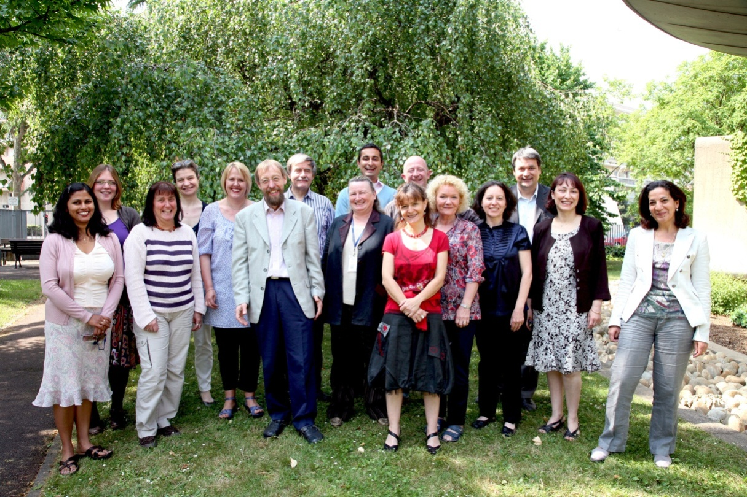

The IARC Monographs team
Merci à toutes et à tous!

