Slide 1
2008/09 New Zealand
Adult Nutrition Survey
Selected findings
Niki Stefanogiannis
19 June 2012

Slide 2
Overview
Background
Methodology
Selected findings
Policy implications

Slide 3
Background
Part of the New Zealand Health Monitor – an integrated programme of household surveys managed by the Ministry of Health
Fourth national population-based nutrition surveys in adults
    Previous surveys – 1977, 1989 and 1997
Planning for survey started in 2005
Notes:
The 1977 and 1989 surveys were not wholly funded by the Ministry.

Slide 4
Key players
Ministry of Health
University of Otago
CBG Health Research Ltd
Plant and Food Research Ltd
External Technical Group
Notes:
Ministry of Health – funders, design, analysis and interpretation, writing of reports’
University of Otago – fieldwork, nutrient matching, analysis and interpretation, report writing
CBG Health Research Ltd – Recruitment
Plant and Food Research Ltd – New Zealand Food Composition Database, recipes
External Technical group - Advice

Slide 5
Survey design
Target population: Usually resident civilian population, 15 years and over, living in permanent private dwellings in New Zealand
Sample design: Multistage, stratified, probability-proportional-to-size; increased sampling of Māori, Pacific, 15-18 years, 71+ years
Recruitment: Participants recruited by CBG Health Research Ltd; information passed onto University of Otago to organise interview; voluntary
Notes:
15-18 years, 71+ years – these age groups were oversampled due to the small numbers in particular ethnic groups – particularly important for the analysis of the 24 hour recall.

Slide 6
Data collection
October 2008 to October 2009
Face-to-face computer-assisted personal interviews
  24 hour dietary recall
  Questionnaire
    Dietary supplements
    Dietary habits
    Health conditions
    Food security
    Sociodemographics
  Height, weight, waist and blood pressure measurements
  Blood and urine collection
Notes:
The 24 hour recall software was updated in 2007/08.
The dietary habits questions replaced the food frequency questionnaire in the 1997 survey and were developed specifically for this nutrition survey.

Slide 7
Information collected from 4721 New Zealanders 15 years and over
The overall response rate was 61% (44% for blood and urine samples)
Notes:
These response rates are considered good for a national nutrition survey and are good compared to international surveys

Slide 8
Selected findings
Notes:
ANS – produced a wealth of information. I am only going to present selected findings focusing on
Energy, fat, protein and carbohydrate intake
Dietary habits
Dietary supplements
Food security
Nutrition-related health outcomes – specifically those relating to obesity, cardiovascular disease and diabetes

Slide 9
There was a decrease in reported energy intake from 1997 to 2008/09 for men but not for women
Decrease for Māori women but not for men
Table: Energy intake (MJ), by sex and ethnic group, 1997 and 2008/09
Sex | 1997 | 2008/09 | Trend
Total males | 12.0 | 10.7 | ↓
Total females | 8.0 | 7.6 | No change
Māori males | 11.8 | 11.1 | No change
Māori females | 8.5 | 7.5 | ↓
Notes:
More discussion on the how to interpret this trend later when I present results on obesity
Total response ethnicity for Māori

Slide 10
% contribution to total energy
 | Sex | 1997 | 2008/09 | Trend
Total fat | Males | 35% | 34% | ↓
 | Females | 35% | 34% | No significant change
Saturated fat | Males | 15% | 13% | ↓
 | Females | 15% | 13% | ↓
Protein | Males | 15% | 16% | ↑
 | Females | 16% | 17% | ↑
Carbohydrate | Males | 45% | 46% | No significant change
 | Females | 47% | 47% | No significant change
Notes:
The contribution of saturated fat to energy intake decreased from 1997 to 2008/09 in both males (15 % to 13%) and females (15% to 13%).
But … still above the recommended 10% contribution of saturated fat to total energy
The contribution of energy from total fat also decreased significantly for males (35% to 34%), but not for women (34%) – the recommended contribution is 20-35%
The contribution of total carbohydrates to energy intake did not significantly change from 1997 to 2008/09
The contribution of protein to energy intake increased from 1997 to 2008/09

Slide 11
Overall, almost half (48%) of New Zealanders used dietary supplements in the last year
Most commonly used supplements were fish / plant oil supplements and multi-vitamins / multi-minerals
Māori and Pacific people were less likely to have had a dietary supplement in the last year compared to non-Māori and non-Pacific respectively

Slide 12
Eating patterns associated with good health outcomes
 | Males | Females
Breakfast eaten daily | 65% | 69%
3 or more servings of vegetables a day | 59% | 72%
2 or more servings of fruit a day | 55% | 66%
Wholegrain bread chosen most of the time | 60% | 66%
Reduce fat or trim milk chosen most of the time | 45% | 52%
Excess fat trimmed of meat regularly/always | 57% | 67%
Skin removed from chicken regularly/always | 42% | 53%
Margarine used as a spread most of the time | 68% | 68%
Salt added to food – never or rarely | 43% | 52%
Use of iodised salt | 86% | 86%
Notes:
We only had time trends for vegetable and fruit intake – while there was no change in the proportion of adults consuming the recommended vegetable intake from 1997 to 2008/09, there was an increase in the proportion of both men and women who consumed 2 or more servings of fruit a day
Differences by ethnic groups;
Maori and Pacific people were more less likely than non-Maori and non-Pacfic to:
Eat breakfast daily
Choose reduced fat or trim milk
Remove skin of chicken
Trim fat off meat and
To rarely or never add salt to food

Slide 13
Less healthy eating patterns …
 | Males | Females
Eating hot chips 3 or more times a week | 11% | 4%
Eating fast food 3 or more times a week | 8% | 4%
Drinking soft drinks or energy drinks 3 or more times a week | 31% | 17%
Notes:
Maori and Pacific people were more likely than non-Maori and non-Pacific people to have these eating patterns

Slide 14
Overall, approximately 7% of households were classified as having low food security
However … this is a marked increase from 1997 (2 % to 6% for males and 4% to 9% for females)
Also, low food security is an issue for Māori and Pacific – 16 % Māori and 22% Pacific live in households with low food security
Notes:
The survey also asked a range of questions looking at food security. Food security is an internationally recognised term that encompasses the ready availability of nutritionally adequate and safe foods, and the assured ability to acquire personally acceptable foods in a socially acceptable way.

Slide 15
Body size continues to track upwards
Mean BMI (kg/m²) increased in all groups:
 | 1997 | 2008/09
Total males | 26.2 | 27.6
Total females | 26.1 | 27.6
By ethnic group
Māori males | 29.0 | 31.0
Pacific people | 31.9 | 32.5

Slide 16
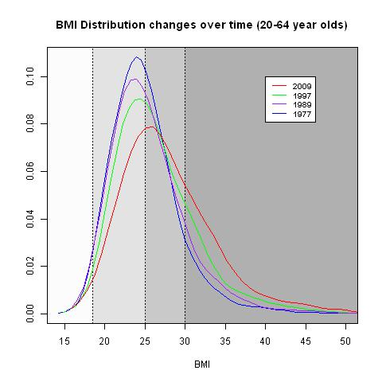
Notes:
Universal shift and increased skewness

Slide 17
The prevalence of obesity increased from 1997 to 2008/09 …
… from 17.0% to 27.7% for males and from 20.6% to 27.8% for females
The prevalence also increased for Pacific people – 54.5% to 58.1%
No significant change for Māori –
41– 46%
Notes:
The 2002/03 and 2006/07 New Zealand Health Surveys have also shown that the prevalence of obesity has increased significantly since 1997.
This result is interesting in relation to the result I presented earlier in relation to the decrease energy intake found. You would expect a decrease in energy intake would be associated in a decrease in obesity.
What we say is that the finding surrounding energy intake needs to be interpreted with caution as energy intake tends to be under-reported by survey respondents and the degree of under-reporting increases as the prevalence of obesity increases – this has been found by other surveys internationally. The increase in prevalence of obesity in the intervening period suggests that the energy ‘equation’ is unbalanced, with energy ‘in’ exceeding energy ‘out’. The Survey did not assess energy expenditure, so further research is needed to explore the underlying reasons for this apparent decrease in energy intake from 1997 to 2008/09.

Slide 18
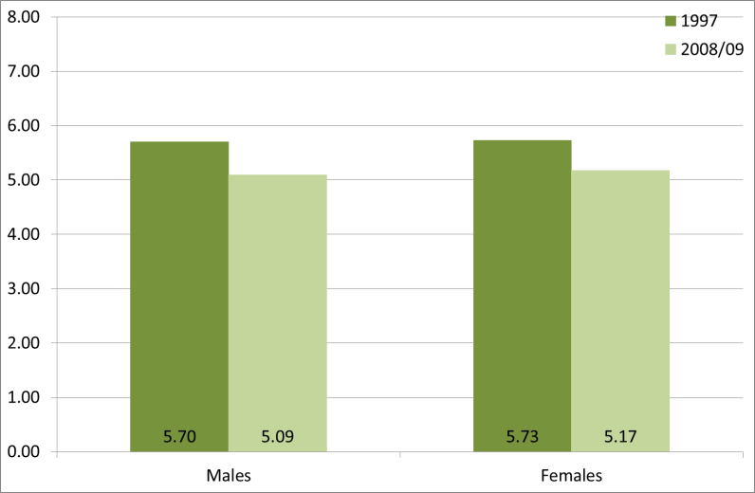
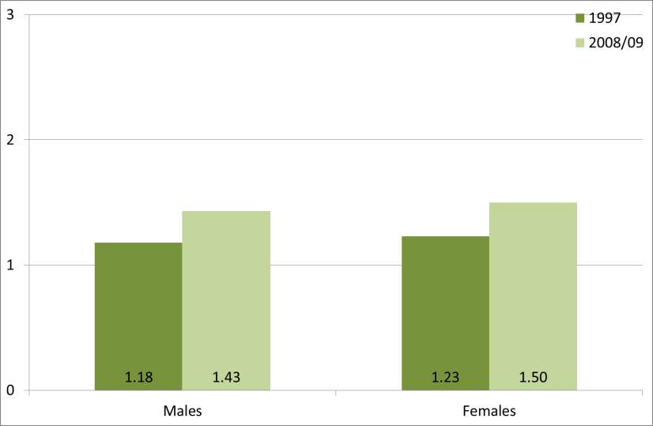
On a more positive note…
Total cholesterol (mmol/L)
Mean total blood cholesterol decreased from 1997 to 2008/09
HDL cholesterol (mmol/L)
And… mean HDL cholesterol increased
However, total cholesterol levels are still higher than optimal (3.8 – 4.0)
Notes:
Approximately 10% decline in total cholesterol
What has caused this decrease in total choleterol? Probably a combination of dietary factors such as the decrease in saturated fat intake as well as the increased prescribing of lipid – lowering drugs.

Slide 19
The total cholesterol : HDL cholesterol ratio is a strong predictor of vascular disease mortality – the ideal ratio is < 4.5
Proportion of the population with Total cholesterol : HDL ratio ≥ 4.5
 | Sex | 1997 | 2008/09 | Trend
Total | Males | 58% | 36% | ↓ (40 % decrease)
 | Females | 33% | 16% | ↓ (50 % decrease)
Māori | Males | 74% | 38% | ↓ (50 % decrease)
 | Females | 50% | 17% | ↓ (65% decrease)
Pacific | Males | 78% | 41% | ↓ (50 % decrease)
 | Females | 40% | 24% | ↓(40 % decrease)

Slide 20
For the first time in a NZ population survey HbA1c (a biomarker for diabetes) was measured in blood samples
HbA1c levels can be used to diagnose diabetes and to give an indication of blood glucose management among those who have been diagnosed with diabetes

Slide 21
Overall – 7% of New Zealanders aged 15 years and over have diabetes
One-quarter had not been told by a doctor that they had diabetes and had HbA1c levels ≥6.5%, which is indicative of undiagnosed diabetes
There are differences in undiagnosed diabetes by ethnic group:
  20-25 % of Māori have undiagnosed diabetes
  Approximately half of Pacific people

Slide 22
Just under one-half (49%) of New Zealanders with known diabetes had good diabetes control (HbA1c levels <7.0%).
Māori men (26%) with diagnosed diabetes were less likely to have good control compared to non-Māori men

Slide 23
Survey identified areas where progress had been made
Decrease in saturated fat intake and cholesterol levels
Increase in the proportion of people eating the recommended intake of fruit

Slide 24
However, the survey has also identified areas where more work needs to be done:
Curtailing the increase in BMI and obesity
Improving the diagnosis of diabetes – particularly for Māori and Pacific people
Improving the management of diabetes among those diagnosed – particularly for Māori

Slide 25
Other uses of the survey data
Development of Food and Nutrition Guidelines
Reviewing nutrient reference values
Providing data for international reports and studies
Monitoring folic acid and iodine fortification
New Zealand Burden of Disease study
Researchers
Notes:
Development of Food and Nutrition Guidelines
Reviewing nutrient reference values
Providing data for international reports and studies
Monitoring folic acid and iodine fortification – eg FSANZ is using the data for food standards development, MPI – dietary modelling, and risk assessment
New Zealand Burden of Disease study
Researchers – Otago is carrying out a further 25 + projects

Slide 26
More information
Survey publications can be found on the Ministry of Health website (http://www.health.govt.nz/nz-health-statistics/national-collections-and- surveys/surveys/current-recent-surveys/nutrition-survey):
          A Focus on Nutrition: Portrait of Health. Key findings of the 2008/09 New Zealand Adult Nutrition Survey
          A Focus on Pacific Nutrition: Findings of the 2008/09 New Zealand Adult Nutrition Survey
          A Focus on Māori Nutrition: Findings of the 2008/09 New Zealand Adult Nutrition Survey
          Vitamin D Status of New Zealand Adults: Findings from the 2008/09 New Zealand Adult Nutrition Survey
Methodology report also on the website
Confidentialised Unit Record Files (CURF) available to researchers through Statistics New Zealand
Online data tables of results planned for the website

Slide 27
Update on New Zealand Health Survey
Approximately 5000 children (0-14 years) and 14000 adults (15+ years)
Face-to-face and computer assisted questionnaire comprised of
  a set of core questions and
  a flexible programme of rotating thematic/topic modules
Includes height, weight and waist measurements
1 hour for adults, 30 minutes for children

Slide 28
Update on New Zealand Health Survey
On 1 July will have been in the field for 1 year
Good response rate – approximately 80%
Blood pressure measurements introduced from 1 July 2012
First lot of results will be released at end of year
Notes:
Year 1 module – Health Service Utilisation
Year 2 – Alcohol, drug and tobacco use for adults; Developmental Wellbeing and Health; Food Security; Second-hand Smoke Exposure for children

